Slide 2
Revision
In the forest
At the aquarium

Slide 3
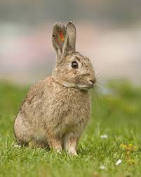
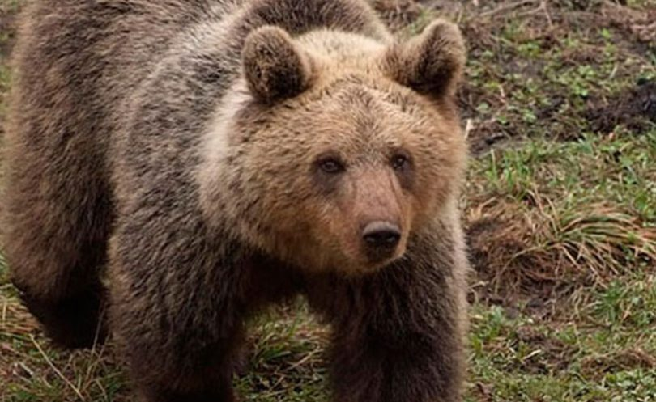
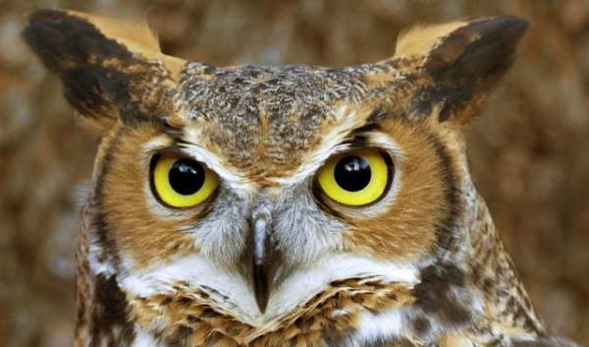
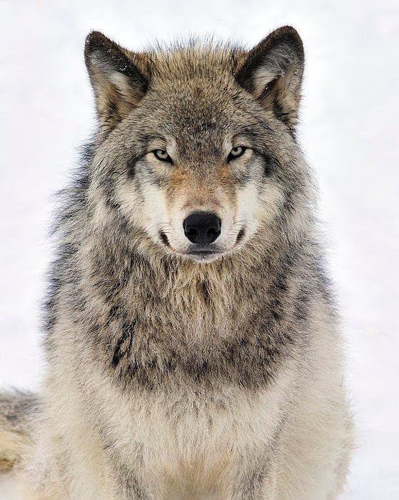
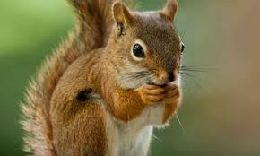
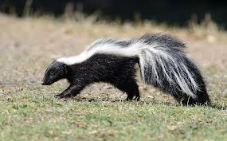
Animals in the forest

Slide 4
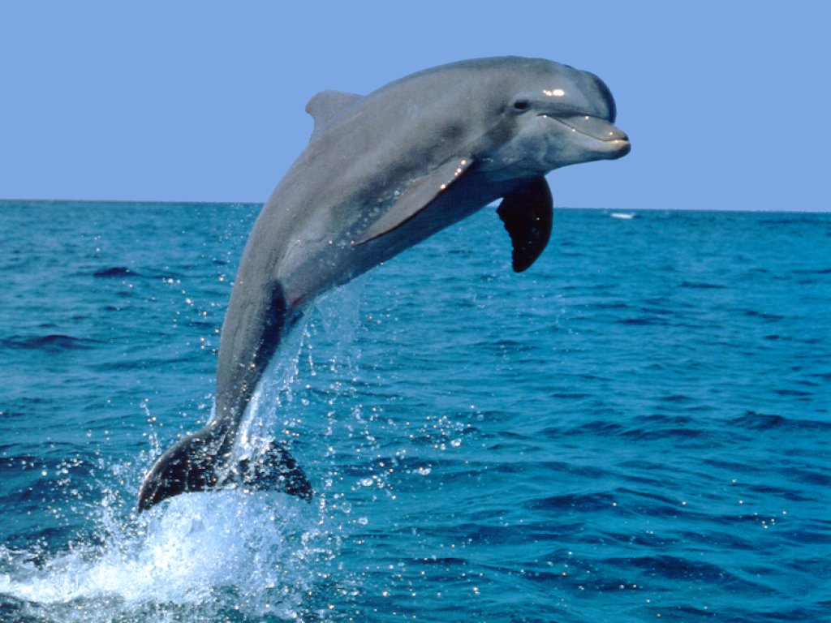
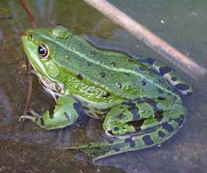
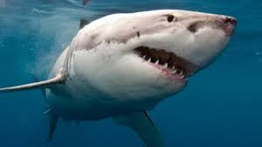
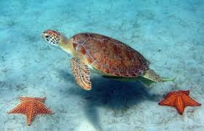
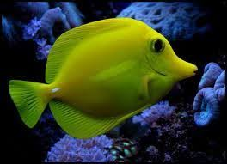
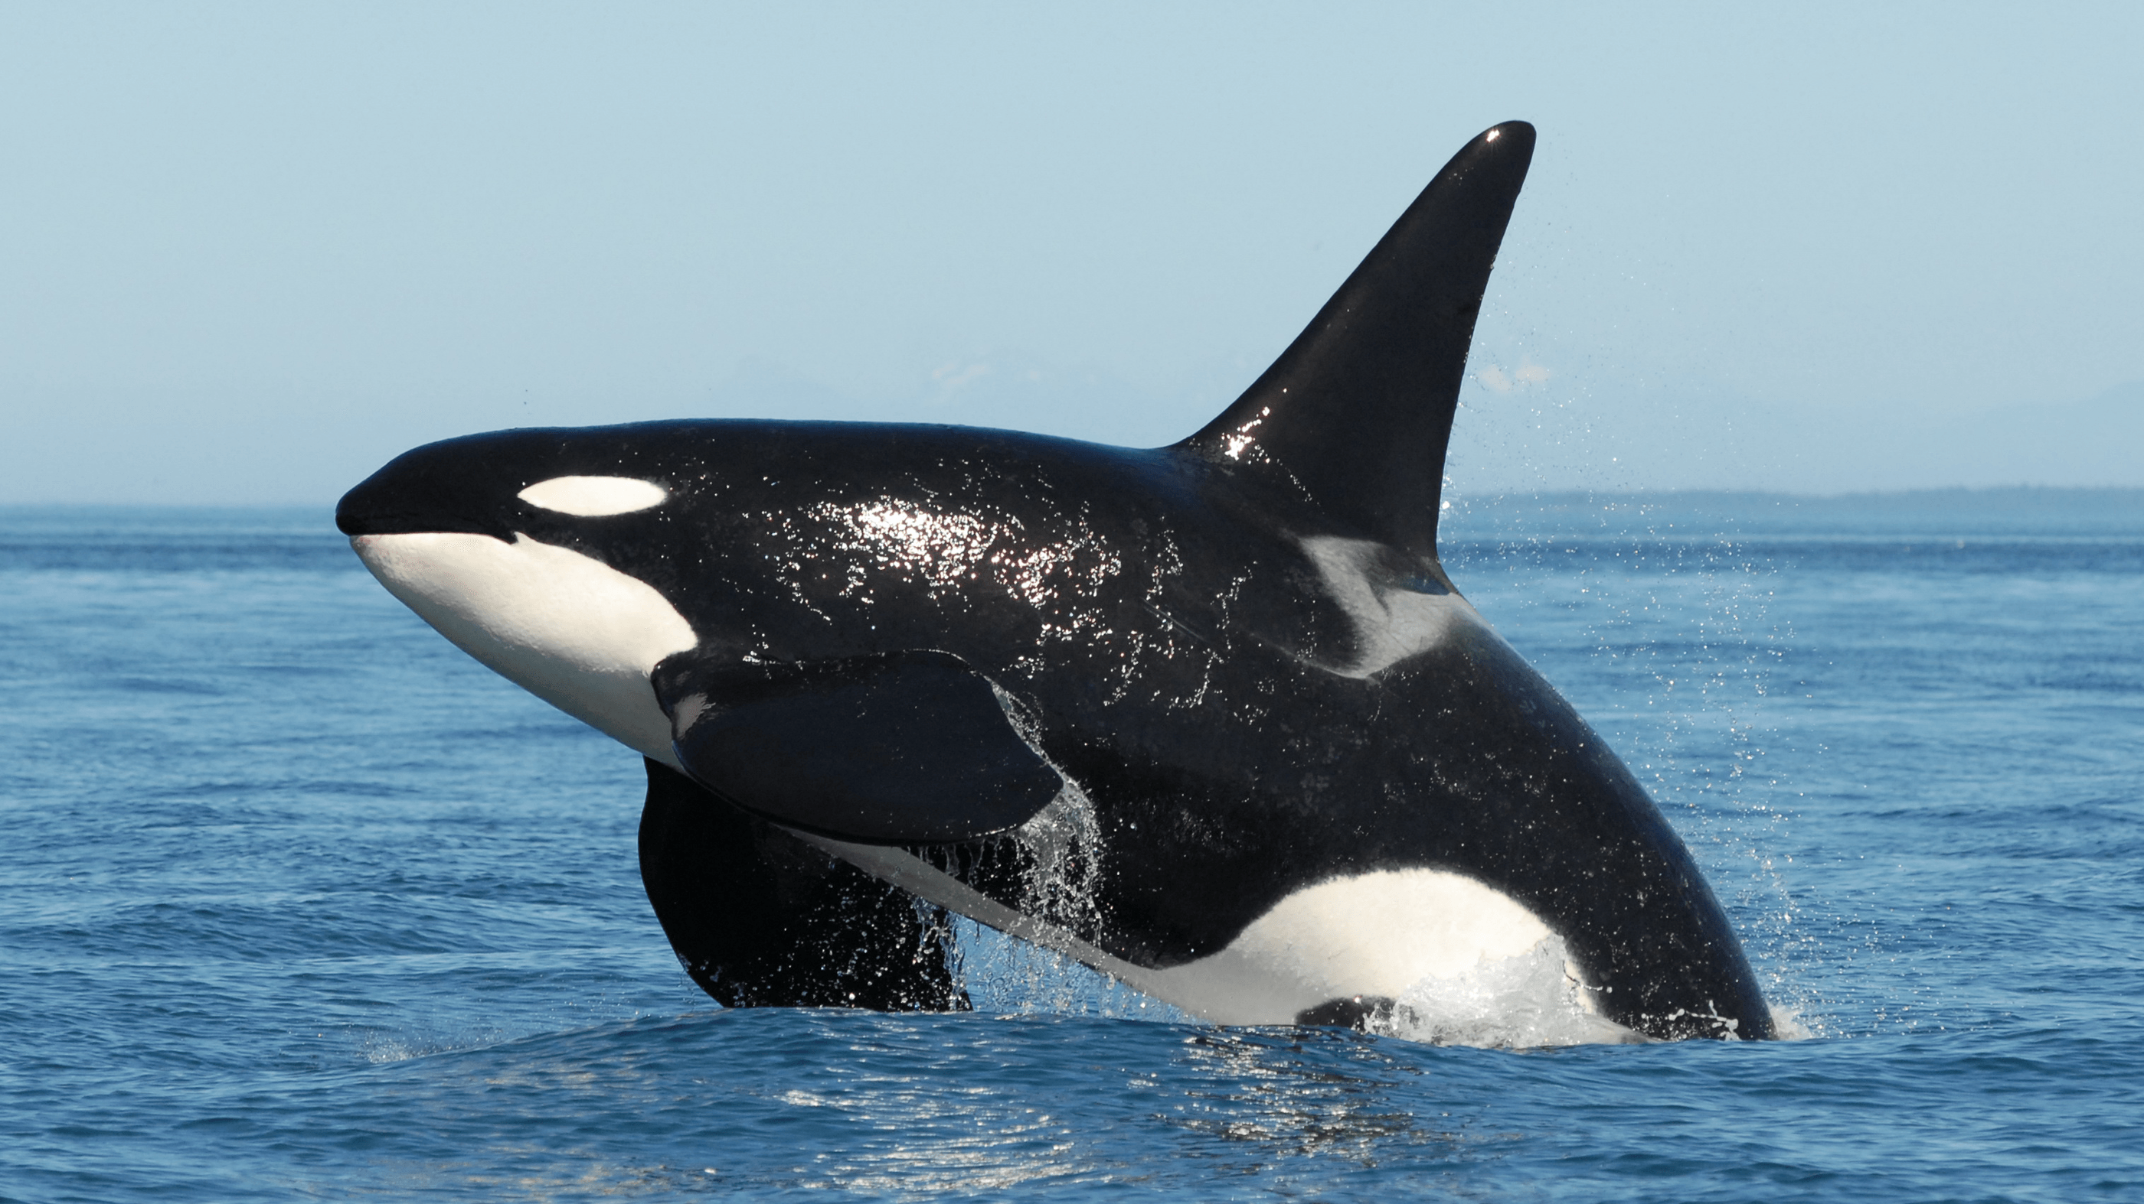
Animals at the aquarium

Slide 5
Exercise 1 Put the names of animals into the correct group: foxes, turtle, owl, rabbit, frogs, skunk, fish, dolphins, shark, squirrel
Forest
Aquarium
foxes
owl
rabbit
skunk
squirrel
turtle
frogs
fish
dolphins
shark

Slide 6
Exercise 2
Questions
Answers
Where do foxes live?
Which animals eat sheep and chicken?
Where do bears live?
Are the animals at the aquarium in cages?
Can children feed the animals at the aquarium?
In the forest.
Wolves.
In a cave.
No, they aren’t. They are in big tanks.
No, they can’t.

Slide 7
Remember the plural of nouns
a frog
a wolf
a dolphin
a man
a fox
an owl
a child
a bear
a squirrel
a fish
a woman
frogs
wolves
dolphins
men
foxes
owls
children
bears
squirrels
fish
women

Slide 8
Homework
Workbook, page 46
1. /
2. Match the sentence parts
3. Fill in the missing words
4. /

Slide 9
Stay home and stay well!

