Slide 1
UNIT 3
SCHOOL LIFE

Slide 2
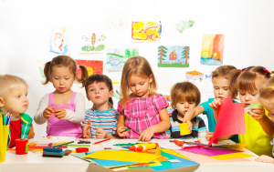
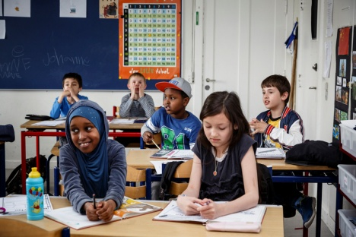
SCHOOLS in the USA
Preschool
(3-6 years)
Elementary school
(6-12 years)
Junior high school
(13-15 years)

Slide 4
VOCABULARY
students – ученици
grade - разред
count – броји
such as – као
principal – директор школе
secretary – секретарица
janitors – помоћно особље (чистачица, домар, ложач)
recess - одмор

Slide 5
SB pg. 30/31 ex. 1 and 3
1. Find the words from the text among these jumbled letters:
3. Find in the text and write:
ooprelchs – preschool
roinuj –
aprilpinc –
torijan –
ssrcee –
Age School
3-6 preschool
6-12
13-15

Slide 6
NUMBERS
100 – one hundred or a hundred
270 – two hundred seventy
110 –
543 –
987 –
909 –
411 –
642 –
1000 – one thousand

Slide 7
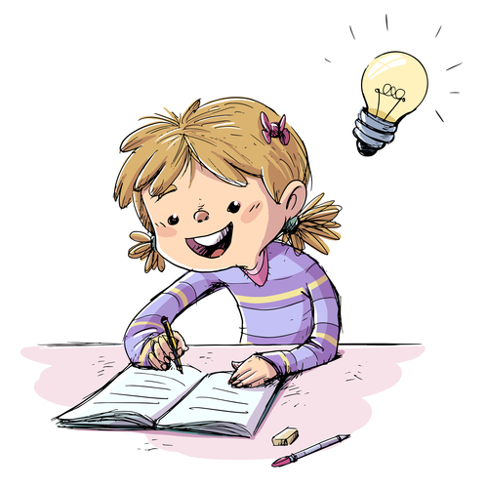
HOMEWORK
Read the text “ A thousand students” carefully
Write the new vocabulary (slide 4) and the numbers (slide 6) in your notebook
WB pg. 20 ex. 1 and 3

