Slide 1
A world of fun 6.1 the world of tomorrow

Slide 2
Student's book
(page 66)

Slide 3
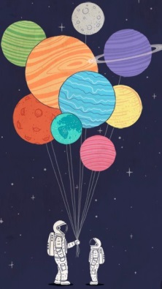
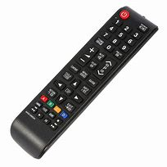
KEY VOCABULARY
space - the area outside the earth’s atmosphere where all the other planets and stars are
invention - something new
disease - illness, when you are ill/sick
future - the time that will come after the present or the events that will happen then
remote control - a device that allows you to operate a television, etc. from a distance
channel - a television station
develop -become better

Slide 4
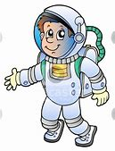
Exercise 1,SB, page 66
Find the words from the text among these jumbled letters and fill in the blanks:
1 Lisa often helps her mother and does the _ _ _ _ _ _ _ _ _ (ohwsroeku).
2 Astronauts travel to _ _ _ _ _ (csape).
3 This machine is an important _ _ _ _ _ _ _ _ _ (nintenovi).
4 A good doctor can cure this _ _ _ _ _ _ _ (sdeisea).
5 Cars will fly in the _ _ _ _ _ _ (ufrute).

Slide 5
ANSWERS:
1 Lisa often helps her mother and does the housework.
2 Astronauts travel to space.
3 This machine is an important invention.
4 A good doctor can cure this disease.
5 Cars will fly in the future.

Slide 6
2 Choose the correct word:
1 We use remote/leisure control to change channels on TV.
2 The night is beautiful. I can see the month/Moon from the window.
3 I will help my mother with the homework/ housework.
4 Let us discuss/disease your ideas.
5 The mobile phone is an important inventor/invention.

Slide 7
ANSWERS:
1 We use remote control to change channels on TV.
2 The night is beautiful. I can see the Moon from the window.
3 I will help my mother with the housework.
4 Let us discuss your ideas.
5 The mobile phone is an important invention.

Slide 8
FUTURE SIMPLE TENSE (PROSTO BUDUĆE VRIJEME)
POSITIVE FORM
FULL NEGATIVE FORM
WILL + INFINITIVE
WILL NOT + INFINITIVE
I will watch TV tomorrow. He will buy a pet next week. We will go to London next summer.
I will not watch TV tomorrow. He will not buy a pet next week. We will not go to London next summer.
Time expressions: Tomorrow, next week, next summer,…
*Short negative form: WON’T

Slide 9
SB, page 66 A) Look at the examples. Then complete the sentences
with the verbs in the brackets.
1 The future __________ many new inventions. (bring)
2 Cars ______________ in the future. (fly)
3 In a few years, people______________ to space. (travel)
4 I ________________ basketball tomorrow. (play)
5 One day, robots___________ all the housework. (do)
6 In the next century, people _____________ longer. (live)
7 I ______________ this book next week. (read)
8 My brother ______________ his birthday
9 I _________________ a poem tomorrow. (write)
10 My parents _______________me to the movie theater next Saturday. (take)

Slide 10
ANSWERS:
1 The future will bring many new inventions. (bring)
2 Cars will fly in the future. (fly)
3 In a few years, people will travel to space. (travel)
4 I will play basketball tomorrow. (play)
5 One day, robots will do all the housework. (do)
6 In the next century, people will live longer. (live)
7 I will read this book next week. (read)
8 My brother will celebrate his birthday in two weeks. (celebrate)
9 I will write a poem tomorrow. (write)
10 My parents will take me to the movie theater next Saturday. (take)

Slide 11
HOMEWORK
SB, PAGE 67, EXERCISE B
(Look at the examples. Then write the negative forms of the underlined verbs).
WB, PAGE 44, EXERCISE 2
( Look at the examples. Then follow the same pattern).

