Slide 1
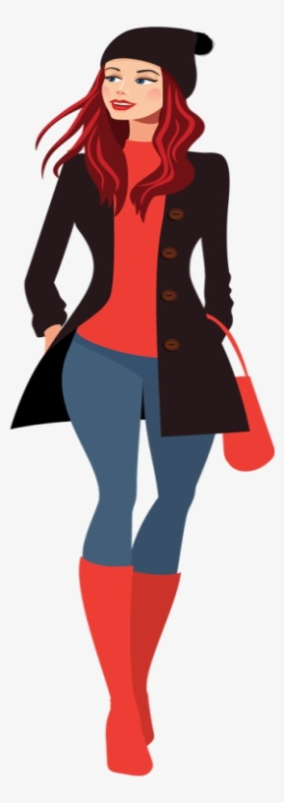
Indirect speech
You meet your friend Jane
You are telling your friend about it
My parents are very well
I am going to learn to drive.
I can‘t come to the party on Friday.
Her parents are very well.
She is going to learn to drive.
She can‘t come to the party on Friday.

Slide 2
Indirect Speech – statements, commands and requests; p68
My mom says: ”you are a very determined girl. “
My mom says (that) I am a very determined girl.
My brother says: ”Messi is the best.“
My brother says (that) Messi is the best.

Slide 3
Indirect Speech – statements; page 68
1 Look at the examples. Then do the following:
1 The teacher: “Milica is very good at English.”
__________________________________________
2 The journalist: “Caroline and her colleagues are working on a project.”
__________________________________________
3 Their aunt: “The children weren’t playing in the garden all the afternoon.”
__________________________________________
4 Milica: “I would like to travel to England.”
___________________________________________
5 Marko: “I must finish my homework now.”
___________________________________________

Slide 4
Indirect Speech – statements p68
1 Look at the example. Then do the following:
1 The teacher: “Milica is very good at English.”
The teacher says (that) Milica is very good at English._
2 The journalist: “Caroline and her colleagues are working on a project.”
The journalist says (that) Caroline and her colleagues are working on a project.
3 Their aunt: “The children weren’t playing in the garden all the afternoon.”
Their aunt says (that) the children weren’t playing in the garden all the afternoon.
4 Milica: “I would like to travel to England.”
Milica says that she would like to travel to England.
5 Marko: “I must finish my homework now.”
Marko says (that) he must finish his homework now.

Slide 5
Indirect Speech, commands - p68
2 Look at the examples. Then do the following:
Our chief: ”Observe this sea animal. “
Our chief tells us to observe this sea animal.
My mom: “Study hard.”
__________________________________
The teacher: “Students, read this book until Tuesday.”
__________________________________
A father: “Son, don’t drink cold water.”
__________________________________
The teacher: “Student, be hard-working and determined in life.”
__________________________________
My best friend: “Don’t sit too much in front of the computer.”
__________________________________

Slide 6
Indirect Speech, commands - p68
2 Look at the examples. Then do the following:
Our chief: ”Observe this sea animal. “
Our chief tells us to observe this sea animal.
1 My mom: “Study hard.”
My mom tells me to study hard.
2 The teacher: “Students, read this book until Tuesday.”
The teacher tells students to read this book until Tuesday.
3 A father: “Son, don’t drink cold water.”
A father tells his son not to drink cold water.
4 The teacher: “Student, be hard-working and determined in life.”
The teacher tells her student to be hard-working and determined in life.
5 My best friend: “Don’t sit too much in front of the computer.”
My best friend tells me not to sit too much in front of the computer.

Slide 7
Indirect Speech, requests - p68
2 Look at the examples. Then do the following:
A mom: ” Go to sleep, please. “
A mom asks her child to go to sleep.
1. An aunt: “Nephews, be careful when you cross the street, please.”
______________________________________________________
2. My grandmother: “Put on your jacket, please.”
______________________________________________________
3. Our uncle: “Don’t ride a bike when it is cold outside, please.”
______________________________________________________
4. My sister: “Lend me your skirt, please.”
______________________________________________________
5. A father: “Children, don’t eat all the sweets, please.”
______________________________________________________

Slide 8
Indirect Speech, requests - p68
2 Look at the examples. Then do the following:
A mom: ” Go to sleep, please. “
A mom asks her child to go to sleep.
homework:
Activity book pages 56 and 57;
Exercise: 4
optional: 5 and 6
1. An aunt: “Nephews, be careful when you cross the street, please.”
An aunt asks her nephews to be careful when they cross the street.
2. My grandmother: “Put on your jacket, please.”
My grandmother asks me to put on my jacket.
3. Our uncle: “Don’t ride a bike when it is cold outside, please.”
Our uncle asks us not to ride a bike when it is cold outside.
4. My sister: “Lend me your skirt, please.”
My sister asks me to lend her my skirt.
5. A father: “Children, don’t eat all the sweets, please.”
A father asks children not to eat all the sweets.

