Slide 1
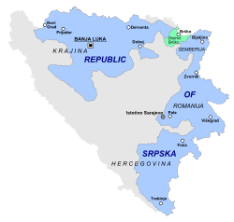
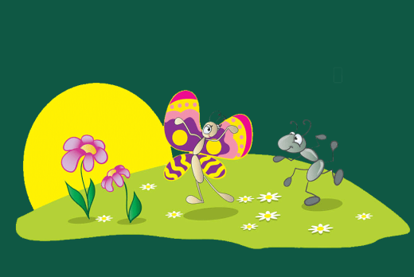
VOCABULARY
UNJUMBLE THE LETTERS TO FIND WORDS
itnaolna kapr
epka
ietnty
oewadm
ucyentr
________________
________________
________________
________________
________________
national park
peak
entity
meadow
century

Slide 2
EXAMPLES
My family is going to visit the Sutjeska national park next week.
Maglić is the highest peak in this area.
The Republic of Srpska is an entity in Bosnia and Herzegovina.
Look at all the sheep on that meadow!
He was a famous painter in the 19th century.

Slide 3
NUMBERS
WRITE THE NUMBERS
first
1st | _______________
2nd | _______________
3rd | _______________
4th | _______________
5th | _______________
9th | _______________
12th | _______________
I will visit Paris for the first time.
Is she the second person you met?
He was the third person to finish the race.
That is the fourth blue shirt you bought!
This is the fifth time I am watching this movie.
My birthday is on the ninth of this month.
This building is from the twelfth century.
second
third
fourth
fifth
ninth
twelfth

Slide 4
ADJECTIVES
COMPLETE THE TABLE
smart
boring
interesting
bad
funny
smarter | the smartest
more boring | the most boring
more interesting | the most interesting
worse | the worst
funnier | the funniest
She is ____________ person in her class.
This film is ____________ than the last one.
That is __________________ book in the store.
The weather is much ____________ than yesterday.
He is ____________ person I know.
the smartest
more boring
the most interesting
worse
the funniest

Slide 5
IRREGULAR PLURAL
COMPLETE THE TABLE
COMPLETE THE SENTENCES
I didn’t see the __________ on the wall.
That forest is full of __________.
It’s fall, so the __________ are turning yellow.
You have to brush your __________ every morning and evening.
Is there a __________ in the hallway?
Lots of __________ love to play with toys in their free time.
bug
wolf
leaf
tooth
man
child
bug
bugs
wolves
leaves
teeth
men
children
wolves
leaves
teeth
man
children

Slide 6
PREPOSITIONS
COMPLETE THE SENTENCES WITH WORDS FROM THE BOX
from
in
from
on
in
from
Athens is very far __________ Japan.
Dogs and cats walk __________ four legs.
This is one of the most beautiful parks __________ the world.
British English is different __________ American English.
Monkeys are animals that live __________ trees.
This book is not much different __________ his other books.

Slide 7
FIRST CONDITIONAL
CONNECT THE SENTENCES
If you are thirsty,
If you go to Jane’s birthday party tomorrow,
Take an umbrella with you
If you want to be healthy,
Take a taxi or hurry up
eat a lot of fruit and vegetables.
drink some orange juice.
if you don’t want to be late.
buy her a present today.
if the weather is bad.

Slide 8
THAT’S ALL FOR TODAY!

