Slide 1
The Present Simple Tense

Slide 2
Positive and Negative
I
YOU like cheese
WE don ‘ t like cheese
THEY
HE
SHE likes cheese
IT doesn ‘ t like cheese

Slide 3
PLEASE REMEMBER
Verbs ending in ch,s,sh,o,x,
add –es
I watch – he watches
We guess- he guesses
They finish- she finishes
You go- it goes
Verbs ending in a consonant+y(b,c,d,f,g…)
Change Y to -IES
I study- HE studies
We carry- SHE carries
I cry- IT cries

Slide 4
Questions and Short Answers
I
YOU
DO WE like cheese?
THEY
Yes, I/YOU/WE do.
No, I/YOU/WE/THEY don’t.
HE
Does SHE like cheese?
IT
Yes,HE/SHE/IT does.
No,HE/SHE/IT doesn’t.

Slide 5
P r e s e n t S i m p l e U s a g e

Slide 6
1.
TO DESCRIBE PRESENT TRUTHS
I have brown hair.
Milica works in a supermarket.
Andy is a fireman.

Slide 7
2.
REPEATED ACTIONS AND HABITS
My girlfriend and I go shopping every Saturday.
James reads newspaper every morning.

Slide 8
3.
SOMETHING THAT IS ALWAYS TRUE
Cows give milk.
Sharks are dangerous.
The Sun sets in the west.

Slide 9
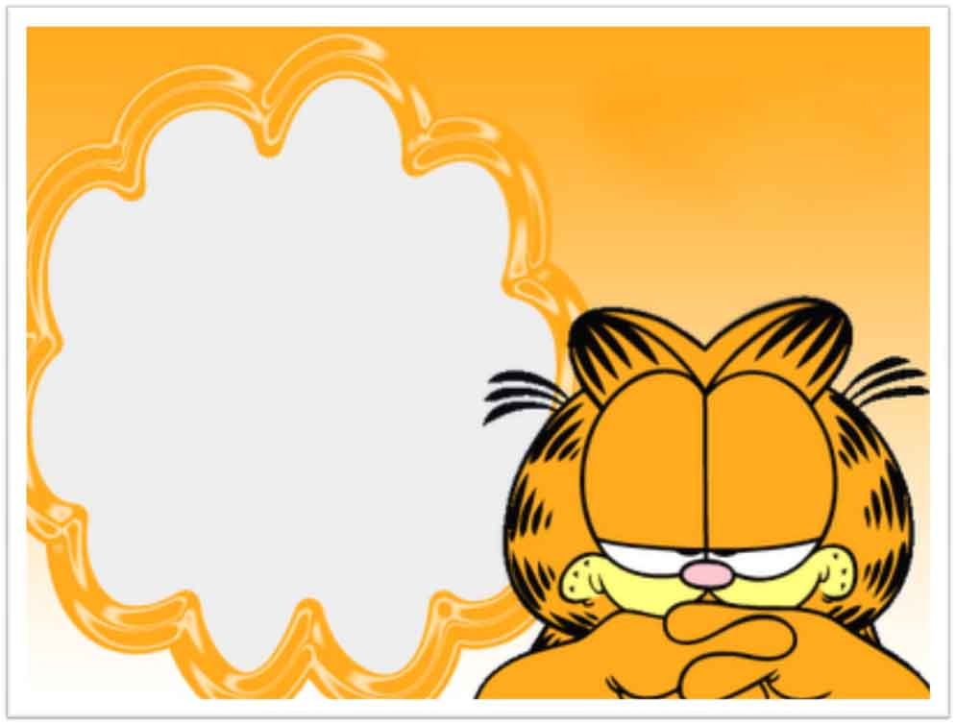
GARFIELD'S
DAILY ROUTINE

Slide 10
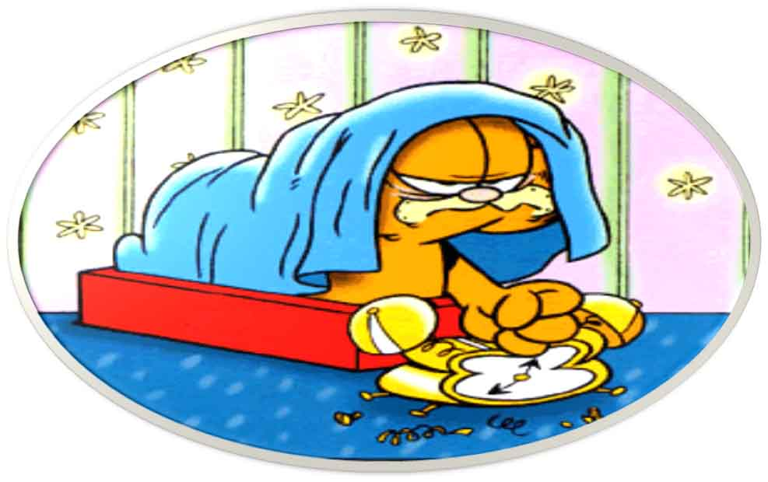
Everyday Garfield wakes up at
ten o´clock

Slide 11
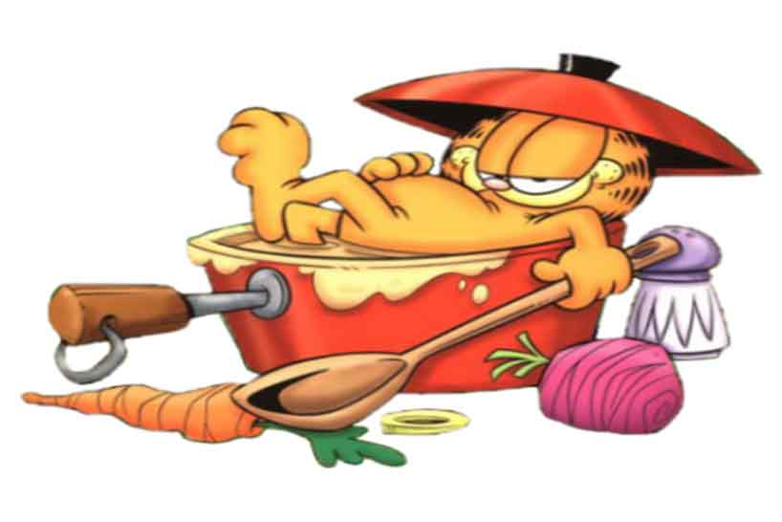
Garfield takes a shower

Slide 12
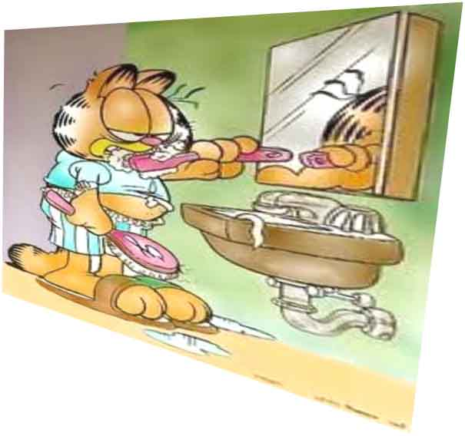
Garfield brushes his teeth

Slide 13
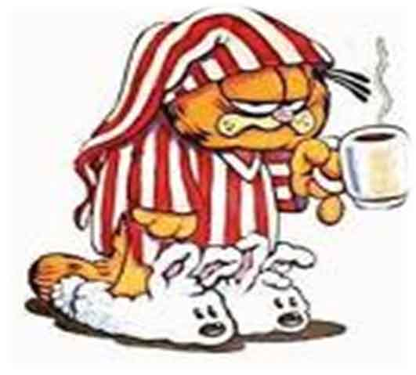
Garfield has breakfast

Slide 14
He goes to school

Slide 15
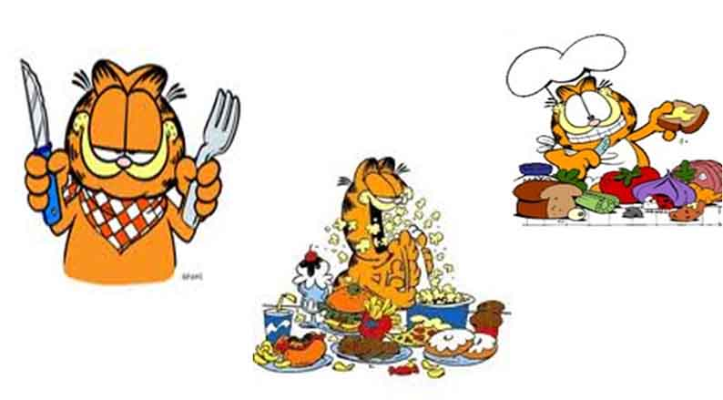
Garfield has lunch at 1.10 pm

Slide 16
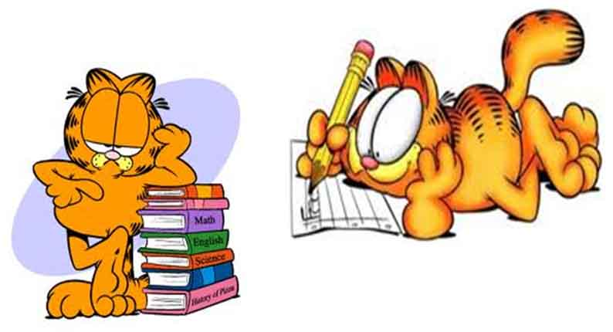
After he does his homework

Slide 17
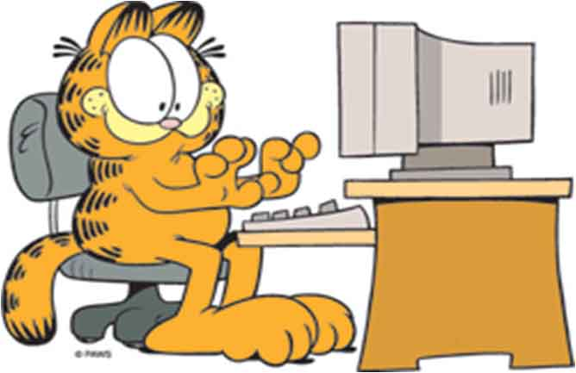
He plays computer games

Slide 18
Garfield has dinner with Odie

Slide 19
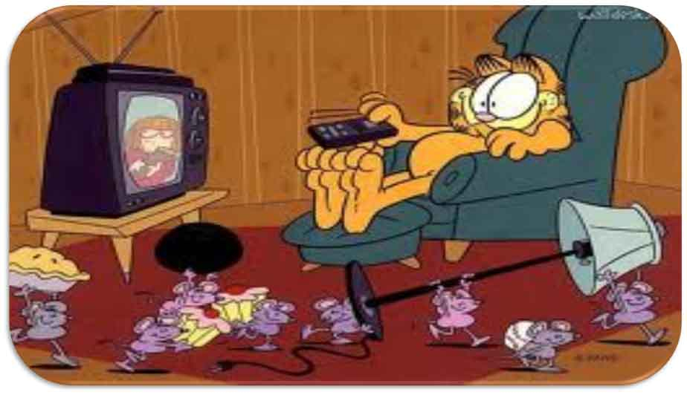
Garfield watches Television

Slide 20
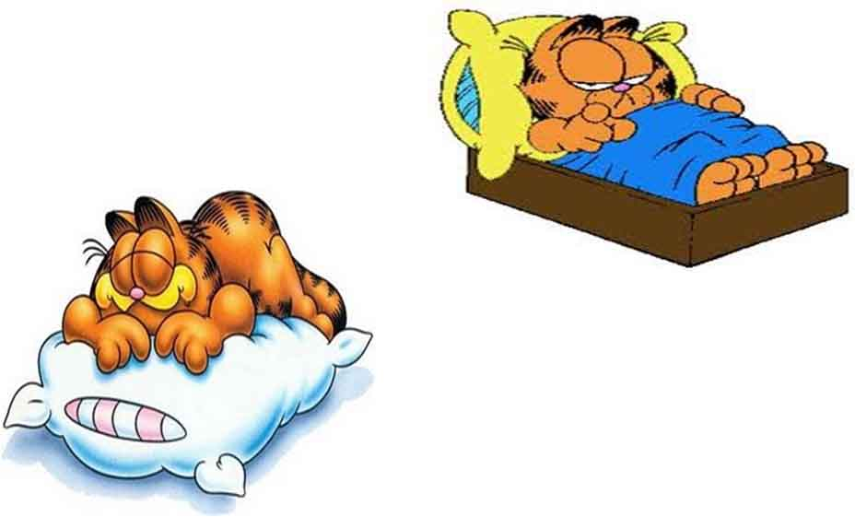
Finally he goes to bed

Slide 21
HOMEWORK: WRITE ABOUT YOUR DAILY ROUTINE (use these verbs)
Get up
Have breakfast
Go to school
Do homework
Have lunch
Hang out with friends
Have dinner
Watch TV
Go to bed

