Slide 1
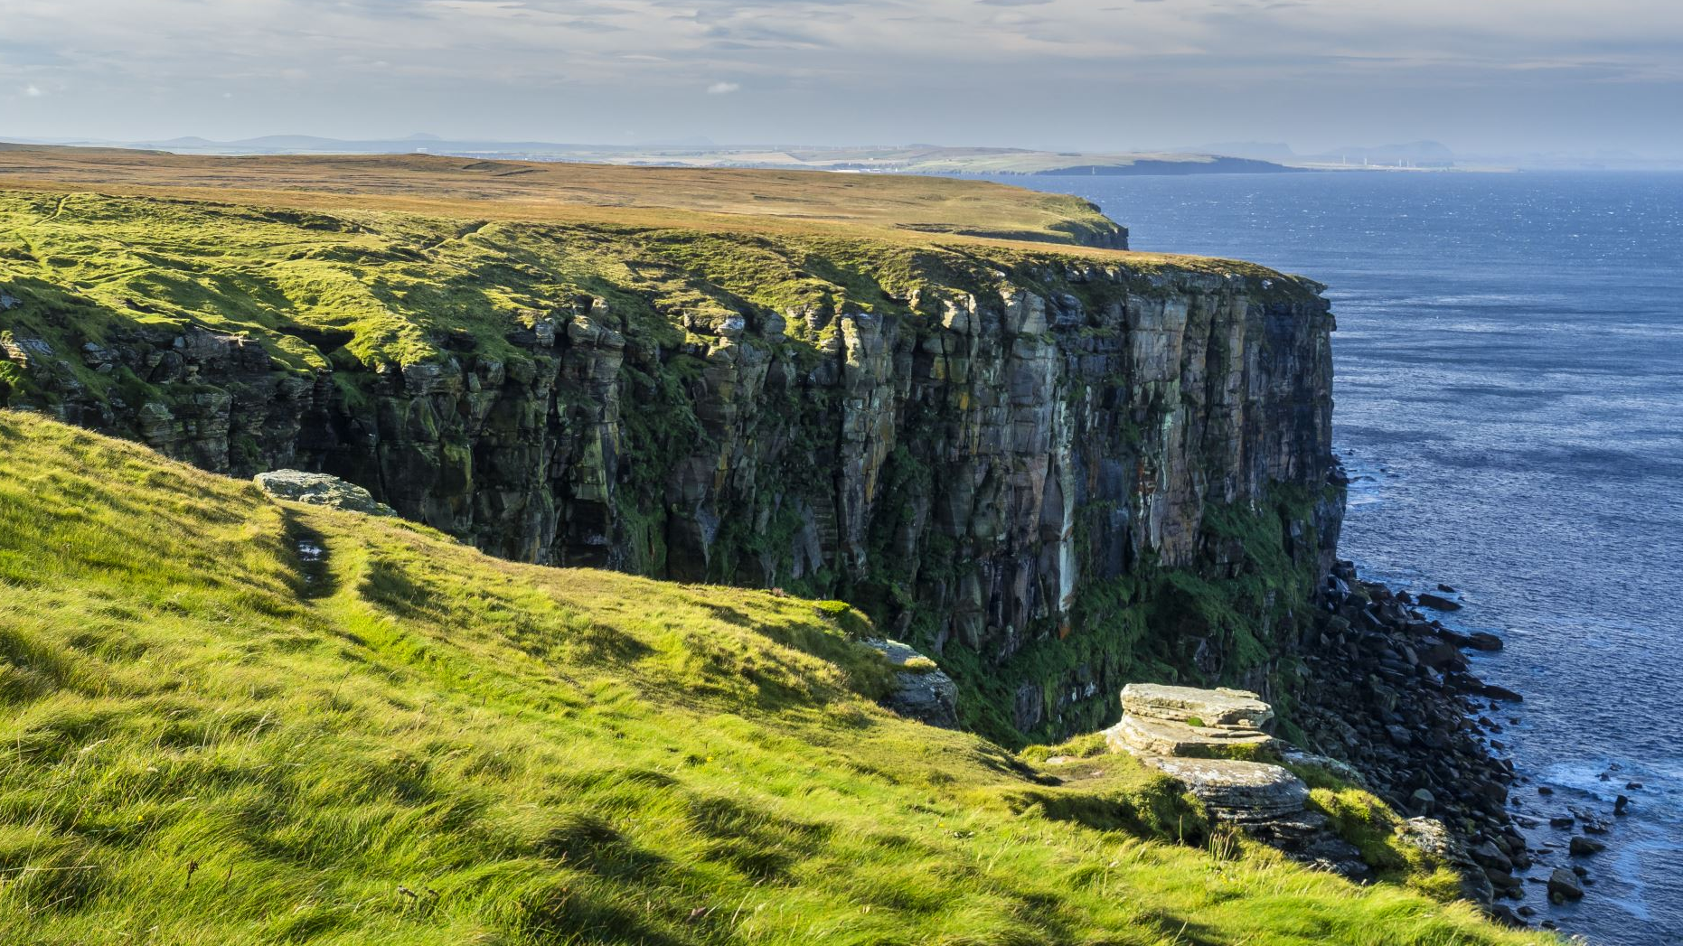
GRADE 8 ADJECTIVES AND ADVERBS
STUDENT’S BOOK pg. 50

Slide 2
ADJECTIVES
We use adjectives to describe nouns and pronouns and they can come before these types of words in a sentence.
01
Examples:
02
He is a serious man.
She is a careful driver.
They always look angry.

Slide 3
adverbs
Adverbs are used to describe verbs, adjectives or other adverbs.They are often (but not always) formed by adding the suffix –ly to the adjective.
Examples:
He always speaks seriously. (How does he speak? Seriously.)
She drives carefully. (How does she drive? Carefully.)
They said that angrily. (How did they say that? Angrily.)

Slide 4
Fill in the table
Adjectives | Adverbs
careful
glad
beautiful
serious
real
angry
happy
carefully
gladly
beautifully
seriously
really
angrily
happily

Slide 5
SPELLING RULES
If a word ends in –l,the –l doubles when we add the suffix –ly.
* careful - carefully
If a word ends in –y and before –y is a consonant, the –y changes into –i and we add the suffix.
* angry - angrily

Slide 6
Complete the sentences with an adjective or adverb
There is ice on the road. Please drive ______________. (slow)
Hey, it’s not a joke. I’m very _____________ about this. (serious)
They all laughed _____________ and started to sing. (happy)
I’m sorry. I ___________ didn’t mean to hurt you. ( real)
This girl sings so _______________. Just listen to her. ( beautiful )
slowly
serious
happily
really
beautifully

Slide 7
HOMEWORK
WORKBOOK pg. 40 exercises 2 and 3
2. Match the words that mean the same
3. Use the words from the left side of exercise 2 and complete the text

