Slide 1
ENGLISH IS FUN 4

Slide 2
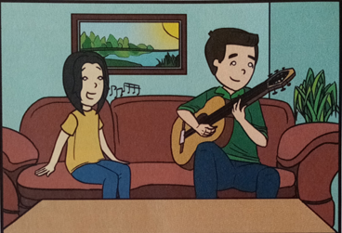

Slide 3
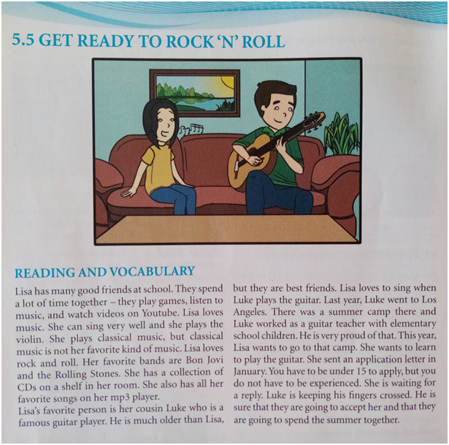
Student’s book, page 62.

Slide 4
New vocabulary :
application letter – a letter you write to a company when you are
looking for a job
accept – to take something that someone offers you
mp3 player - a small piece of eletronic equipment that plays music
CD (compact disc) - a small circular piece of hard plastic on which
high-quality recorded sound can be stored
video – a short film that is made to go with a particular piece of music
keep one’s fingers crossed – to hope that something will happen the
way you want

Slide 5
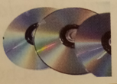
1. Match the words with the pictures :
guitar mp3 player tablet smartphone CDs

Slide 6
2. Match the words on the left and right. Make sure you find a pair for each one :
classical 
rock 
guitar 
summer 
application 
⬧ player
⬧ music
⬧ camp
⬧ letter
⬧ and roll

Slide 7
Have to
Positive form
Negative form
• obligation (obaveza)
I
You
We HAVE TO stay at home.
They
He
She HAS TO stay at home.
It
•choice ( odsustvo obaveze )
I
You
We DON’T HAVE TO eat.
They
He
She DOESN’T HAVE TO eat.
It

Slide 8
Student’s book, page 63. A) Look at the example. Then complete the sentences:
You have to be under fifteen to apply but you do not have to be experienced.
In many countries, you eighteen to get a driver’s license, but in the USA, you _____________ eighteen. You can be sixteen.
In Canada, you _________ seventeen to be a pilot, but in the USA, you ______________ seventeen. You can be sixteen.
have to be
don’t have to be
have to be
don’t have to be

Slide 9
HOMEWORK
Student’s book (page 63)
B) Look at the examples. Then complete the sentences. Use your best ideas.

