Slide 1
6.1 A BEAUTIFUL TOWN page 47

Slide 2
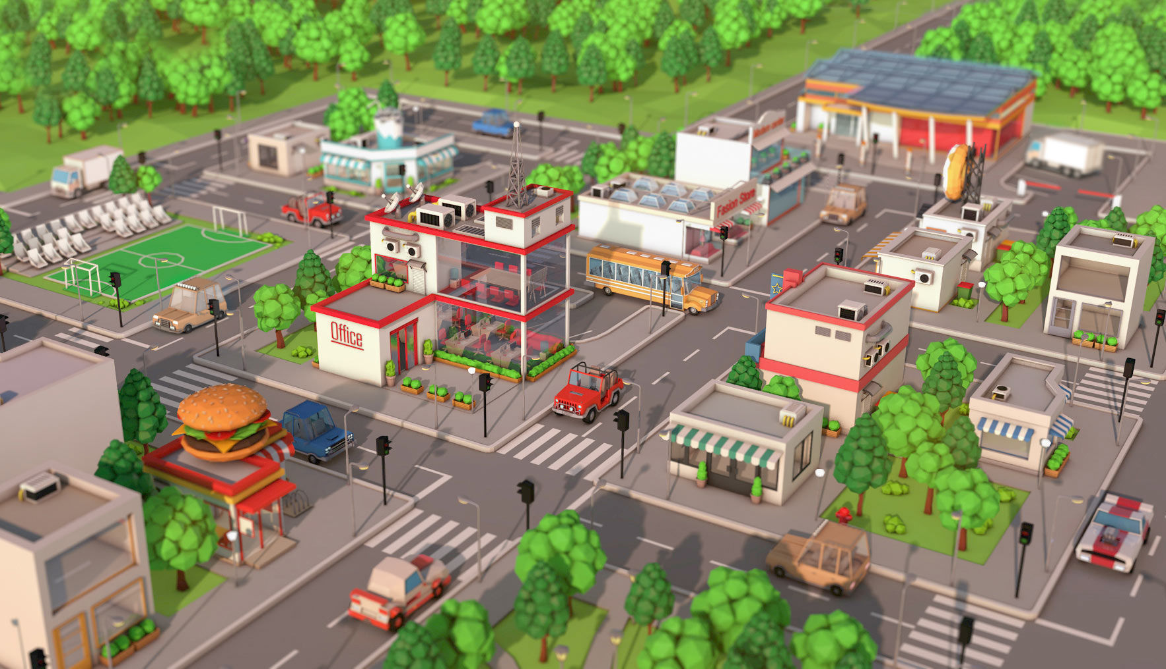

Slide 3
BANK
POST OFFICE
SCHOOL

Slide 4
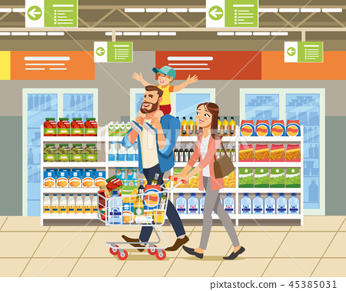
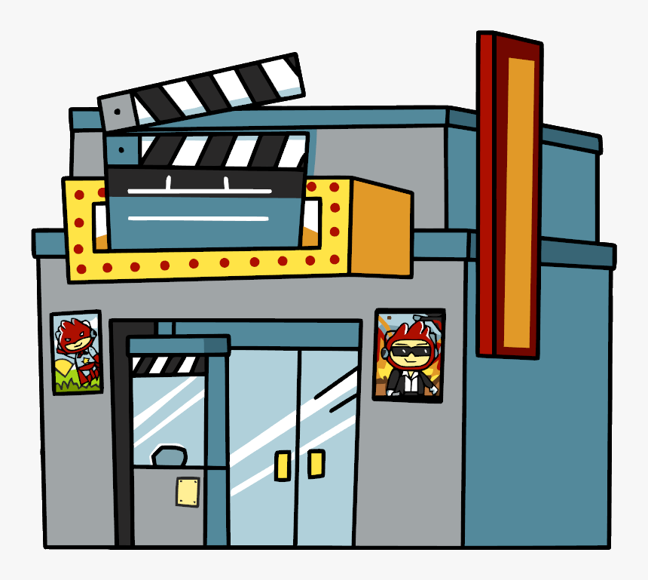
SUPERMARKET
MOVIE THEATER
BOOKSTORE

Slide 5
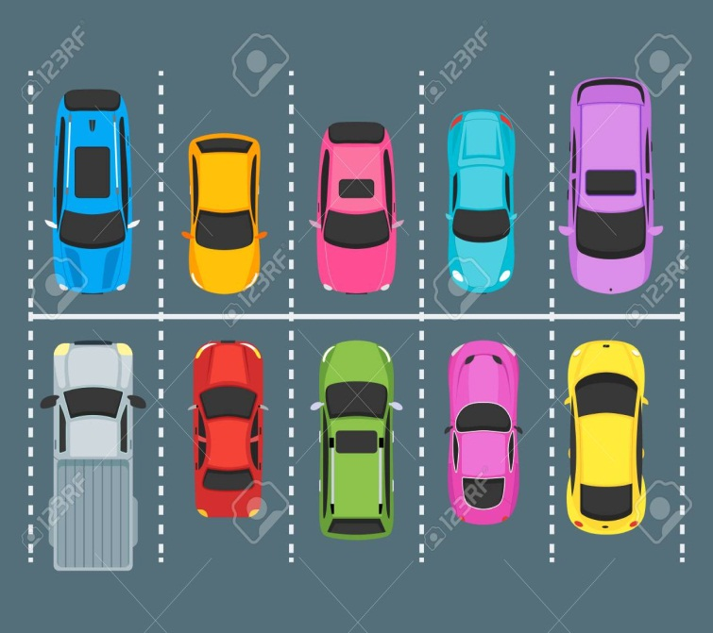
CAR PARK
BUS STOP
TRAFFIC LIGHT

Slide 6
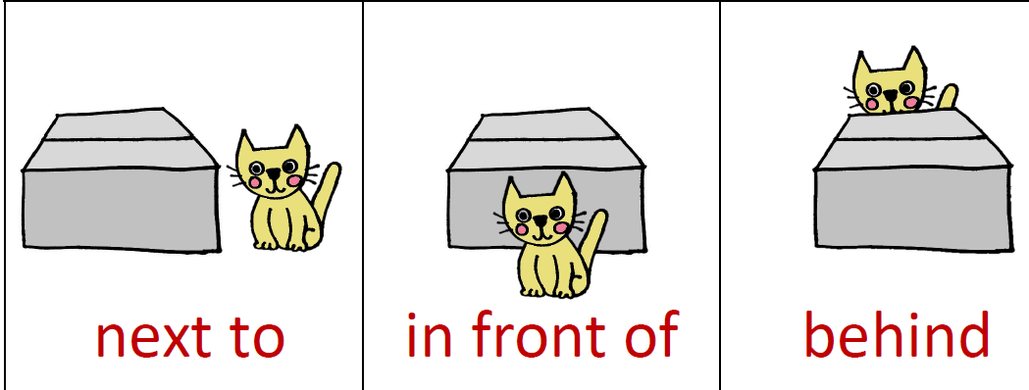
Where is Lola?

Slide 7
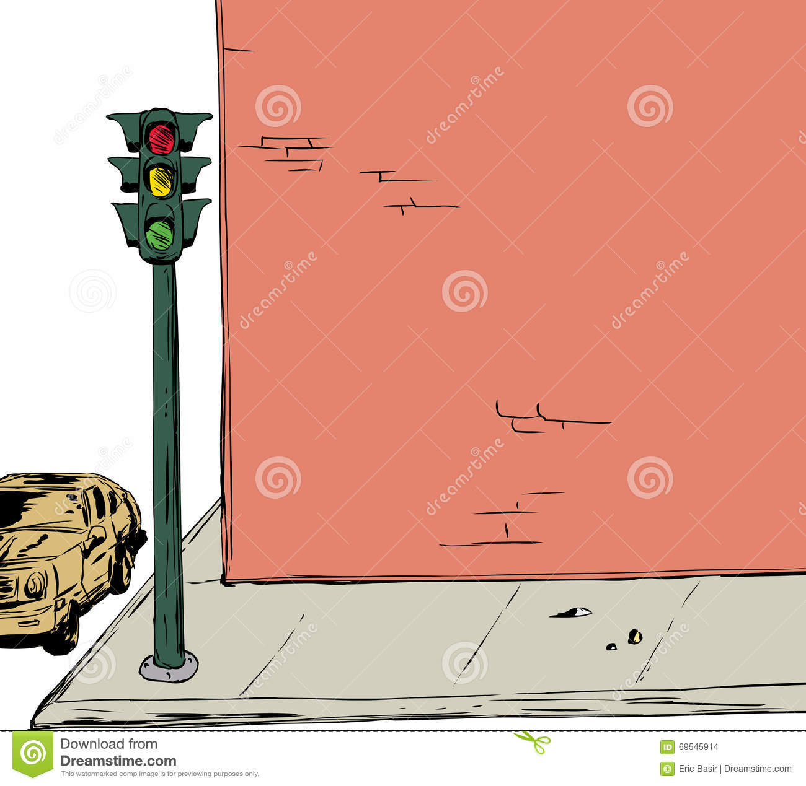
on the corner

Slide 8
Look at the picture, at page 47 in your book and answer the questions:
1. Where is the bank?
2. Where is the bus stop?
3. Where is the school?
The bank is next to the post office.
The bus stop is in front of the supermarket.
The school is behind the post office.

Slide 9
HOMEWORK
WB , page 50, exercise 1 : Fill in the blanks
exercise 3 : Write the missing letters
GOOD LUCK!

