Slide 1
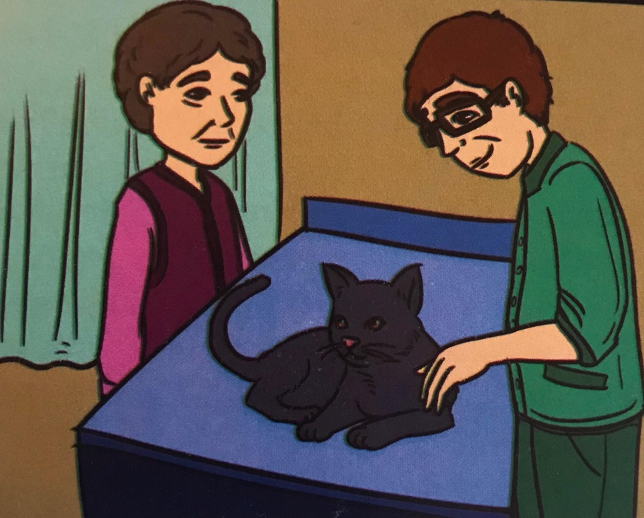
Unit 6 THE WORLD OF ANIMALS
6.1 A VET WITH A HEART OF GOLD

Slide 2
Student’s book,
page 66

Slide 3
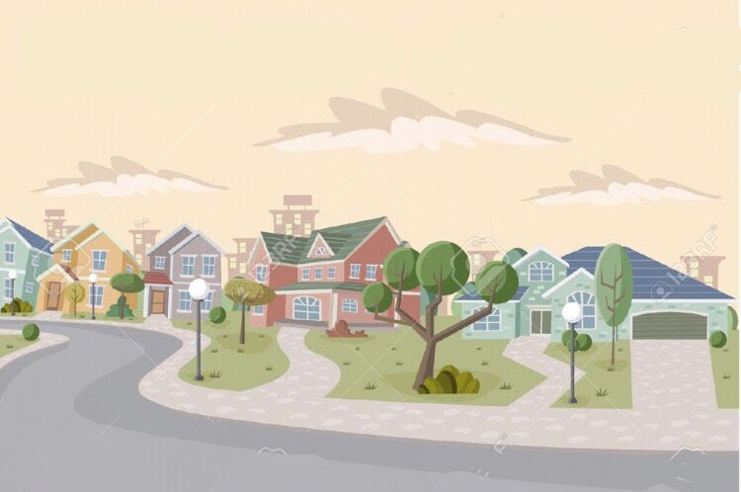
KEY VOCABULARY
suburb /ˈsʌbɜːb/ - a place far away from the center of a city
owner / ˈəʊnə(r)/ ​a person who has something
inspirational /ˌɪnspəˈreɪʃənl/ - something that gives you inspiration
fill /fɪl/ - to become full of something
elderly /ˈeldəli/ - used as a polite word for ‘old’
paw /pɔː/ - the foot of an animal
splinter /ˈsplɪntə(r)/ -​a small, sharp piece of wood
comfort /ˈkʌmfət/ - make someone feel better

Slide 4
READING COMPREHENSION Student’s book,exercise 1, page 66 Read the text and write true (T) or false (F):
1 Dr Garrick lives in downtown Chicago. ____
2 Dr Garrick is a veterinarian. _____
3 The young lady’s name is Mrs. Jones. ______
4 The little cat has a broken leg. ________
5 Mrs. Jones has to keep an eye on Frisky’s paw. ______
*Garrick /ɡarɪk/
*Chicago /ʃɪˈkɑ.ɡəʊ/

Slide 5
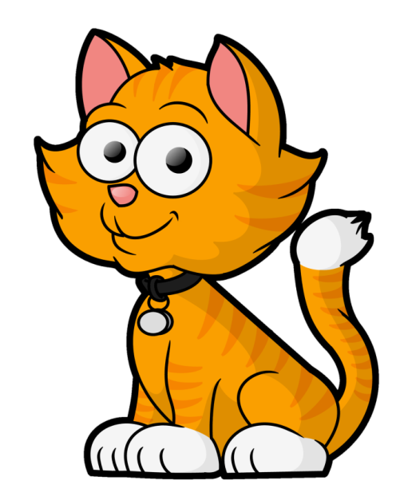
ANSWERS:
1 Dr Garrick lives in downtown Chicago.
2 Dr Garrick is a veterinarian.
3 The young lady’s name is Mrs. Jones.
4 The little cat has a broken leg.
5 Mrs. Jones has to keep an eye on Frisky’s paw.
F
T
F
F
T

Slide 6
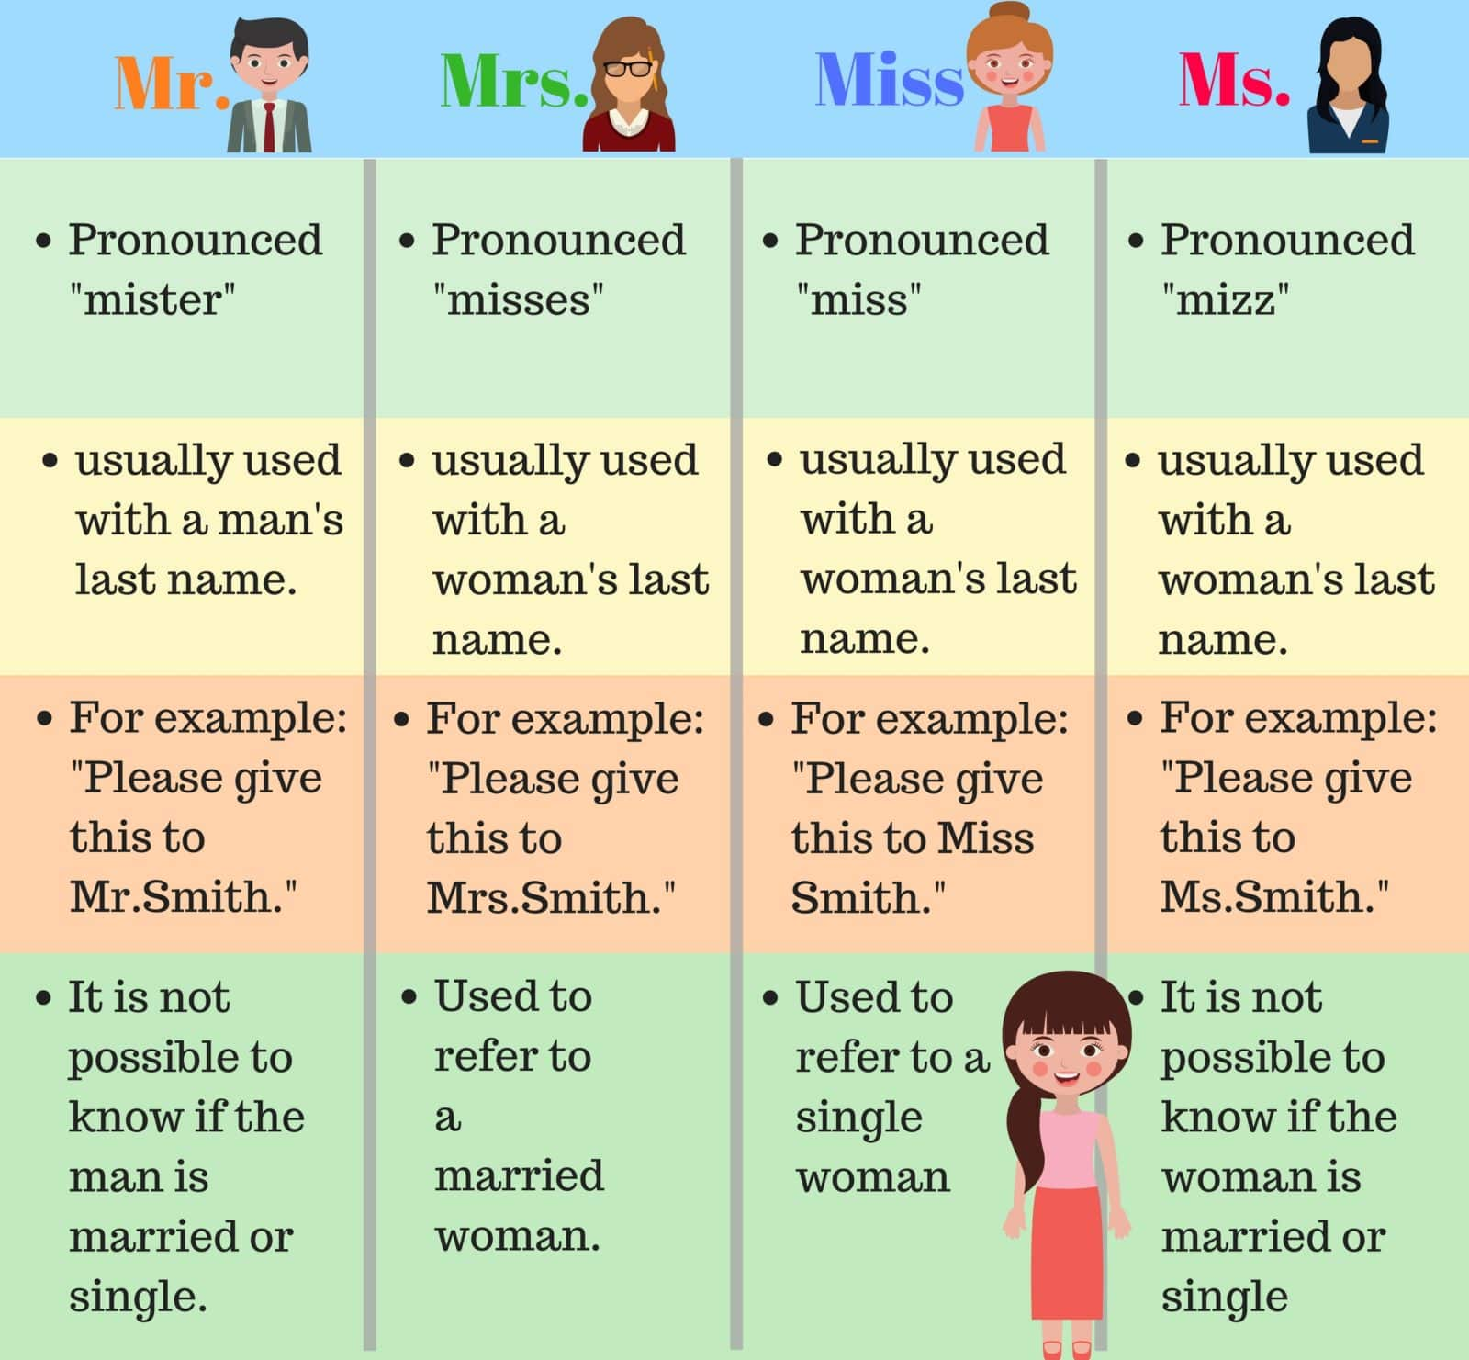

Slide 7
VOCABULARY, SB, page 67 Fill in the blanks with the following words. Use each word once:
1
1 This is _____ Darcy. He is your new English teacher.
2 This is Mr. o’Malley and his wife, _______ O’Malley?
3 ________ Smith, this is your next patient.
4 Hello, _______ Robertson, how can we help you today?
5 This is John Dover and this is his young daughter, _____ Dover.
She is fourteen.

Slide 8
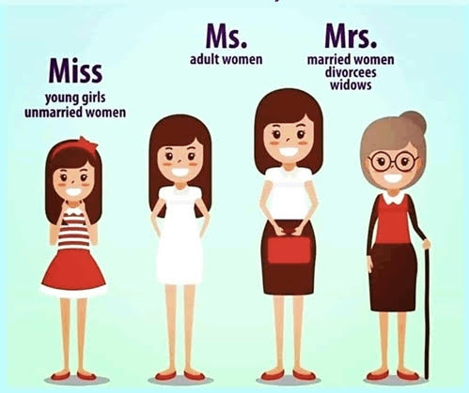
ANSWERS
1 This is Mr. Darcy. He is your new English teacher.
2 This is Mr. o’Malley and his wife, Mrs. O’Malley?
3 Dr. Smith, this is your next patient.
4 Hello, Ms. Robertson, how can we help you today?
5 This is John Dover and this is his young daughter, Miss Dover.
She is fourteen.

Slide 9
2
Fill in the dialogs with the following expressions: It’s nice to see you again / It’s all right / Here you are Look /Have a nice day /How are you / Congratulations
1 Cashier: One kilogram of peaches and two dozen eggs. ________________.Would you like anything else?
Customer: No, thank you.
Cashier: Thank you! _________________!
2 Linda: Hi, Chris! I can’t believe it’s you! __________________
Chris: You too. The last time we met was two years ago. ___________?
Linda: Fine, thank you. I got married last week.
Here’s a picture. ______________!
Chris: Wow! That’s a really nice picture.
____________________!
Linda: Thank you so much.
3 Carla: I’m sorry about yesterday.
Tim: ____________________ . I’m not angry.
Don’t worry about it.

Slide 10
ANSWERS:
1 Cashier: One kilogram of peaches and two dozen eggs. Here you are.
Would you like anything else?
Customer : No, thank you.
Cashier: Thank you! Have a nice day!
2 Linda: Hi, Chris! I can’t believe it’s you! It’s nice to see you again!
Chris : You too. The last time we met was two years ago. How are you?
Linda: Fine, thank you. I got married last week. Here’s a picture. Look!
Chris: Wow! That’s a really nice picture. Congratulations!
Linda: Thank you so much.
3 Carla: I’m sorry about yesterday.
Tim: It’s all right. I’m not angry. Don’t worry about it.

Slide 11
HOMEWORK
WB, page 46,exercise 1
Match the opposites.
Then fill each sentence with the appropriate word or phrase.

