Slide 1
Revision of 5.1
This is our new English teacher whose name is Maja.
Defining relative clauses
WHO/THAT
WHICH/THAT
WHOSE

Slide 2
Reading
What is the text about?
What kind of programmes does ABL TV station produce?
Where is the island of Djerba?
What is it famous for?

Slide 3
Vocabulary
Vivid
Mainland
Orchard
Scent
Appeal to

Slide 4
HOME IS WHERE THE HEART IS

Slide 5
Do you have any relatives or friends who live abroad?
Do some of them go to school?
Are among them those who attend school?
Do you know anything about their school?

Slide 6
Student’s book, page 57
Read the text and put the words in the correct place.
however tradition
attract who expensive

Slide 7
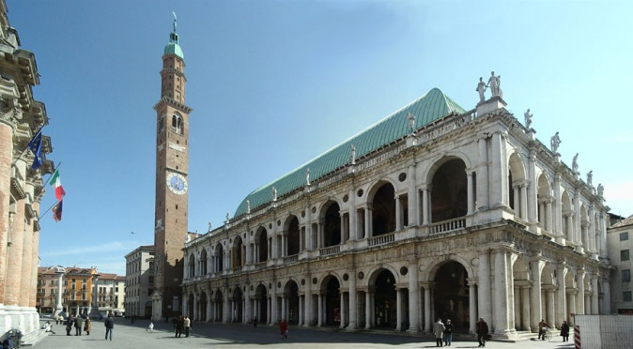
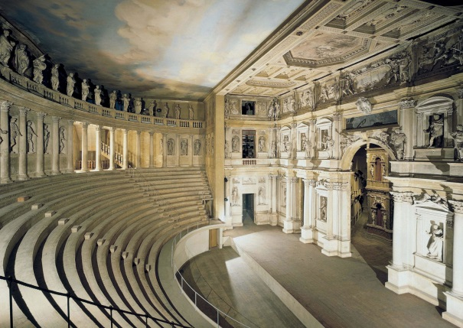
Read the text again and answer the questions at the page 58
1 Tourists usually visit magnificent buildings such as Basilica Palladiana and Teatro Olimpico.

Slide 8
2 Students can attend Serbian Language, My country, the Basics of Serbian Culture and religious classes.
3 Ms. Abadic is a teacher.
4 These classes are useful because the children can learn about their home country and tradition.
5 It is good to learn about home country because you keep your tradition alive.

Slide 9
Vocabulary, page 58
cheerful and friendly –
have existed for some time in the past –
get something; to accept or start to use something new –
a person’s family background –
JOVIAL /ˈdʒəʊ.vi.əl/
DATE BACK
ADOPT
ORIGIN /ˈɒr.ɪ.dʒɪn/

Slide 10
dates back
established
origin
jovial
adopt
1 The magnificent cathedral to the 17th century.
2 All children their first language without much difficulty.
3 Her family is of Italian but they have lived in the USA for many years.
4 They wanted to a college in that small town but it wasn’t approved.
5 I think that people in Greece are relaxed and .

Slide 11
Exercise 3, page 58
Jovial people
Date back
Lie in the fact
Keep in touch
Keep tradition alive
Adopt a language
Do your best
Home country
True identity
Continue education

Slide 12
Non-defining relative clauses
Ms. Olivera Abadic, who is a Serbian language teacher, works in one school of this kind in Vicenza.
The Teatro Olimpico, which is famous theater in Vicenza, is from the 16th century.
THAT
Many children, whose parents are of Serbian origin, like this school in Vicenza.

Slide 13
A few/few and a little/little
a few/ a little
enough to complete an action
few / little
not enough
We have a few eggs so we can make a cake.
There is little sugar. We should go to the supermarket to buy some.

Slide 14
HOMEWORK
WORKBOOK,
PAGES 48 AND 49

Slide 15
http://www.letshavefunwithenglish.com/games/relative_pronouns/index.html

Slide 16
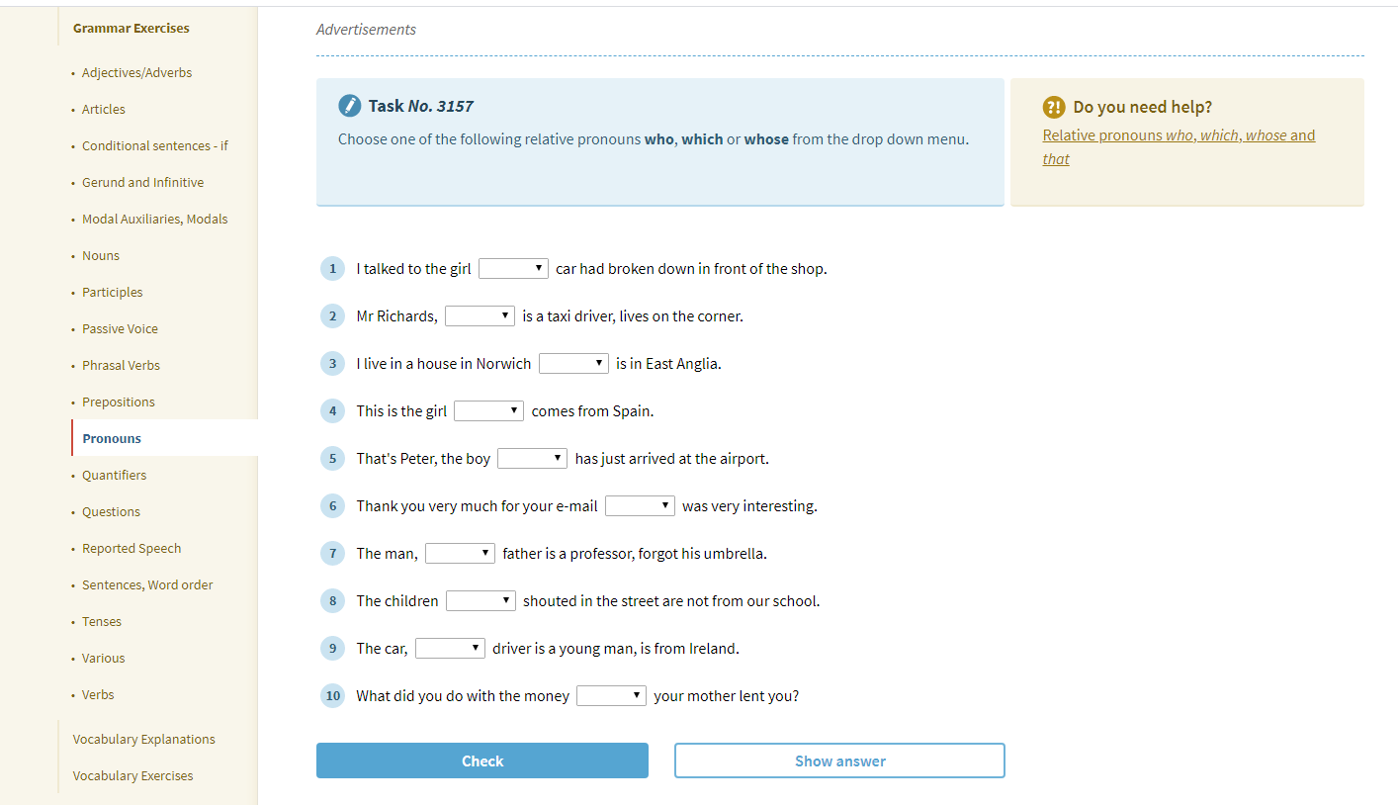
https://www.englisch-hilfen.de/en/exercises/pronouns/relative_pronouns.htm

