Slide 1
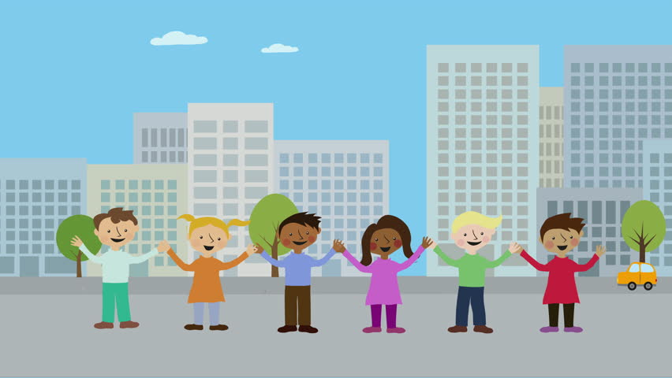
REVISION 5.5 – 5.6

Slide 2
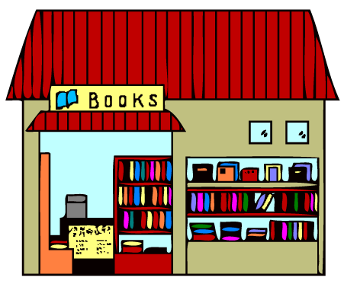
Notes:
What is this? It`s a bookstore.

Slide 3
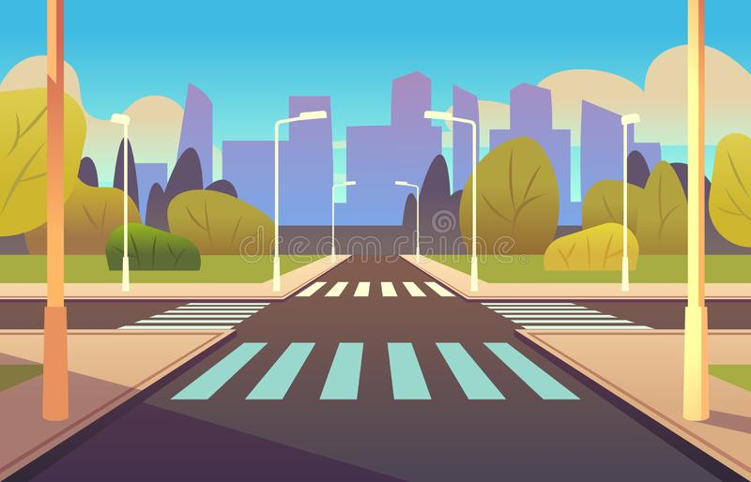
Notes:
What is this? It`s a street.

Slide 4
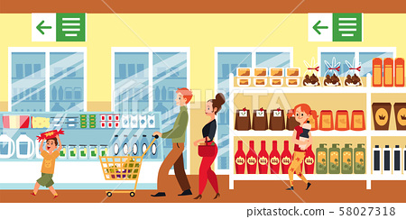
Notes:
What is this? It`s a supermarket.

Slide 5
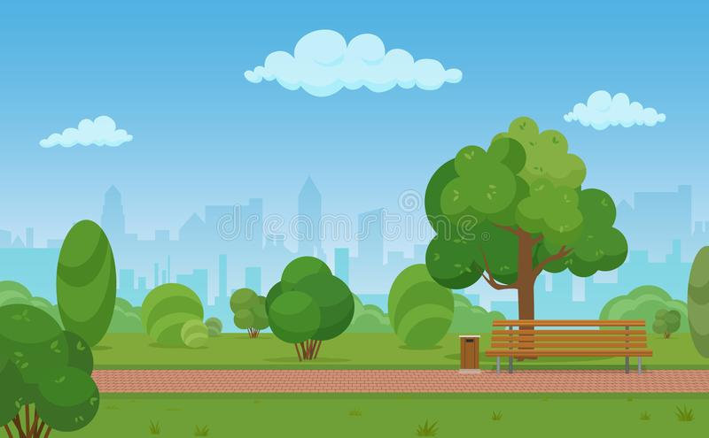
Notes:
What is this? It`s a park.

Slide 6
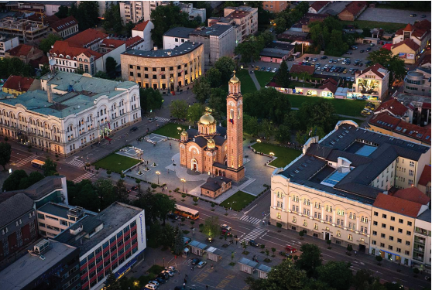
Notes:
What is this? It is a city.
What city is this? It is Banjaluka.
Where is Banjaluka? Banjaluka is in the Republic of Srpska.
Are there many cars in Banjaluka? Yes, there are.
Is there a park in Banjaluka? Yes, there is.

Slide 7
SUPERMARKET
Notes:
Marko wants to buy some sweets.
Excuse me, where is the supermarket?
It`s across the street.
Thank you.

Slide 8
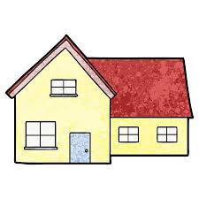
Sremska
19
Notes:
My address is 19, Sremska street.
What is your address?
Is it number 19? Is it number 20?

Slide 9
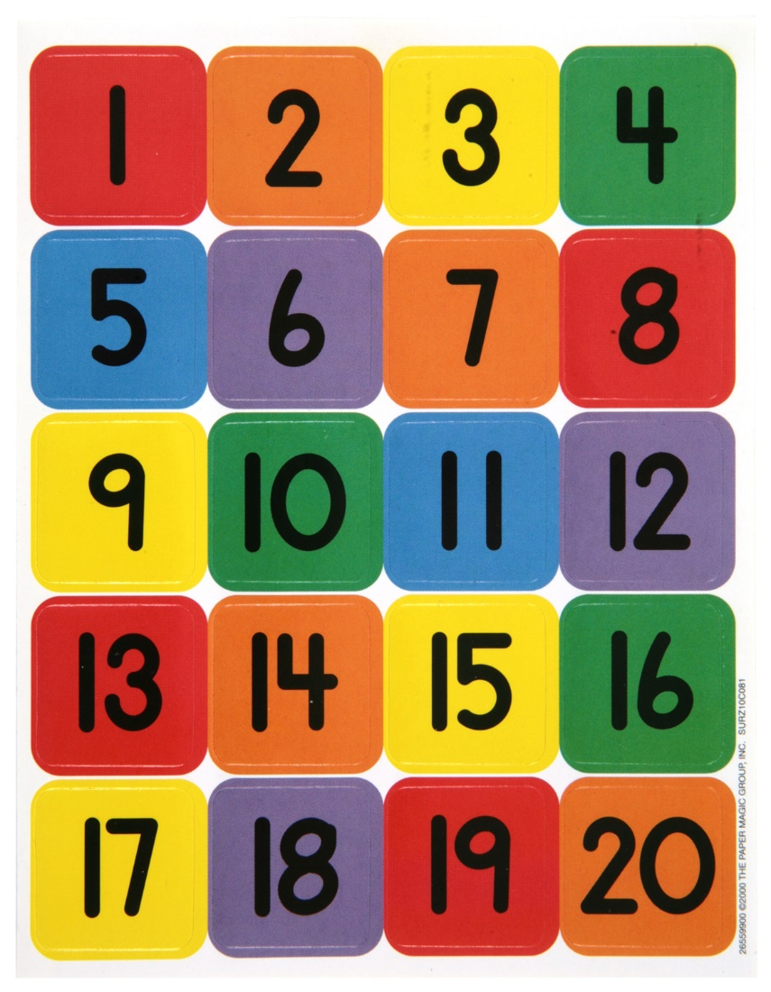
Notes:
Let‘s count from 1-20. What colour is number 3? It‘s yellow.
What colour is number 5? Blue
What colour is number 13? Red...

Slide 10
Homework: workbook, page 50, color and say the numbers. Задаћа: Радна свеска, 50. страница, обојити и изговорити бројеве.

Slide 11
Notes:
Have a nice day!

