Slide 1
VOCABULARY
MATCH THE WORDS WITH THE PICTURE
attic
basement
staircase
hallway
closet
dresser
refrigerator
dishwasher
stove
sink
tub

Slide 2
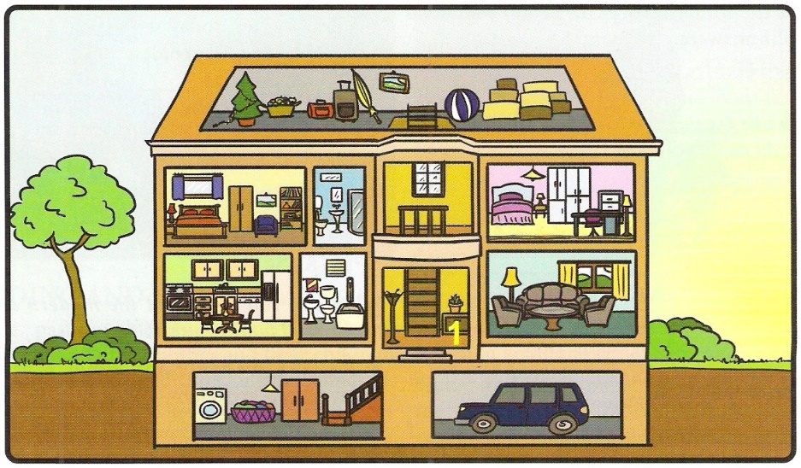
EXAMPLES
Maggie’s attic is very big.
The garage is next to the basement.
The staircase is in the hallway.
In Maggie’s bedroom, there is a large bed, a closet and a dresser.
The kitchen has a refrigerator, dishwasher and stove.
There is a tub in one of the bathrooms.
There is a toilet and a large sink in each bedroom.

Slide 3
ADJECTIVES
COMPLETE THE TABLE
good
bad
old
funny
interesting
better | the best
worse | the worst
older | the oldest
funnier | the funniest
more interesting | the most interesting
better | the best
worse | the worst
older | the oldest
funnier | the funniest
more interesting | the most interesting
good
I am very ________ at English – I just got an A.
This is ________ movie in the world!
Josh is much ________ than his cousins.
That story is so ________! Lisa has to hear it.
Maggie’s essays are _______________ than Clara’s.
the worst
older
funny
more interesting

Slide 4
PLURAL FORMS
COMPLETE THE TABLE
You don’t need three dressers in your bedroom.
The dishes go in the dishwasher.
How many hallways do you have?
Two families live in that house.
Can you give me the glasses?
dresser
dish
hallway
family
glass
dressers
dishes
hallways
families
glasses

Slide 5
PRESENT SIMPLE AND CONTINUOUS
CHOOSE THE CORRECT ANSWER
leaves
The bus always __________ on time.
A. leave B. is leaving C. leaves D. doesn’t leaves
What’s wrong? Why ______ you __________?
A. do/cry B. are/cry C. are/crying D. is/crying
He __________ very good French.
A. speak B. doesn’t speaks C. speaks D. is speaking
Listen! John __________ some music!
A. doesn’t play B. isn’t playing C. plays D. is playing
I always __________ coffee, but today I __________ some tea.
A. haves/have B. am having/have C. have/am having D. haves/am having
are
crying
speaks
is playing
have
am having

Slide 6
IRREGULAR VERBS
COMPLETE THE TABLE
PUT THE VERBS IN THE SENTENCES
Did
make
INFINITIVE | PAST | MEANING
be
go
have
make
write
______ you ______ this cake for John’s birthday?
He __________ a pet when he was a child. (not)
________ she at school yesterday?
Jane ________ a letter to her family two months ago.
We ________ to the museum last week.
was/were | biti
went | ići
had | imati
made | napraviti
wrote | pisati
didn’t have
Was
wrote
went

Slide 7
FUTURE
FORM QUESTIONS
We will eat dinner at 7 pm tonight.
Maggie will not have a math class tomorrow.
In the future, people will live longer.
Her friends will not go shopping at the weekend.
Lisa will finish her work on Tuesday.
Will we eat dinner at 7 pm tonight?
Will Maggie have a math class tomorrow?
Will people live longer in the future?
Will her friends go shopping at the weekend?
Will Lisa finish her work on Tuesday?

Slide 8
THAT’S ALL FOR TODAY!

