Slide 1
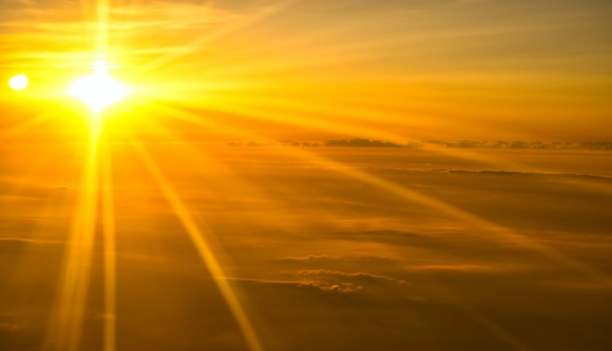
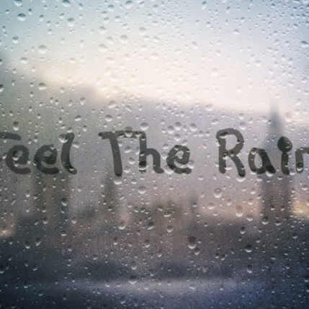
UNIT 3
RAIN OR SHINE

Slide 2
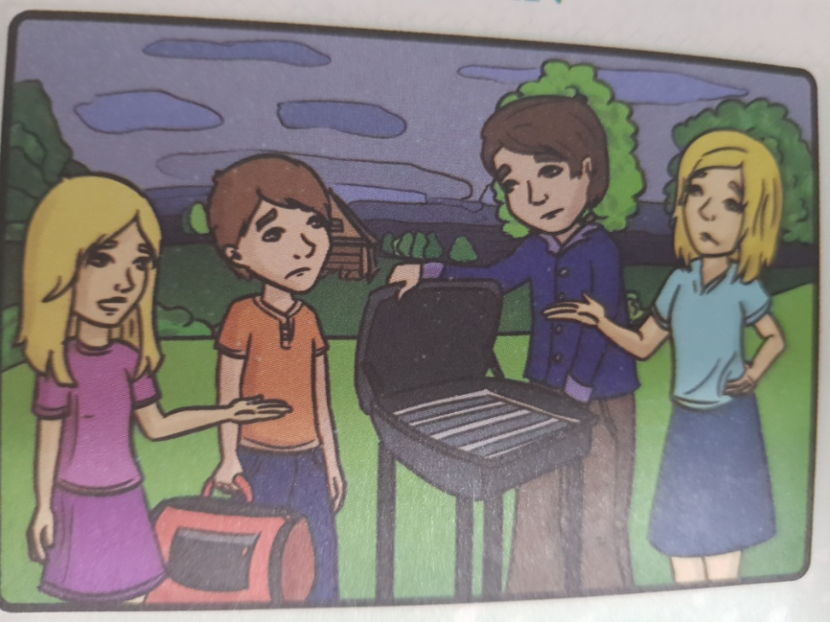
Feel the rain
Where are the Kecmans’?
What is Mr. Kecman going to do?
What is the weather like?

Slide 3
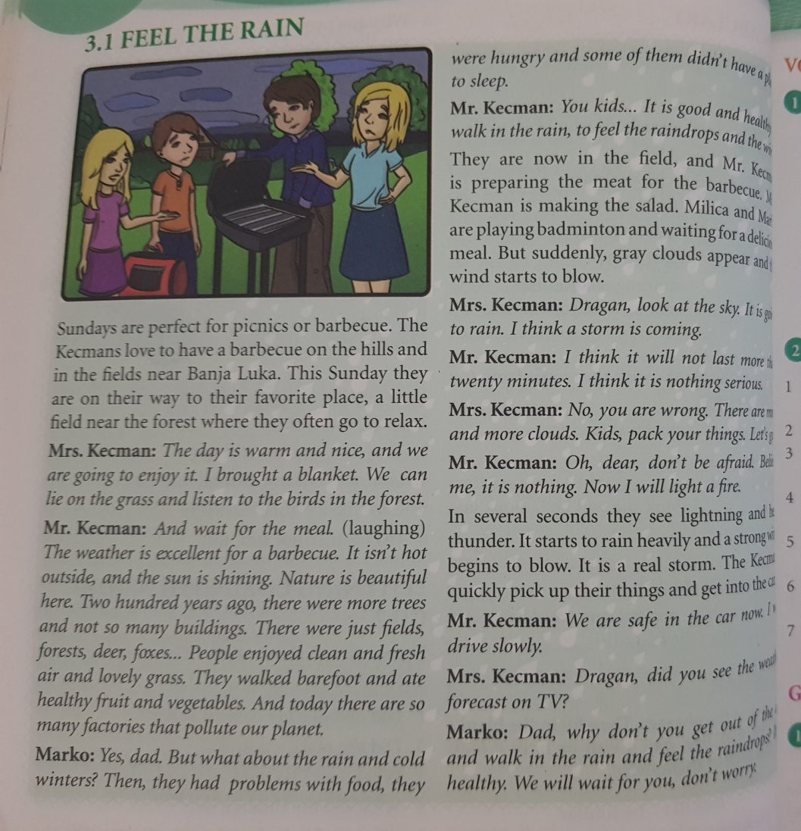
VOCABULARY
field – a wide open piece of land
blanket – a large cover
barefoot – without anything on your feet
pollute – make something dirty and unhealthy
appear – get somewhere
several – a few
lightning – a flash of light in the sky
thunder – a loud noise that you hear during the storm

Slide 4
SB pg. 31 ex. 1 and 2 (Vocabulary)
1. Find the words in the text which mean the same. The first letter will help you:
2. Complete the sentences with the words from exercise 1:
A wide open piece of land – field
A large cover – b _ _ _ _ _ _
Without anything on your
feet – b _ _ _ _ _ _ _
Make something dirty and unhealthy - p _ _ _ _ _ _
A few – s _ _ _ _ _ _
A flash of light in the sky –
l _ _ _ _ _ _ _ _
A loud noise that you hear during a storm – t _ _ _ _ _ _
1. Many factories and cars ________our towns and villages these days.
2. I do not need many photos, just __________.
3. The weather was awful, I was scared when I saw _________ in the sky.
4. I saw black clouds and heard _________ . The storm began in a few minutes.
5. Why are you walking ________?
You will catch a cold.
6. There are a lot of cows and sheep in the field.
7. You do not need a __________ , nights are warm here.

Slide 5
Homework
SB pg. 30 Read the text “Feel the rain” carefully
SB pg. 30“READING COMPREHENSION” Answer the questions in your notebook
SB pg. 31 ex.1 & 2 Complete the Vocabulary tasks

