Slide 1
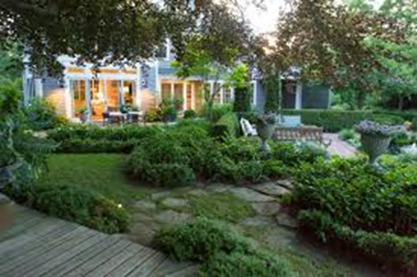
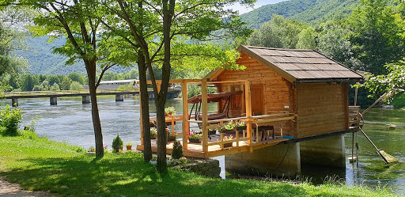
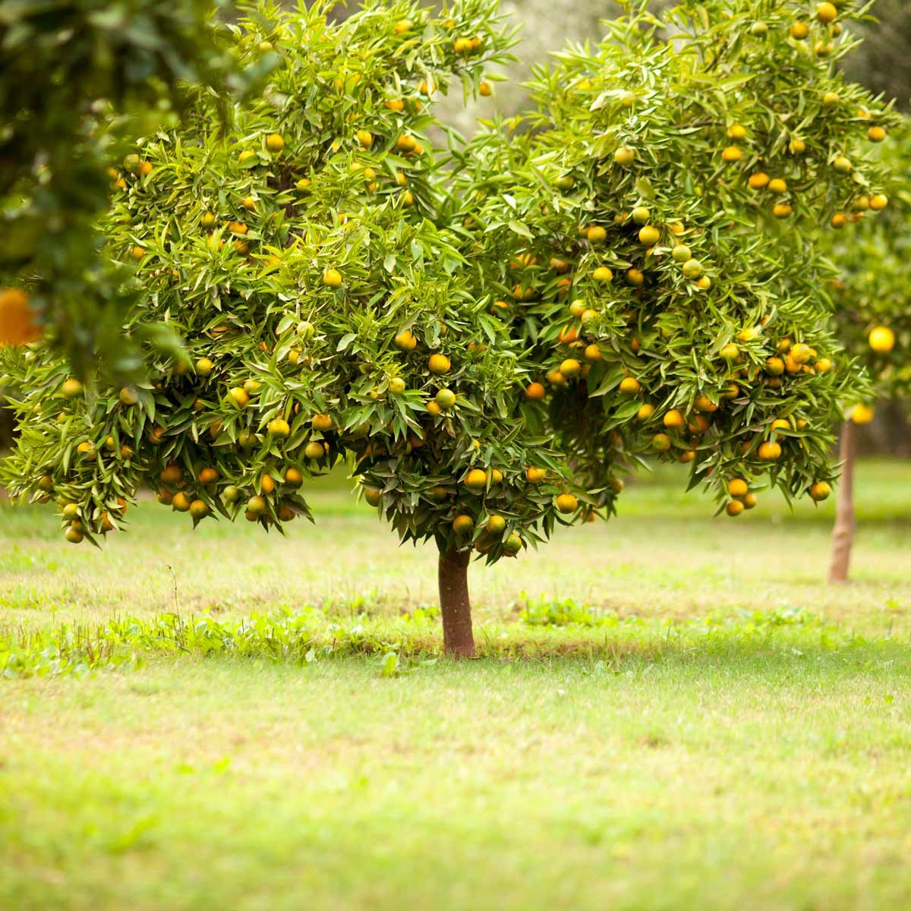
In the country

Slide 2
3.2 In the country, page 22
Maggie lives in the city with her family. The family also has a beautiful vacation home in the country. Maggie’s mother loves to spend time outside, in the garden. Behind the house, she has a beautiful flower and fruit garden. There are many beautiful flowers, small fruit trees and plants in her garden. There is also a nice wooden bench and a small table. She often sits on a bench to rest or to drink a cup of tea.
In the garden, she grows roses and violets. She uses a spade and a rake to plant them. She uses a watering can to water them. She loves her flowers. Sometimes, she cuts them and puts them in a vase in the living room.

Slide 3
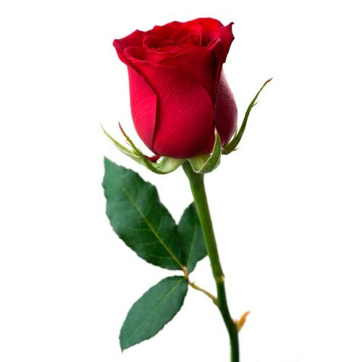
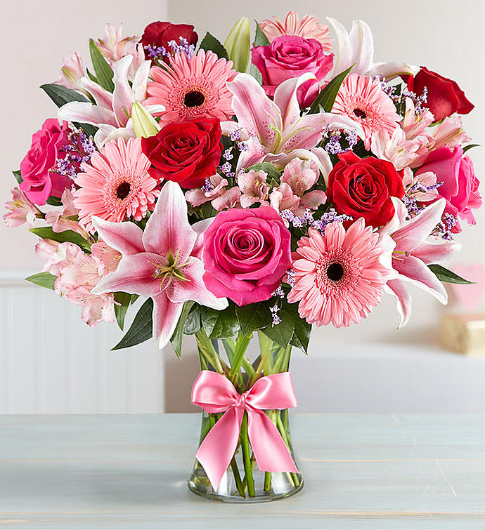
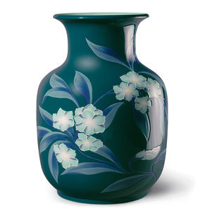
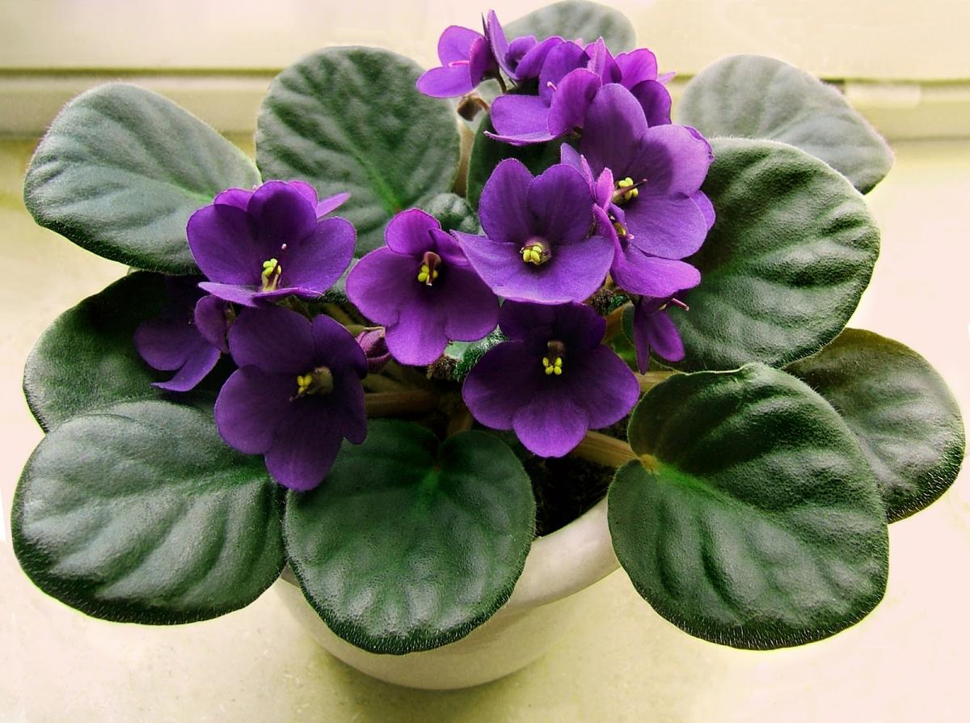
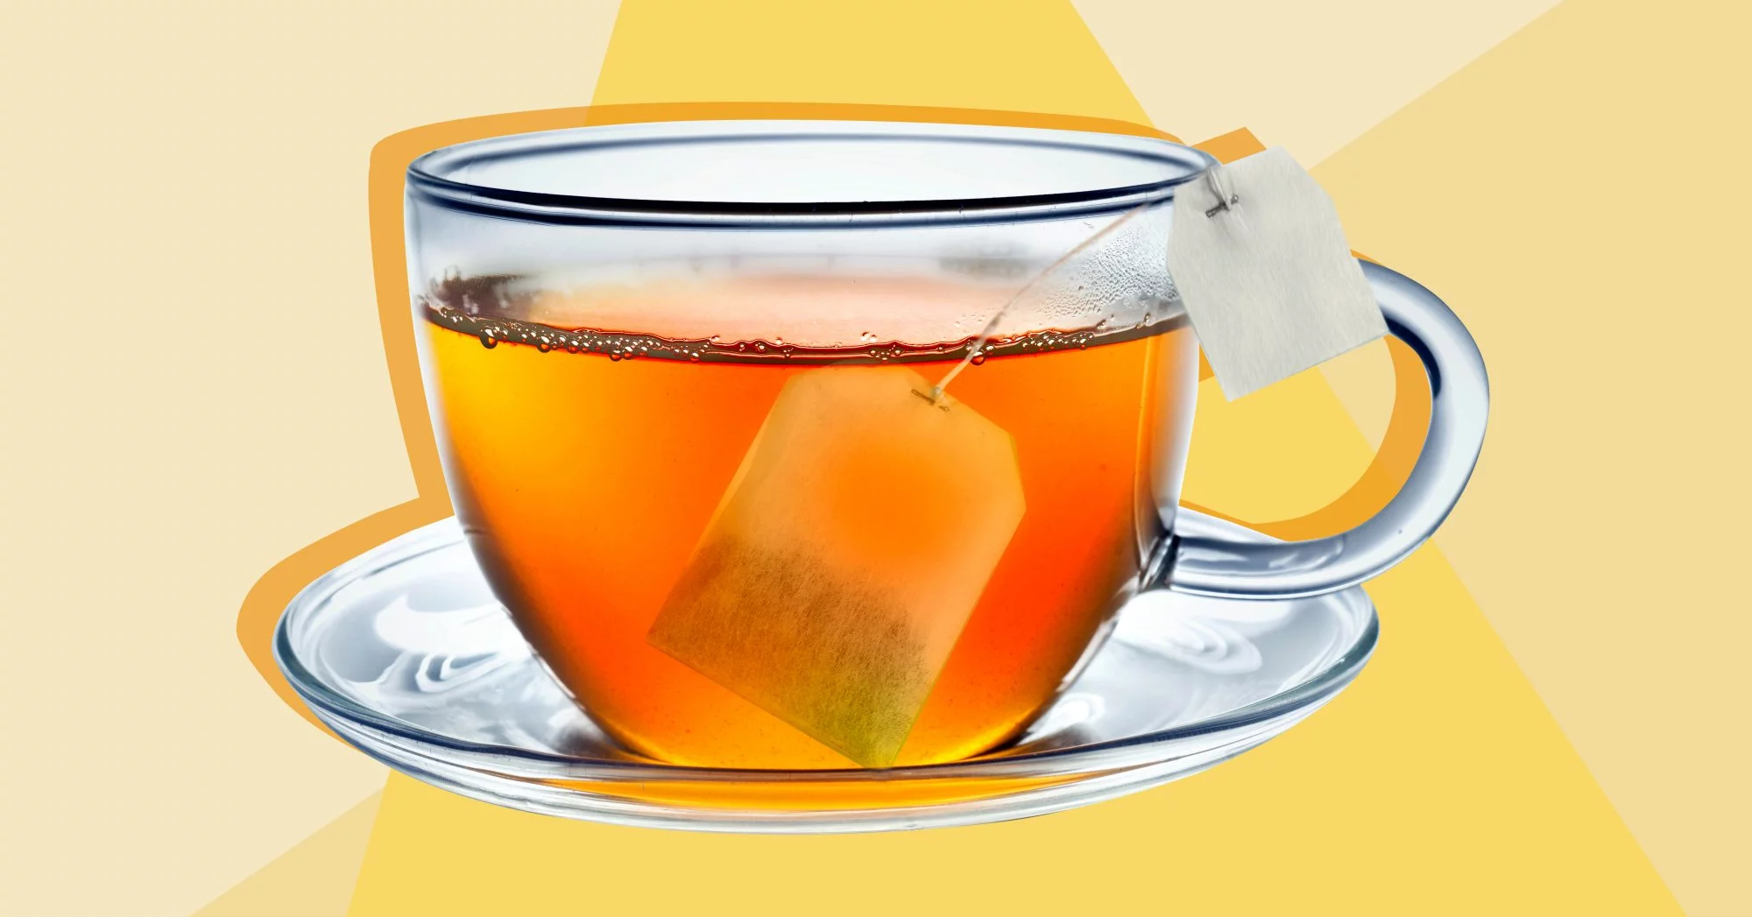

Slide 4
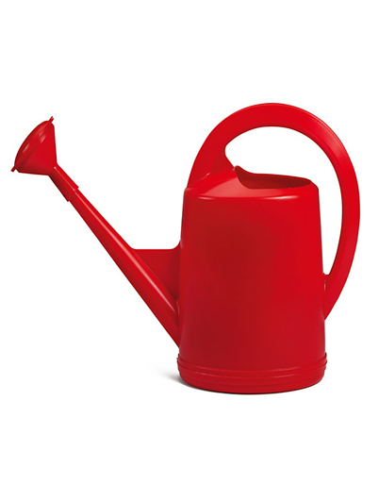
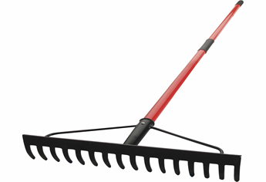
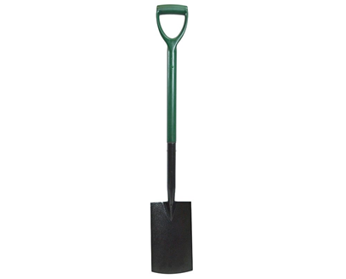
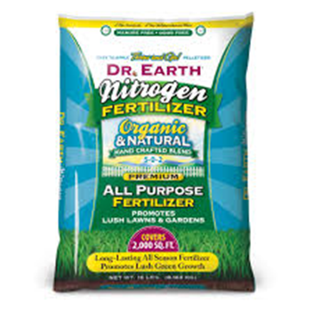

Slide 5
New vocabulary:
flower - цвијет
plant – биљка
wooden – дрвени
bench – клупа
rest – одморити се
tea- чај
rose – ружа
violet - љубичица
spade - ашов
rake – грабље
watering can – канта за залијевање
vase – ваза
fertilizer - ђубриво

Slide 6
Answer the questions:
• Where does Maggie live?
• Why does Maggie sometimes go to the country?
• Who loves gardening?
• What does she grow in the garden?
• What kind of tools does she use in the garden?

Slide 7
Answers:
• She lives in the city. • She goes to the country because her family has a beautiful vacation home there. • Maggie’s mother loves gardening. • She grows plants, flowers and small fruit trees. • She uses a spade, a rake and a watering can.

Slide 8
Activity Book, page 24
Write the correct words to complete the sentences:
1 Maggie’s mom likes to spend time __________ , in her garden. ( TOSUDEI )
2 She likes to spend a lot of time with her _________ flowers. ( LUFITEBAU )
3 She often sits on her nice _________ when she wants to drink a cup of tea. ( CHENB )
4 For her flowers she needs a spade, a rake and a ________ can. ( RINGTEW )
5 She sometimes puts flowers in the _______ room in their vacation home. ( GVINLI )

Slide 9
1 Maggie’s mom likes to spend time outside , in her garden.
2 She likes to spend a lot of time with her beautiful flowers.
3 She often sits on her nice bench when she wants to drink a cup of tea.
4 For her flowers she needs a spade, a rake and a watering can.
5 She sometimes puts flowers in the living room in their vacation home.

Slide 10
Homework: Workbook, page 24 Exercise 2 Read text 3.2 again. Write T ( true ) or F (false)

