Slide 1
CANADA – A LAND BETWEEN THREE OCEANS
The English language for the seventh grade

Slide 2
1. Where is Canada?
2. How many official languages are there in Canada?
3. What are the names of the oceans around Canada?
4. What sports are very popular there?

Slide 3
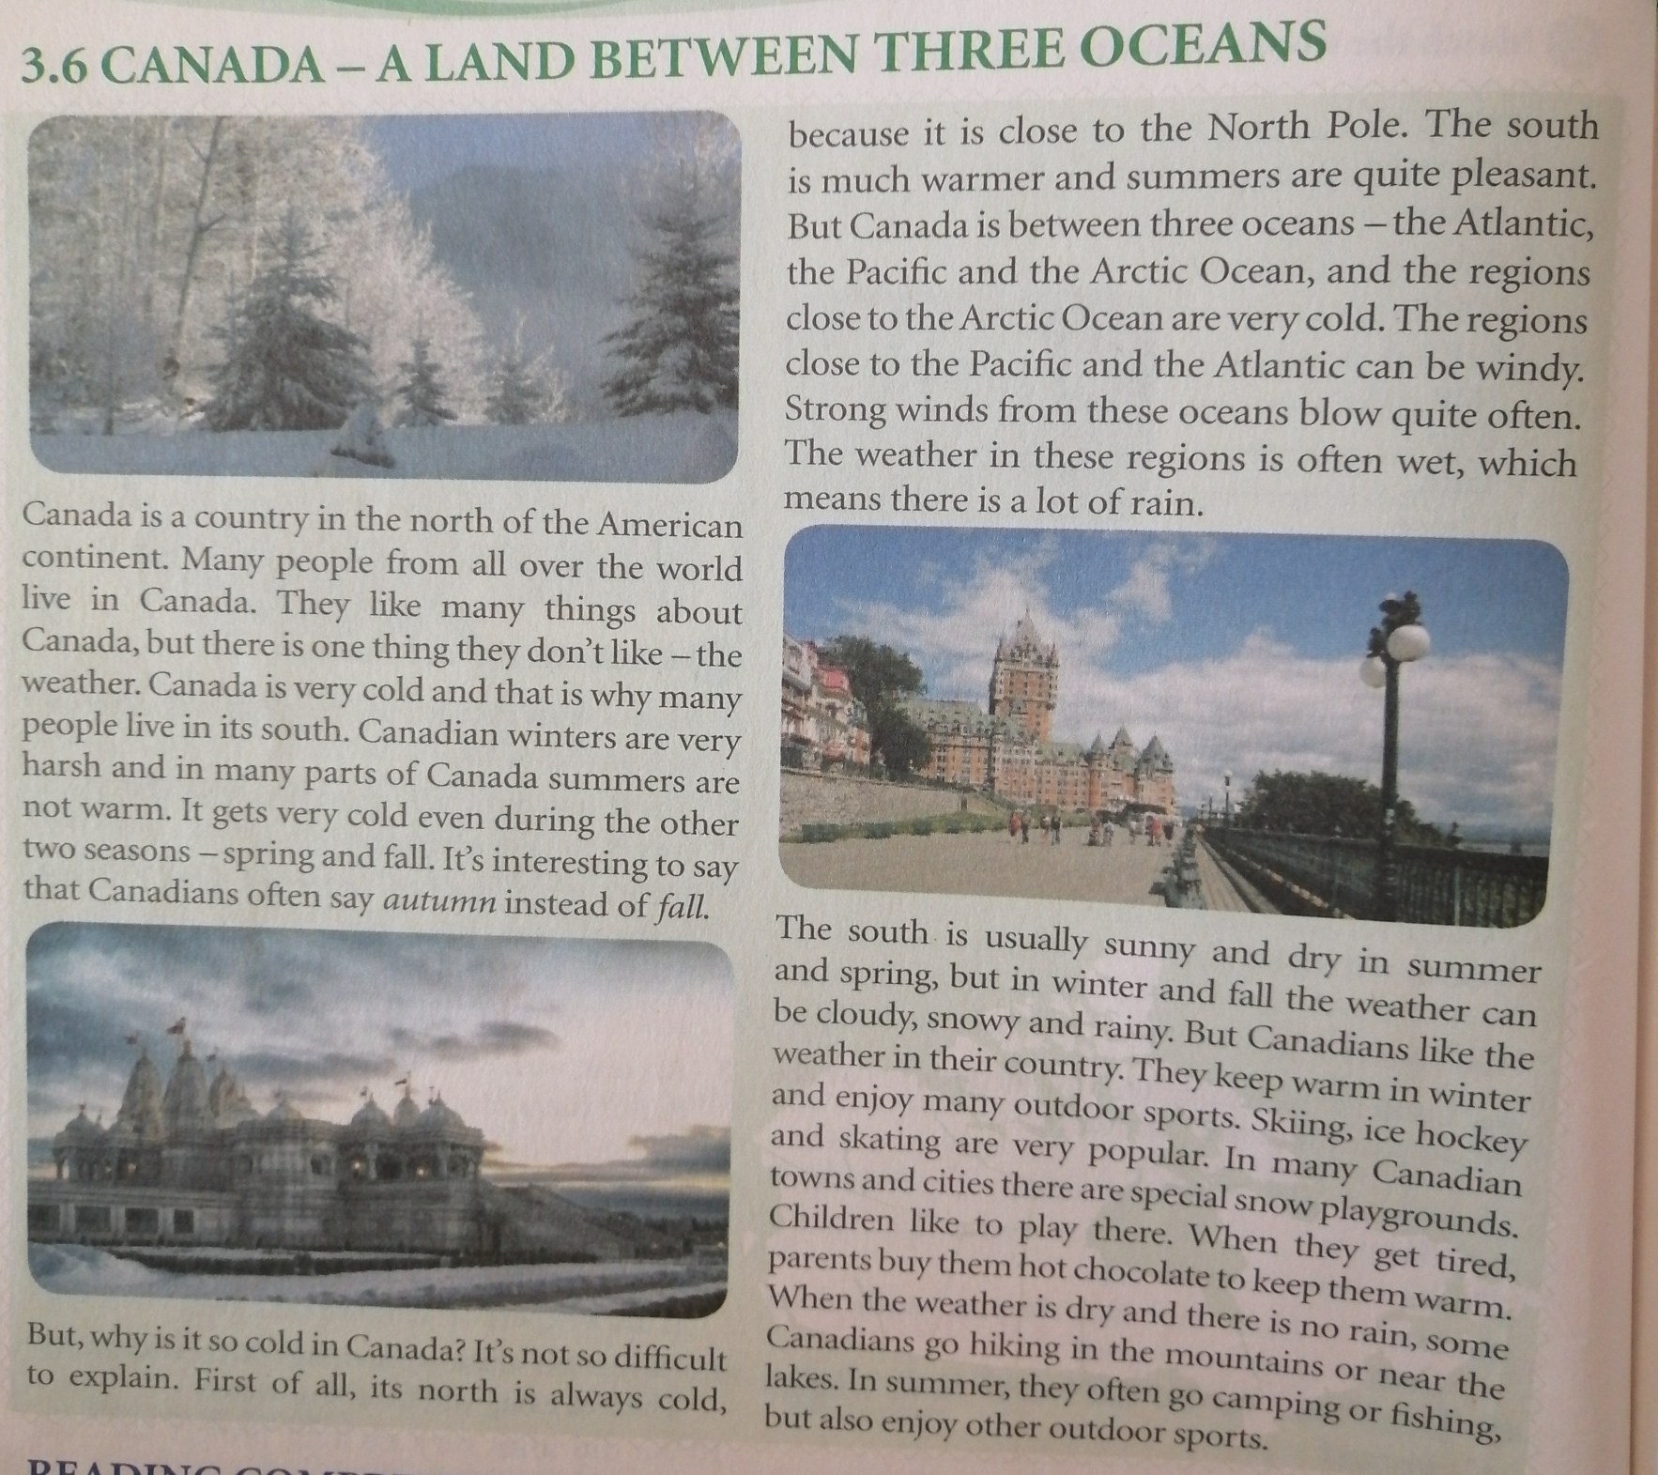

Slide 4
NEW VOCABULARY:
HARSH - bad, difficult ( оштра, тешка нпр. зима )
AUTUMN - fall, the season that comes after summer
( јесен )
CLOSE - near ( близу )
QUITE GOOD - very good ( веома добро )
PLEASANT - nice ( угодан,пријатан )
EXPLAIN - make something clear to someone by describing it in more details ( објаснити )
REGION - an area, a part of the country ( регија )

Slide 5
1. FIND THE ODD ONE OUT:
WINTER WEATHER SPRING AUTUMN SUMMER

Slide 6
1. FIND THE ODD ONE OUT:
WINTER WEATHER SPRING AUTUMN SUMMER

Slide 7
2. MATCH THE WORDS THAT MEAN THE SAME:
AUTUMN VERY
HARSH NICE
CLOSE FALL
QUITE NEAR
PLEASANT BAD, DIFFICULT

Slide 9
3. FILL IN THE BLANKS WITH THE FOLLOWING WORDS:
AUTUMN HARSH CLOSE QUITE PLEASANT
1. The bookstore is _________ to our school.
2. ____________ comes after summer and before winter.
3. I like this book. It is __________ interesting.
4. The weather in our country is ____________, because it is often warm.
5. This winter was very ________ and cold.

Slide 10
3. FILL IN THE BLANKS WITH THE FOLLOWING WORDS:
1. The bookstore is CLOSE to our school.
2. AUTUMN comes after summer and before winter.
3. I like this book. It is QUITE interesting.
4. The weather in our country is PLEASANT , because it is often warm.
5. This winter was very HARSH and cold.

Slide 11
FOR YOUR HOMEWORK DO EXERCISES IN YOUR ACTIVITY BOOKS, PAGE 27
1. Match the words that go together. Then use the phrases to complete the sentences.
2. Complete the sentences with the words from the box. Use each word once.

Slide 12
THAT’S ALL FOR TODAY AND THANK YOU FOR YOUR ATTENTION.

