Slide 1
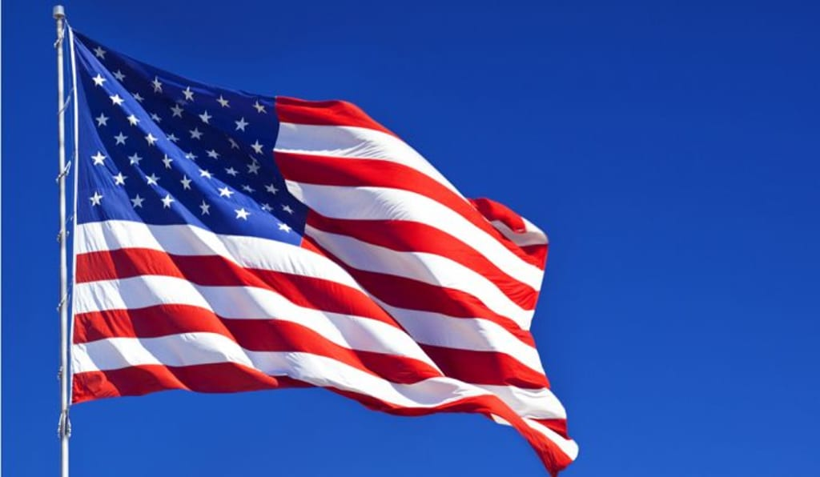
Washington, D.C.

Slide 2
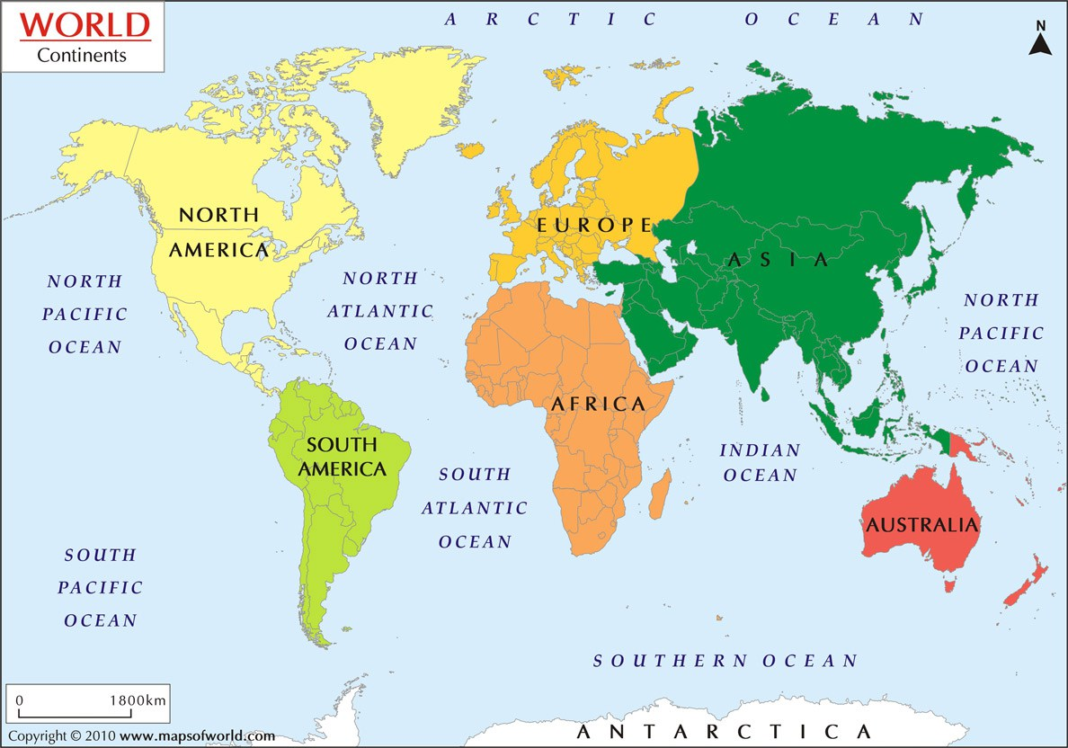

Slide 3
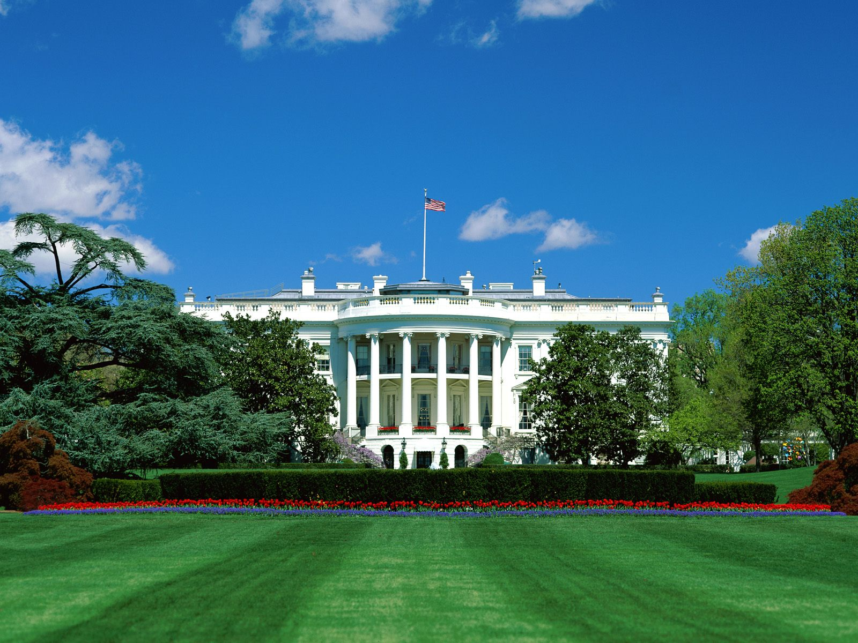
The White House

Slide 4
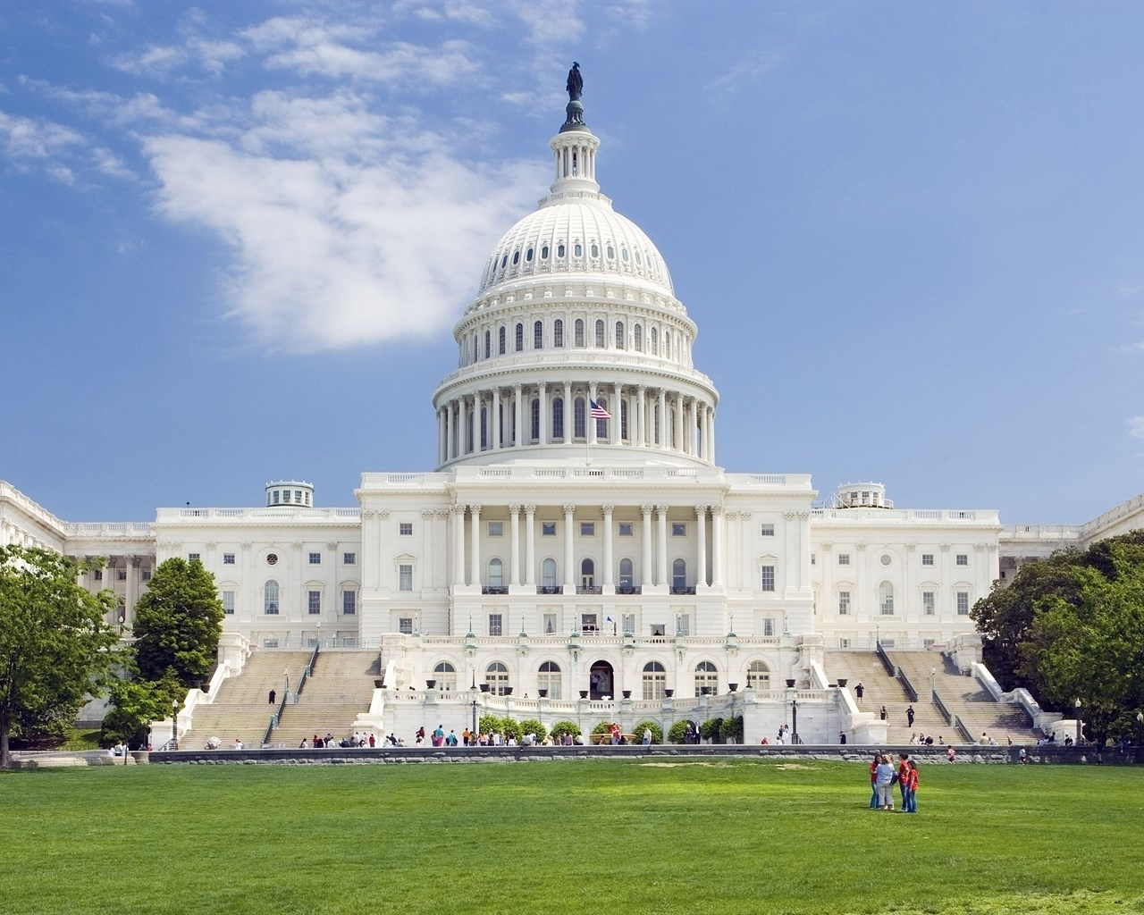
The US Capitol ( the Senate )

Slide 5
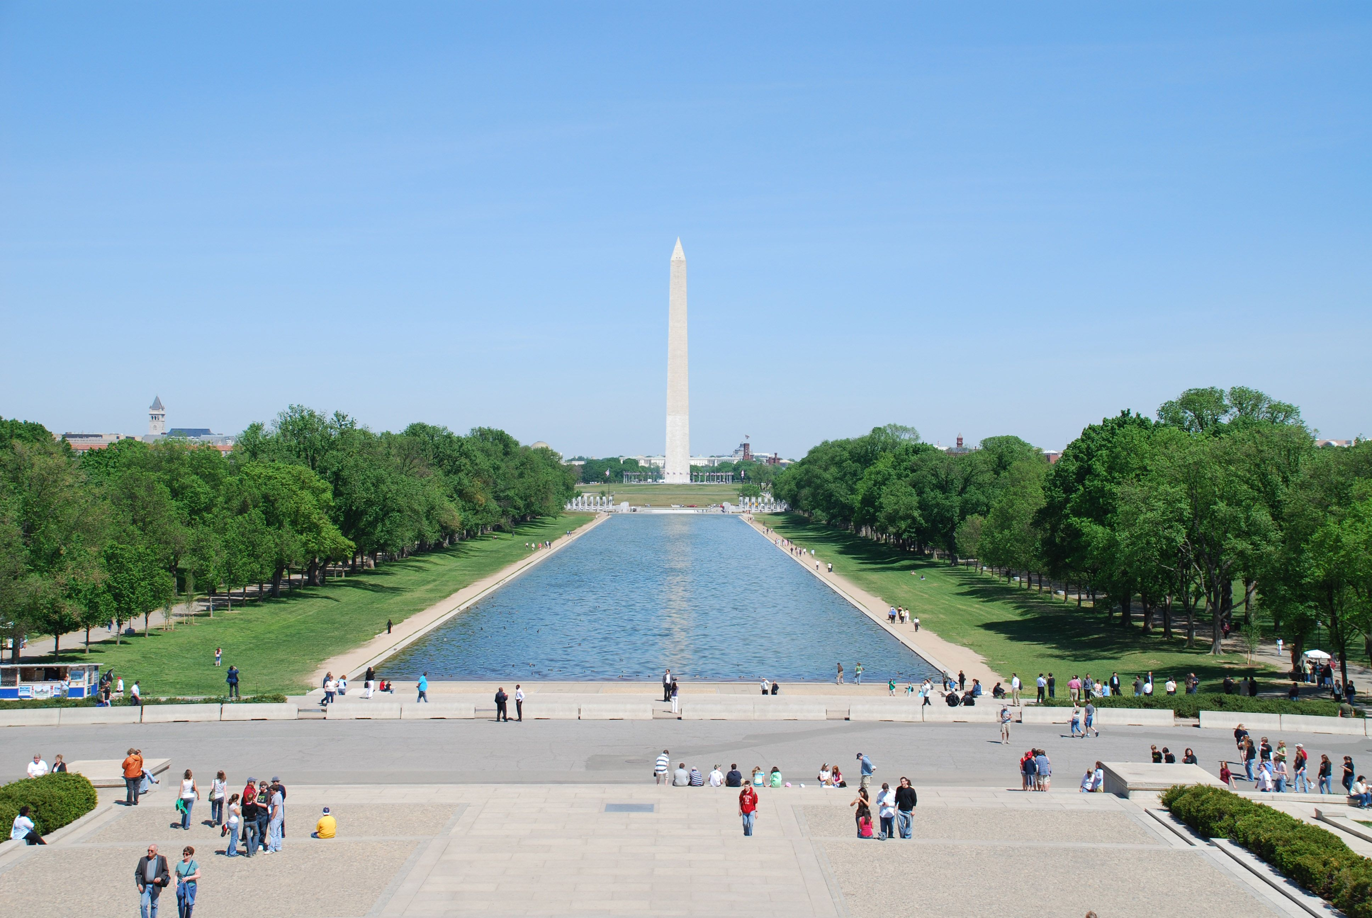
The Washington Monument

Slide 6
Student's Book, page 46.

Slide 7
Vocabulary
monument - споменик
public holiday - државни празник
Independence Day - Дан независности
fireworks - ватромет
celebration - прослава

Slide 8
Fill in the missing words:
fireworks holiday celebration concerts Americans
It is a public ______ - Independence Day.
Many ______ come to the capital to celebrate this day.
They sit on the grass and listen to ______ .
In the evening they watch the ______ .
Uncle Boris can't wait for the ______ .

Slide 9
Fill in the missing words:
It is a public holiday - Independence Day.
Many Americans come to the capital to celebrate this day.
They sit on the grass and listen to concerts .
In the evening they watch the fireworks .
Uncle Boris can't wait for the celebration .

Slide 10
Homework,
S. Workbook, page 51.

Slide 11
Have a great day!

