Slide 1
Christmas in New York City
Student’s book, page 26
Student’s book
Page 26

Slide 2
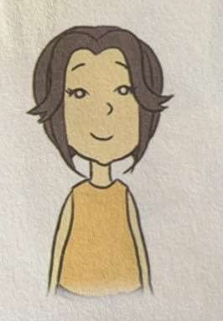
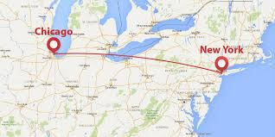
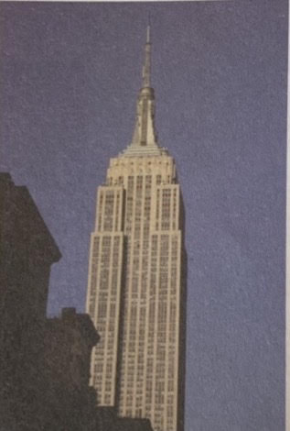
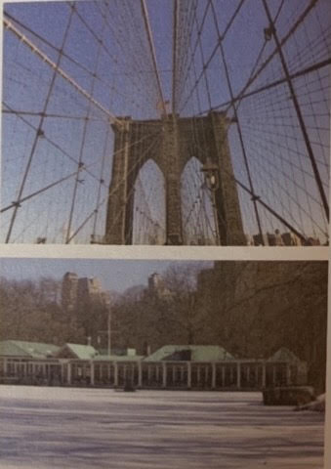

Slide 4
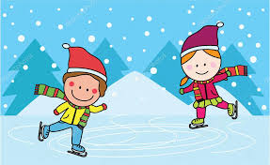
Vocabulary:
East Coast- Источна обала
West Coast- Западна обала
relatives- родбина
midnight- поноћ
ice skating (hobby)
figure skating (sport)

Slide 5
HOMEWORK
Activity book, page 30
Exercises:
2. Write T or F
3. Match the sentence parts

