Slide 1
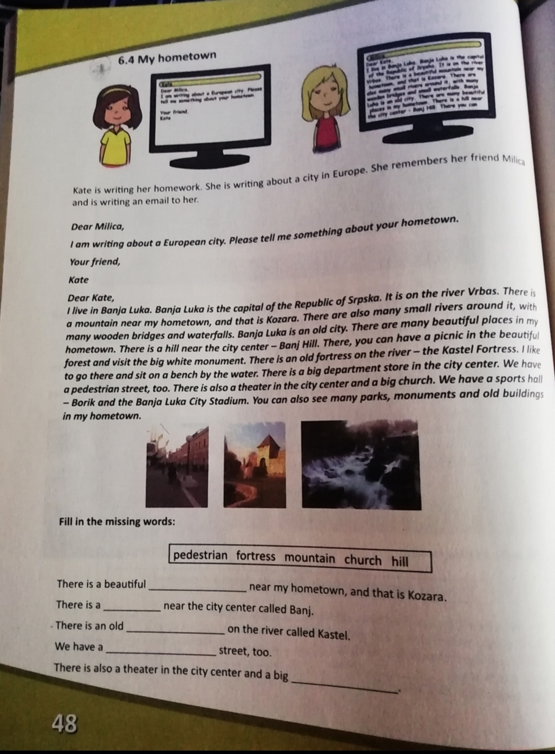
6.4 My hometown

Slide 2
Page 48.

Slide 3
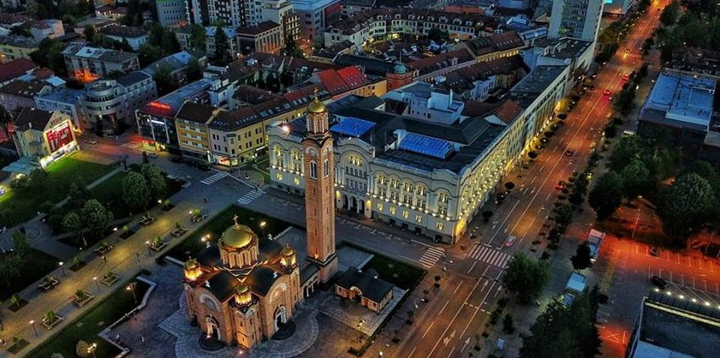
My hometown

Slide 4
Wordlist
Pedestrian - пјешак
Fortress - тврђава
Mountain -планина
Hill - брдо
Church - црква
Monument - споменик
Waterfall - водопад

Slide 5
Pg 48 in SB

Slide 6
Page 48. in S. Book
There is a beautiful mountain near my hometown, and that is Kozara.
There is a hill near the city center called Banj.
There is an old fortress on the river called Kastel.
We have a pedestrian street,too.
There is also a theater in the city center and a big church.

Slide 7
Homework- page 54. in S. Workbook

