Slide 1
3.2 MY LIFE – ONE AND ONLY
Book, page 33

Slide 2
Do you know what “no smoking” means?
Where can you see this sign?
Do you think that many people around you smoke?
How many people of your age do you know who smoke?

Slide 4
New vocabulary
Wind instruments – flute, horn, clarinet, etc.
Hang out – stay out with your friends
Careless – not worried about anything
Cough – we do this when we are ill and breathe heavily
Vietnamese – who or which comes from Vietnam
Realize – understand clearly, get the point
Harmful - bad, which can cause illness
Die – stop living
Martial arts – sports like karate, judo or aikido

Slide 5
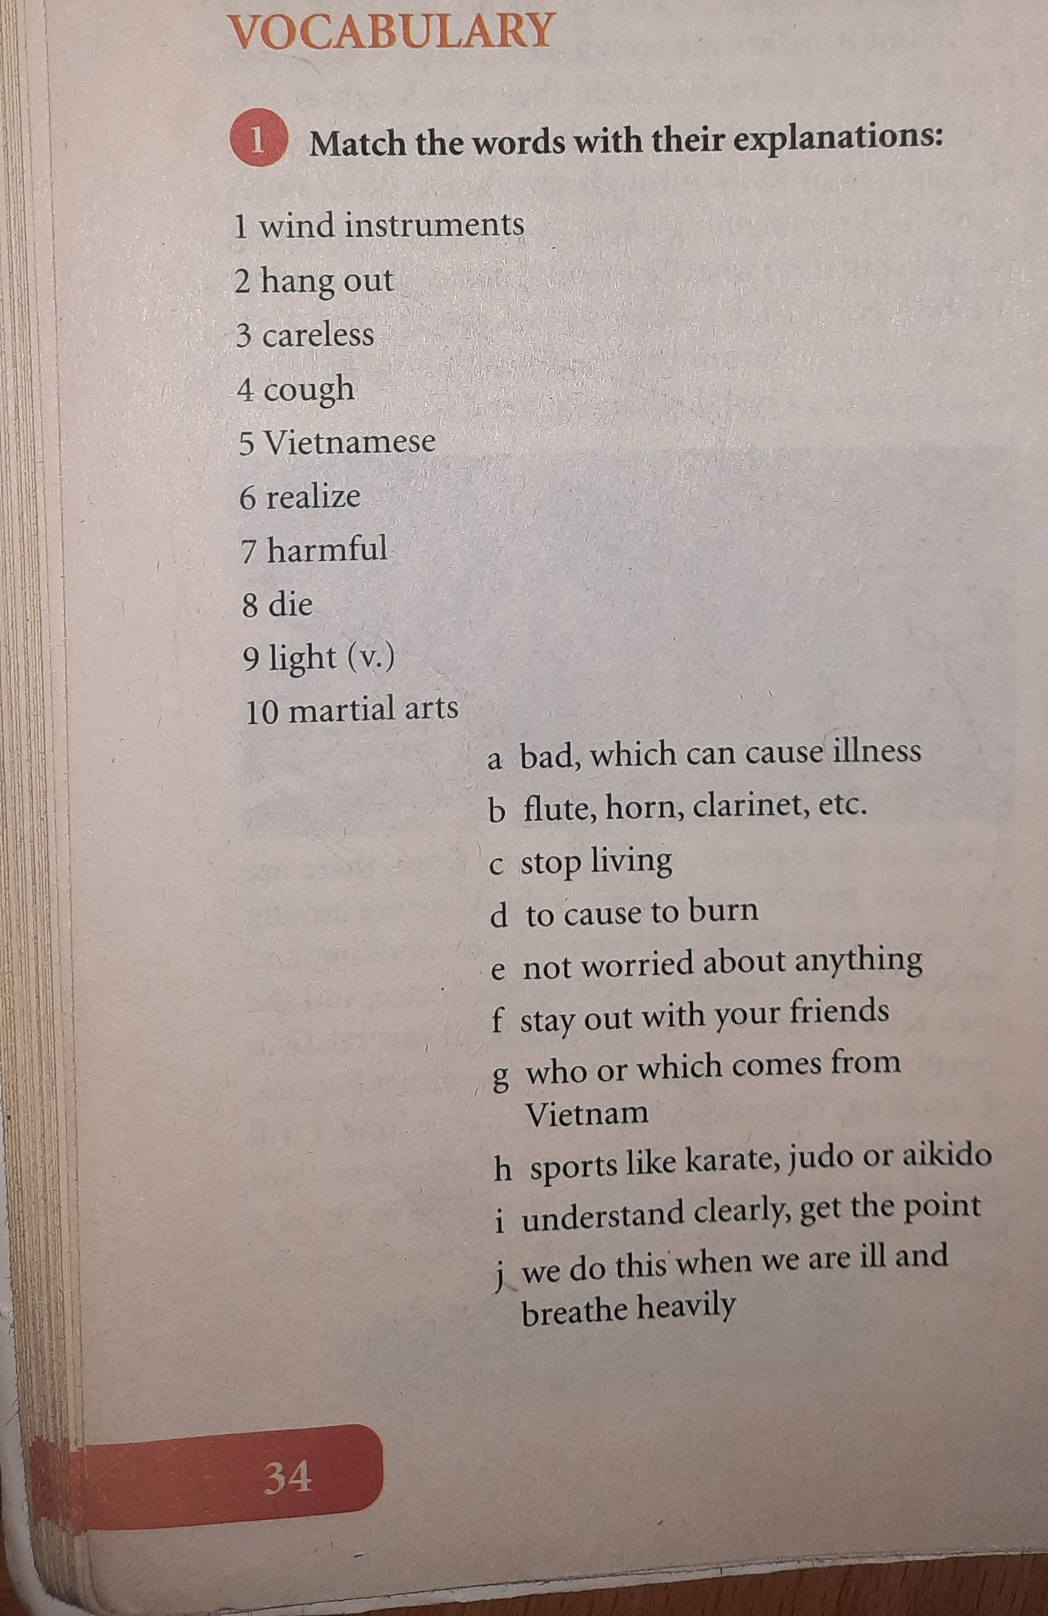
Homework Sb.pg.34 Reading comprehension – answer the questions SB.pg.34 Vocabulary – match the words with their explanations

