Slide 1
REVISION
Tenses (past simple and present perfect)
Modal verbs (can / could)
Numbers ( years)

Slide 2
PAST SIMPLE
PRESENT PERFECT

Slide 3
SB. pg. 25 ex. GRAMMAR 1 Look at the examples. Then put the verbs in brackets in the correct form. Use Present Perfect Simple or Past Simple:
Some people believe that people were (be)happier in the past. – finished action
Nowadays, many old traditions have disappeared (disappear). – unfinished action
In the days of old, people ______ (write)letters almost everyday.
The way that people live __________ (change) a lot in the last few decades.
It is sad that some people ____________ (forget) about spending time with family.
Last year, children ________ (spend)many hours on the internet.
Many people __________ (buy) e-books recently.
Last week, my neighbor ________ (decide)to move to Italy.

Slide 4
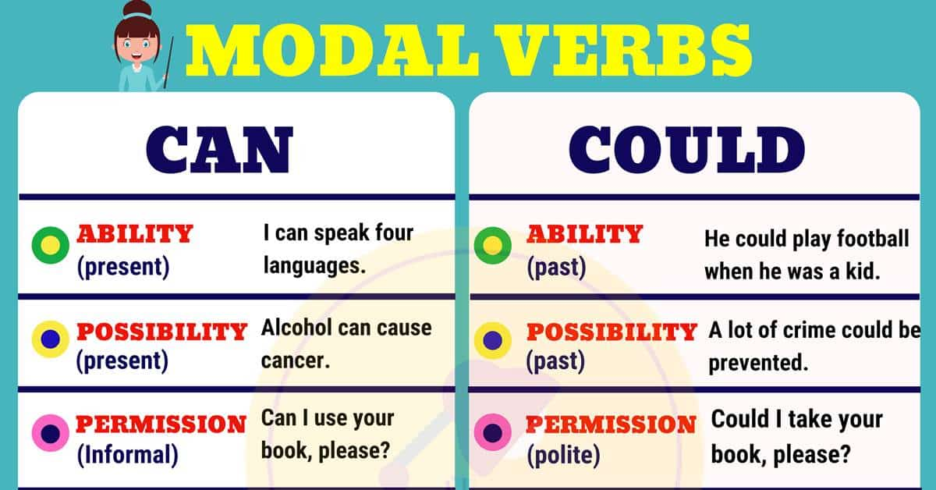
SB pg.26 ex.2 Look at the example. Circle the correct answer:
Nowadays, it can/could sometimes be difficult to find true love.
In the past, people could/can meet other people at social events.
Many centuries ago, it could/can be difficult to travel far.
4. Many decades ago, people can’t / couldn’t find many friends.
5. If you want an answer, you can/could find it in that old book.
6. Many people couldn’t/can’t buy books because they were expensive.
7. Today, people can/could buy e-readers if they travel a lot.
8. today, people can/could find partners online and get married.

Slide 5
YEARS
- 2000
2000 +
19 94 - nineteen ninety four
1998 –
1836 –
1592 –
1673 –
1471 –
2004 – two thousand four
2007 –
2014 –
2020 –

Slide 6
HOMEWORK
SB pg. 25/26 GRAMMAR ex. 1,2 and 3

