Slide 1
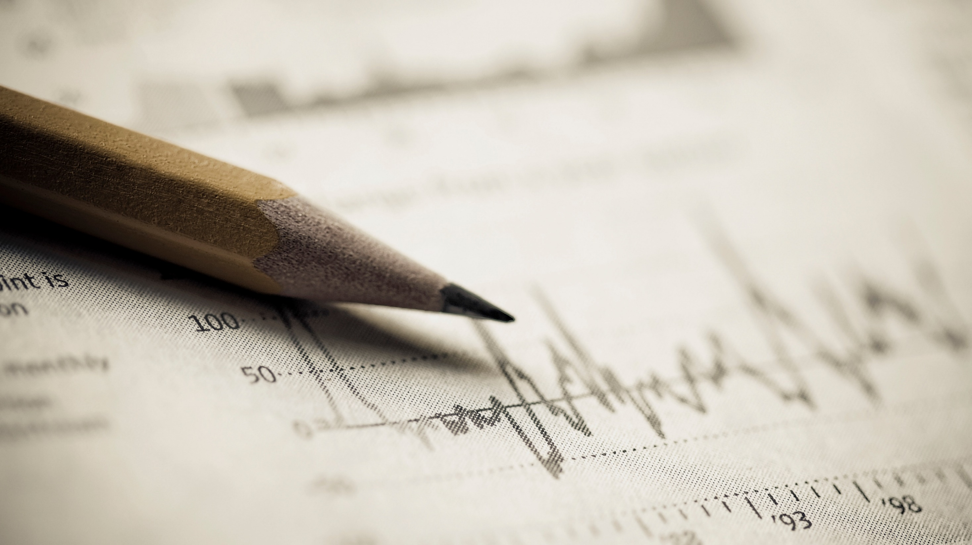
PAST SIMPLE & PAST PROGRESSIVE
Milena Janković

Slide 2
Past Simple Tense: Form
For regular verbs, we add –ED to the base form of the verb
Examples: work + ED → worked
play + ED → played
For irregular verbs, there is a list of irregular verbs.
Examples: go-went
come-came

Slide 3
Questions and negatives
We use auxiliary verb DID to make questions and negatives.
AFFIRMATIVE | INTERROGATIVE | NEGATIVE
Max played football. | Did Max play football? | Max did not play football.
You met John yesterday. | Did you meet John yesterday? | You did not meet John yesterday.

Slide 4
Verb “to be“
The verb to be has two forms in the past: WAS and WERE
AFFIRMATIVE | INTERROGATIVE | NEGATIVE
I was happy. | Was I happy? | I was not happy.
You were late. | Were you late? | You were not late.
It was cold. | Was it cold? | It was not cold.
They were at home. | Were they at home? | They were not at home.

Slide 5
Student’s book, page 28; exercise 1 Grammar
1. Study the examples and complete the sentences. Use Past Simple:
I finished my homework on time.
I didn´t find my History book.
Did you forget Mary´s birthday?
Were you at the cinema last night?
A: When_______ (be) your parents´ anniversary?
B: They _______ (celebrate) it last month.
2 Mr. Davis _______ (live) in Africa a few years ago. Andy _______ (not know) that.
They _______ (decide) to stop the match because the weather _______ (be) bad.
A: _______ (you/buy) a present for Jane´s birthday?
B: Oh, no, I completely ________ (forget) about it.
Where _________ (be) you last night? I _________ (go) to the supermarket.
She _______ (try) to finish her project on time but she ______ (not do) it.

Slide 6
Answers:
A: When was your parents´ anniversary?
B: They celebrated it last month.
2 Mr. Davis lived in Africa a few years ago. Andy didn´t know that.
They decided to stop the match because the weather was bad.
A: Did you buy a present for Jane´s birthday?
B: Oh, no, I completely forgot about it.
Where were you last night? I went to the supermarket.
She tried to finish her project on time but she didn´t do it.

Slide 7
Past Progressive: Form
AFFIRMATIVE S (subject) + was/were + V (verb) + ing | Example: She was cooking all morning.
INTERROGATIVE Was/were + S + V + ing ? | Example: Was she sleeping when you came home?
NEGATIVE S + was/were + not + V + ing | Example: She was not sleeping when I came home.

Slide 8
2. Underline the correct answers:
What was Mr. Davis doing/is Mr. Davis doing last night?
Jane and Kate was/were playing some music at 10 A.M. yesterday.
Steve weren´t/wasn´t expecting any guests last night.
We aren´t/weren´t cleaning the house yesterday morning.
Mr. Davis is talking/was talking on the phone 1 hour ago.
Were they waiting/Was they waiting for us yesterday?

Slide 9
Answers:
What was Mr. Davis doing/is Mr. Davis doing last night?
Jane and Kate was/were playing some music at 10 A.M. yesterday.
Steve weren´t/wasn´t expecting any guests last night.
We aren´t/weren´t cleaning the house yesterday morning.
Mr. Davis is talking/was talking on the phone 1 hour ago.
Were they waiting/Was they waiting for us yesterday?

Slide 10
Past Simple & Past Progressive: Differences
Past Simple | Past Progressive
-action finished in the past (single or repeated) | -action was in progress at a special time in the past
-series of completed actions | -two actions were hapenning at the same time
 | - for background action or description which was interrupted by another past action

Slide 11
SB; page 29; Exercise 3.
Study the examples and use the correct form of the verbs in brackets.
I got up at seven and then I went to work at 8 o´clock.
Andy was going to school when he met Steve.
My sister was cooking lunch, while I was sleeping.
She ____ (listen) to music, while I _____ (clean) the house.
Jane and Kate ______ (talk) when Mr. Davis _____ (come) in.
Mr. Davis _____ (be) sick and he _____ (not go) to work yesterday.
We ______ (watch) the movie when the phone ______ (ring).
A: What _____ (you/do) at 8 last night? B: I _____ (prepare) dinner.
Mrs. Richards _____ (paint) her room when she _______ (fall) down. Luckily, she _____ (not break) anything.
I _____ (take) a shower when I _____ (hear) the doorbell. My guests _____ (arrive) earlier.
I _____ (come) to the office and then I _____ (check) my e-mails
He _____ (check) her mail when Jim _____ (arrive) in Athens.
We ______ (write) while our teacher _____ (talk) all morning yesterday.

Slide 12
She was listening to music, while I was cleaning the house.
Jane and Kate were talking when Mr. Davis came in.
Mr. Davis was sick and he didn´t go to work yesterday.
We were watching the movie when the phone rang.
A: What were you doing at 8 last night? B: I was preparing dinner.
Mrs. Richards was painting her room when she fell down. Luckily, she didn´t break anything.
I was taking a shower when I heard the doorbell. My guests arrived earlier.
I came to the office and then I checked my e-mails
He was checking her mail when Jim arrived in Athens.
We were writing while our teacher was talking all morning yesterday.

Slide 13
HOMEWORK
Activity book, page 20
Exercise 2 – Complete the table.
Exercise 3 – Use the sentences from the table in exercise 2 and complete the text.

