Slide 1
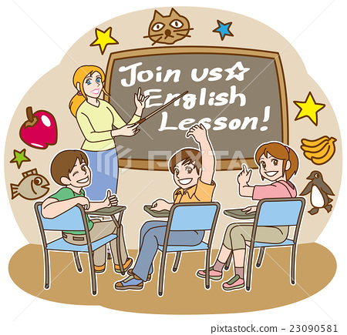
A Literature project

Slide 2
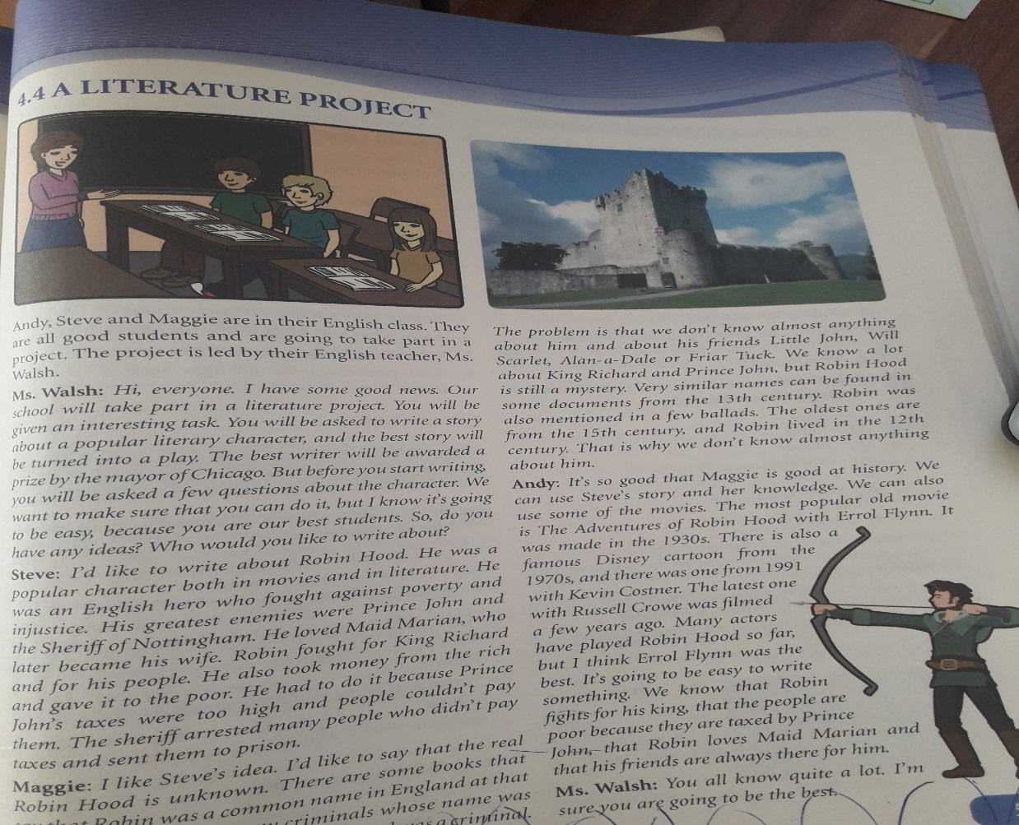
Open your schoolbooks at page 51

Slide 3
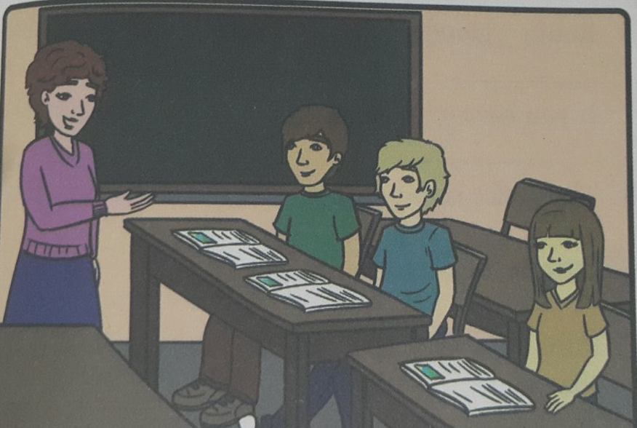
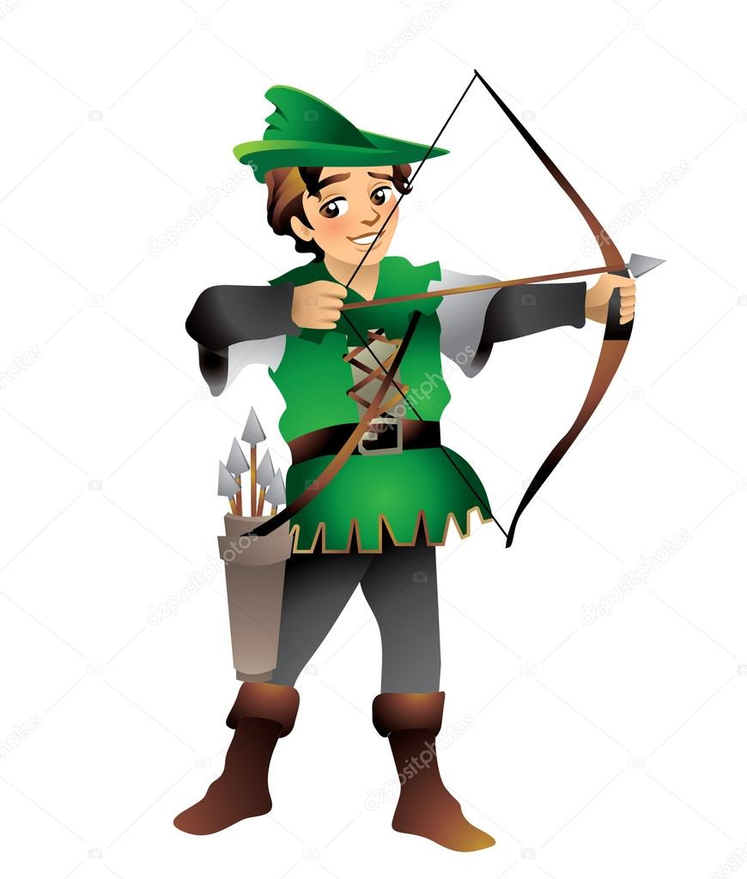
Our students Andy, Steve and Maggie are going to take part in a literature project. They will be asked to write a story about a popular literary character. The best writer will be awarded a prize by the major of Chicago. They agreed to write about Robin Hood.

Slide 4
Robin Hood was an English hero who fought against poverty and injustice. He also took money from the rich and gave it to the poor. He had to do it because Prince John`s taxes were too high and people couldn`t pay them. The sheriff arrested many people who didn`t pay taxes and sent them to prison.

Slide 5
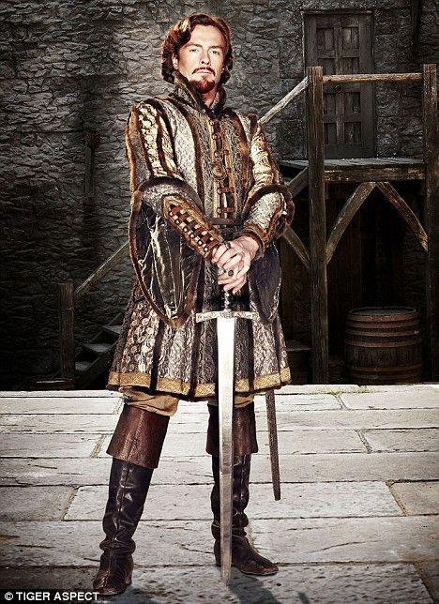
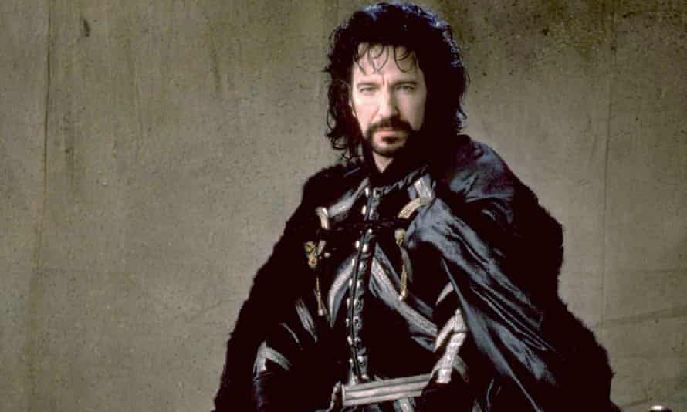
His greatest enemies were Prince John and the Sheriff of Nottingham.

Slide 6
Robin Hood loved Maid Marian who later became his wife.

Slide 7
Vocabulary
play- piece of writing performed in a theater
prize- reward
mayor- person in charge of a town or city
injustice- the situation when people are treated unfairly
arrest- catch someone and take him to the police station
prison- the place where criminals are taken
tax- money given to the state
mention- write or speak about

Slide 8
READING COMPREHENSION Look at text 4.4 again and write true(T) or false(F)
Andy, Steve and Maggie will write a poem about Robin Hood. (F)
Ms.Walsh wants them to write all they know about Robin Hood. (F)
Robin Hood fought against the Sheriff of Nottingham. (T)
Prince John is a well-known history figure. (T)
Robin Hood lived in the 15th century. (F)
Kevin Costner played Robin Hood in the 21st century. (F)
The oldest Robin Hood movie is from 1971. (F)
Andy thinks the project is going to be difficult. (F)

Slide 9
Homework
Write a short story about a well-known literary character from our history and send it to your teacher.

