Slide 1
SHOW AND TELL
THE ENGLISH LANGUAGE FOR THE SIXTH GRADE

Slide 2
1. Do you have a hobby?
2. What do you like to collect or make?
3. How many those things do you have?

Slide 3
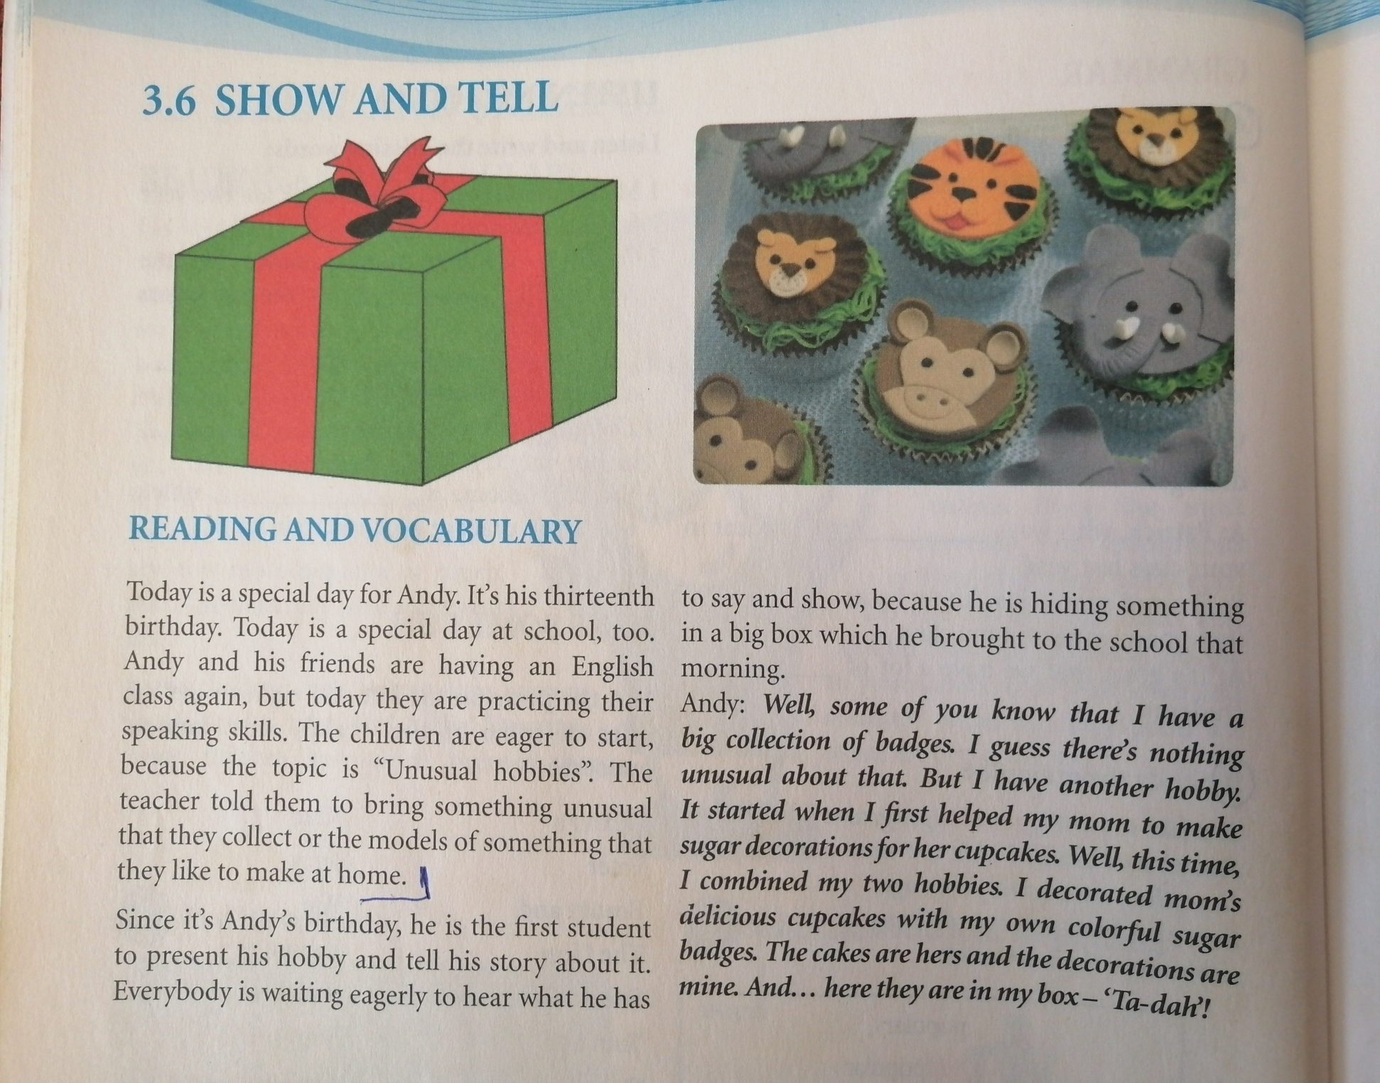

Slide 4
NEW VOCABULARY:
PRACTICE-repeat the same thing many times so that you know how to do it very well (вјежбати)
EAGER- when you want something very much or you can’t wait for something to happen (нестрпљив)
UNUSUAL HOBBY- strange hobby ( необичан хоби )
SINCE- because ( зато што )
HIDE- put somewhere so that others can’t find it
( сакрити )
GUESS- try to say the correct answer ( претпоставити )
CUPCAKE- a kind of cake that we put in small paper cups ( капкејк )
DELICIOUS- very tasty,so good that you want to eat more of it ( веома укусан )

Slide 5
Find the words from the text among these jumbled letters and fill in the blanks.
1. Today, the children are ­­­­_ _ _ _ _ _ _ _ _ _ ( actipringc ) their speaking skills.
2. They are _ _ _ _ _ ( regea ) to start, because the topic is interesting.
3. The topic is unusual _ _ _ _ _ _ _ ( bobeish ).
4. Andy is _ _ _ _ _ _ ( gindih ) something in a big box.
5. He _ _ _ _ _ _ _ ( htrobug ) that box to the school earlier that morning.
6. The children are trying to _ _ _ _ _ ( sgeus ) what he has in the box.
7. His mom made _ _ _ _ _ _ _ _ ( scakecup ) for his friends.
8. Andy _ _ _ _ _ _ _ _ _ ( coratdeed ) mom’s cakes.
9. He made colorful sugar _ _ _ _ _ _ ( sbadeg ).
10. The cupcakes are _ _ _ _ _ _ _ _ _ ( lidceious ).

Slide 6
Find the words from the text among these jumbled letters and fill in the blanks.
1. Today, the children are ­­­­practicing ( actipringc ) their speaking skills.
2. They are eager ( regea ) to start, because the topic is interesting.
3. The topic is unusual hobbies ( bobeish ).
4. Andy is hiding ( gindih ) something in a big box.
5. He brought ( htrobug ) that box to the school earlier that morning.
6. The children are trying to guess ( sgeus ) what he has in the box.
7. His mom made cupcakes ( scakecup ) for his friends.
8. Andy decorated ( coratdeed ) mom’s cakes.
9. He made colorful sugar badges ( sbadeg ).
10. The cupcakes are delicious ( lidceious ).

Slide 7
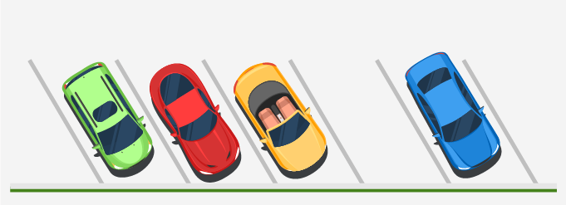
Cardinal numbers
The numbers which give us the exact quantity of an object are called cardinal numbers. In other words, cardinal numbers answer “How many?”
For example: The given picture shows 4 cars in a parking lot. So, 4 or ‘four’ here is a cardinal number.

Slide 8
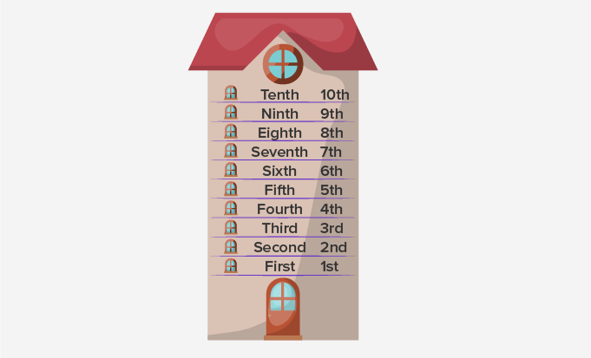
Ordinal numbers
The numbers which give us the exact position of an object are called ordinal numbers. Ordinal numbers tell the position of an object rather than their quantity.
For example:
The given picture shows different floors in a building. We can use ordinal numbers to define their position.
The numbers 1st(First), 2nd(Second), 3rd(Third), 4th(Fourth), 5th(Fifth), 6th(Sixth), 7th(Seventh), 8th(Eighth), 9th(Ninth) and 10th(Tenth) tell the position of different floors in the building. So, all of them are ordinal numbers. Before ordinal numbers we always put the definite article THE.

Slide 9
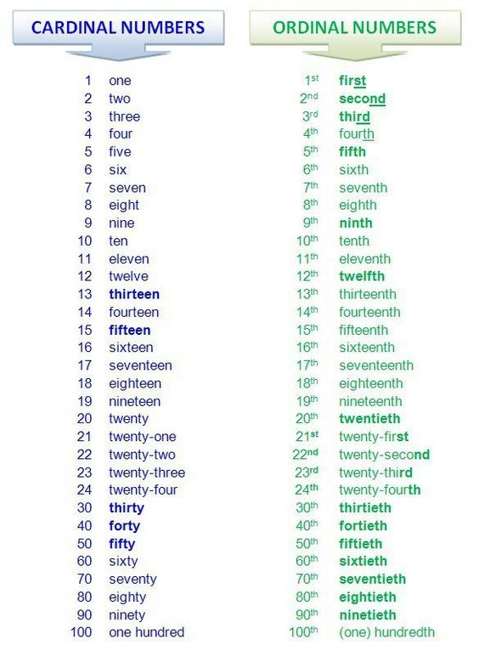
Comparison Chart: Ordinal Numbers v/s Cardinal Numbers
Fun Fact-
• 11, 12 and 13 are the only numbers to use a suffix ‘–th’ but all other numbers ending with 1 use ‘–st’, 2 use ‘–nd’ and 3 use ‘–rd’.
11, 12 and 13 are the only numbers to use a suffix ‘–th’ but all other numbers ending with 1 use ‘–st’, 2 use ‘–nd’ and 3 use ‘–rd’.

Slide 10
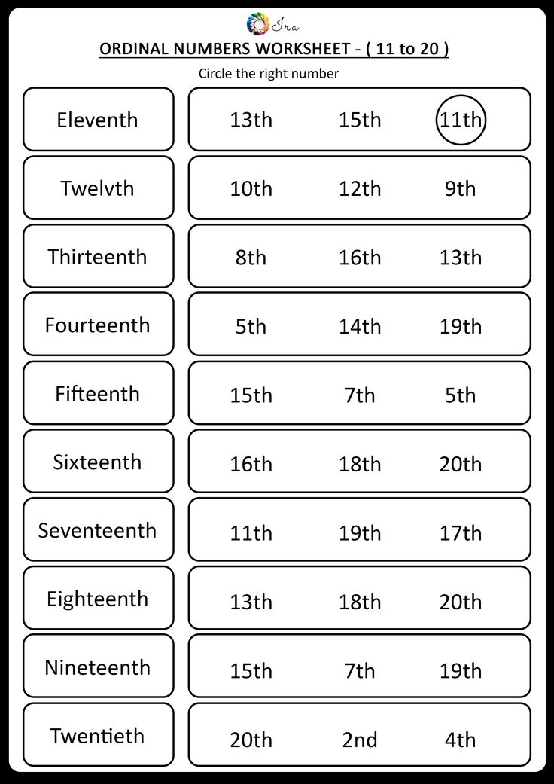
FOR YOUR HOMEWORK

