Slide 1
The scent of jasmine
- VOCABULARY
smell
perfume
SCENT
fragrance
odor
nose
aroma
Student’s book, page 54

Slide 2
The scent of jasmine
-VOCABULARY
detailed
VIVID
bright
clear
realistic
Student’s book, page 54

Slide 3
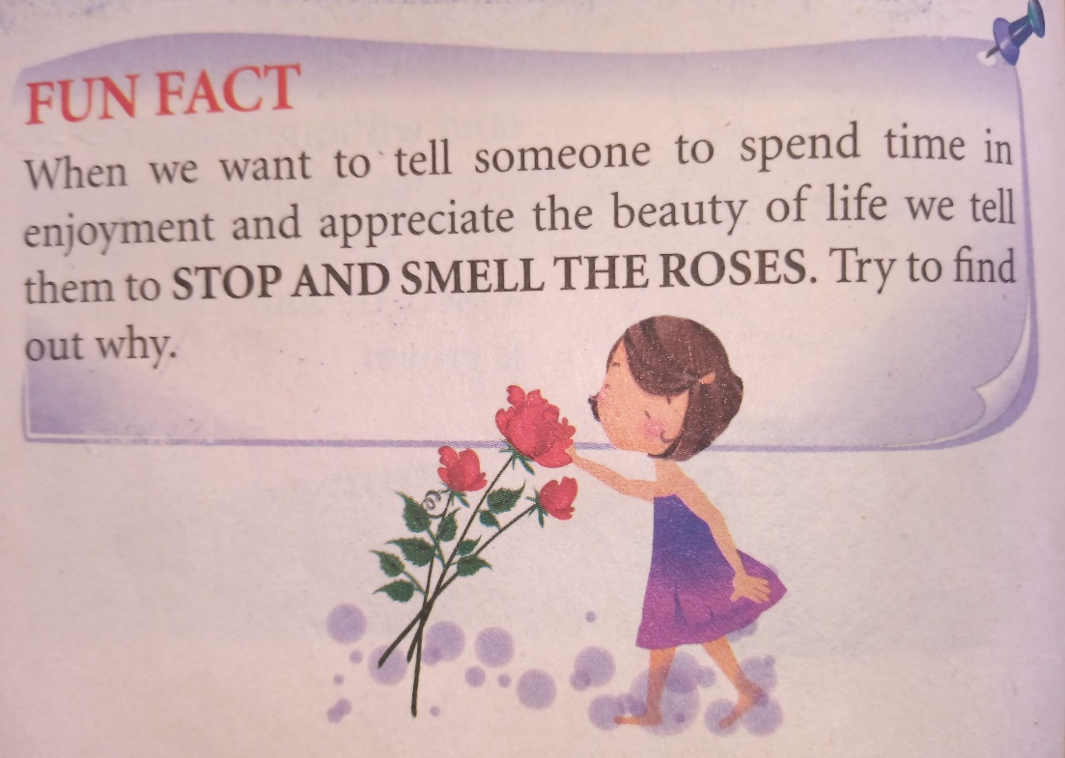
The scent of jasmine
-VOCABULARY
Stop and smell the roses is a common English expression that can be used as friendly advice to someone who may be working too much or too hard.
Student’s book, page 56

Slide 4
Home is where the heart is
-VOCABULARY
glad
JOVIAL
cheerful
happy
merry
Student’s book, page 57

Slide 5
Home is where the heart is
-VOCABULARY
open
ESTABLISH
launch
found
set up
Student’s book, page 57

Slide 6
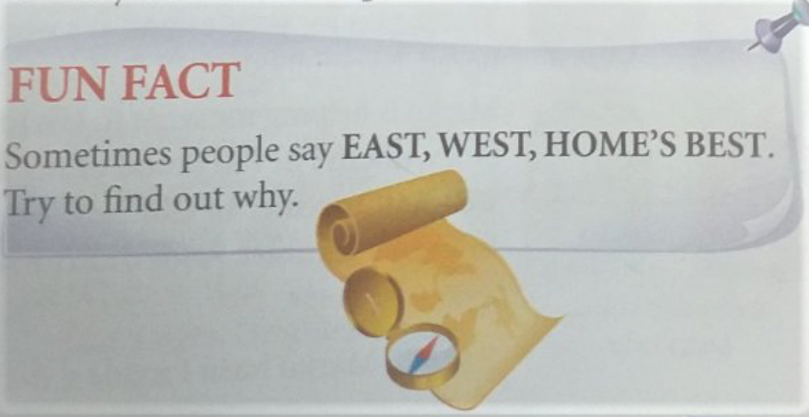
Home is where the heart is
-VOCABULARY
Home is the best or most ideal place to be, regardless of its physical location.
Student’s book, page 59

Slide 7
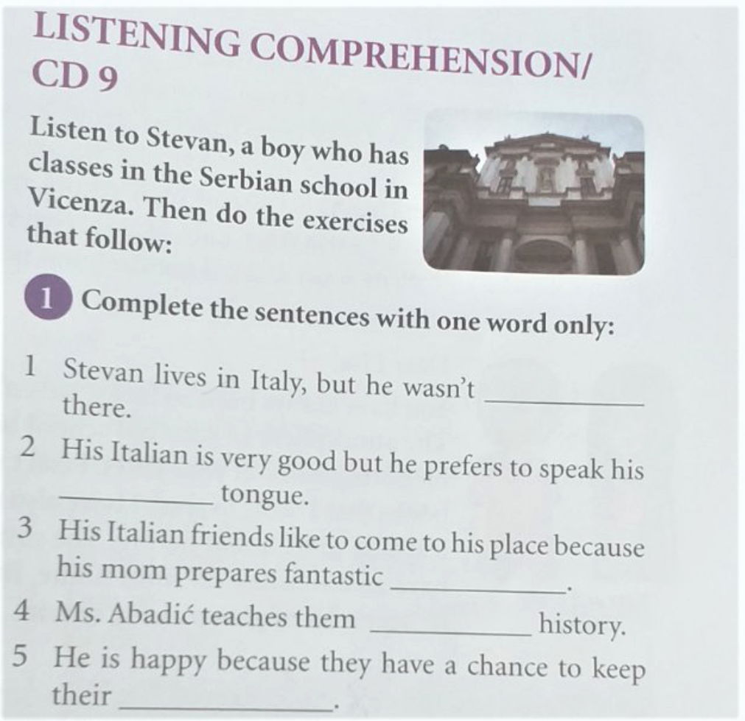
Listening, page 59
Home is where the heart is
born
mother
dishes
Serbian
tradition

Slide 8
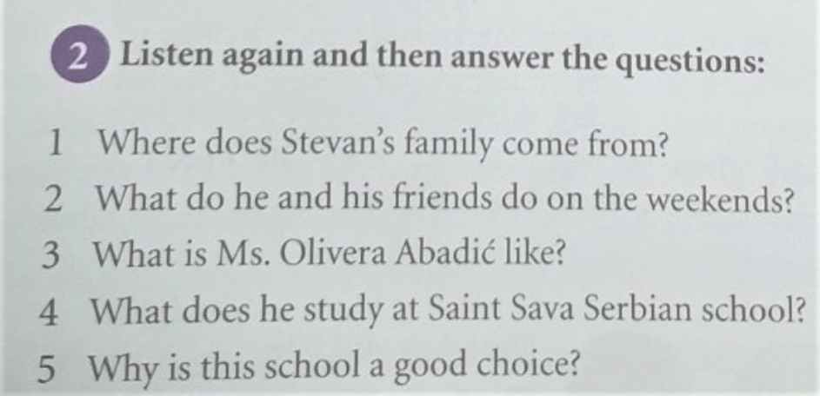
Listening, page 59, exercise 2 for homework
Home is where the heart is

Slide 9
Home is where the heart is
SPEAKING
PAIR/GROUP WORK
Imagine you are visiting Serbian students born in Italy. Talk to them about a famous Serbian writer or some event from Serbian history.
*Use eNastava, Viber, cell phone record your dialog and send it to your teacher.
Student’s book, page 59

Slide 10
HOMEWORK
LISTENING COMPREHENSION: Exercise 2: answer the questions and send them to your teacher. Student’s book, page 59
DIALOG - PAIRS/GROUPS: record a dialog and send it to your teacher. Student’s book, page 59
Useful sites/media:
enastava.skolers.org, Viber, Cell phone
https://www.thefreedictionary.com

