Slide 2
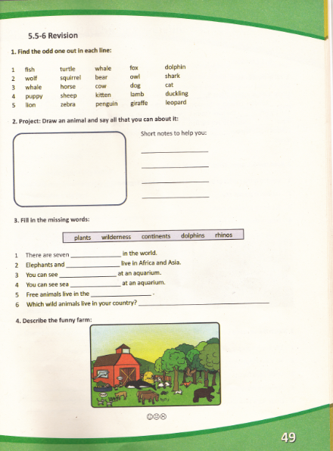

Slide 3
Find the odd one out in each line.
1 fish turtle whale fox dolphin
2 wolf squirrel bear owl shark
whale horse cow dog cat
puppy sheep kitten lamb duckling
5 lion zebra penguin giraffe leopard
fox
shark
whale
sheep
penguin

Slide 4
3. Fill in the missing words:
plants wilderness continents dolphins rhinos
There are seven .................. in the world.
Elephants and ................ live in Africa and Asia.
You can see .................. at an aquarium.
You can see sea ....................... at an aquarium.
Free animals live in the ........................... .
Which wild animals live in your country?............................

Slide 5
Answers
There are seven continents in the world.
Elephants and rhinos live in Africa and Asia.
You can see dolphins at the aquarium.
You can see sea plants at an aquarium.
Free animals live in the wilderness.
Bears, foxes, wolves, squirrels, skunks, owls, rabbits....

Slide 6
Homework
Draw your favorite animal and write what you know about it. Send your homework to your teacher.
( Нацртај своју омиљену животињу и напиши шта знаш о њој. Пошаљи задаћу својој наставници. )

Slide 7
For example: ( На примјер:)
My favorite animal is a dolphin. Dolphins live in seas, oceans or aquariums. They eat fish. They don’t have legs. They are big and friendly. They are very intelligent and playful.

