Slide 1
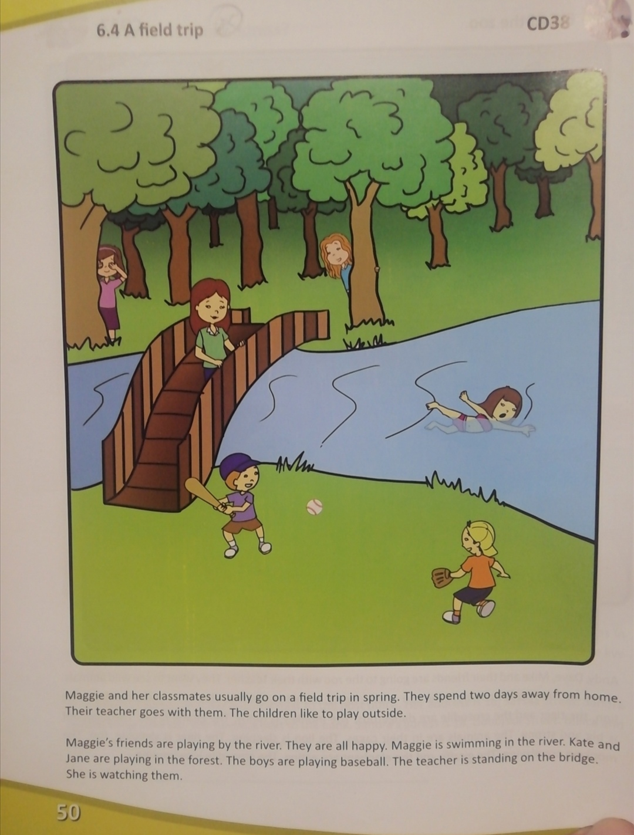
6.4 A field trip
mhg

Slide 2
Maggie and her classmates usually go on a field trip in spring. They spend two days away from home. Their teacher goes with them. The children like to play outside. Maggie’s friends are playing by the river. They are all happy. Maggie is swimming in the river. Kate and Jane are playing in the forest. The boys are playing baseball. The teacher is standing on the bridge. She is watching them.
Pg. 50 in SB

Slide 3
WORDLIST
Field trip – excursion
Away from home - they are not at home
River
Forest
Bridge

Slide 4
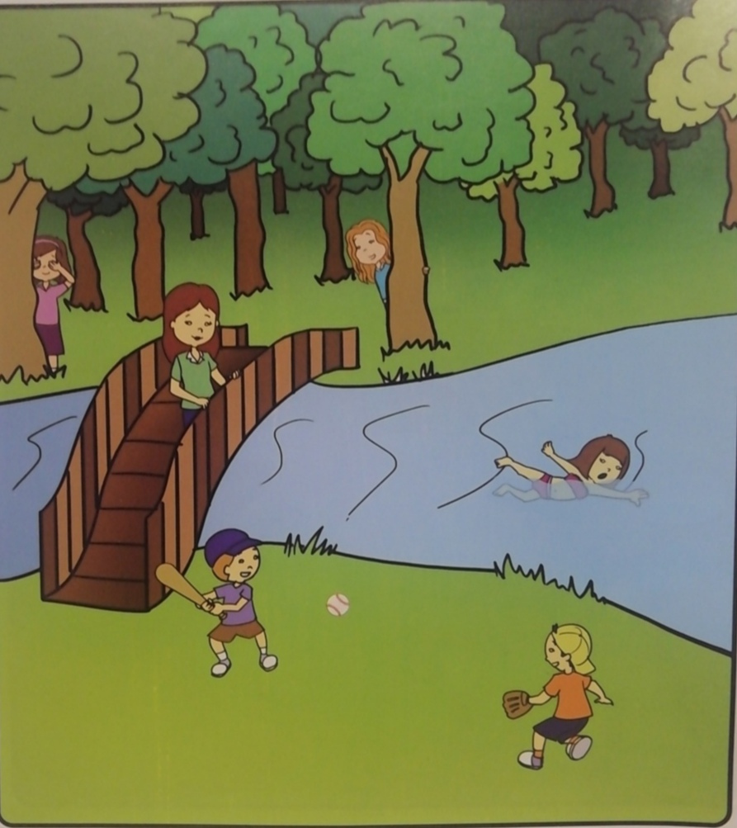

Slide 5
HOMEWORK
Exercise 2 in AB, page 54
(Задатак 2, страна 54, радна свеска)

