Slide 1
PAST PERFECT TENSE-REVISION

Slide 2
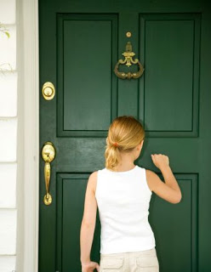
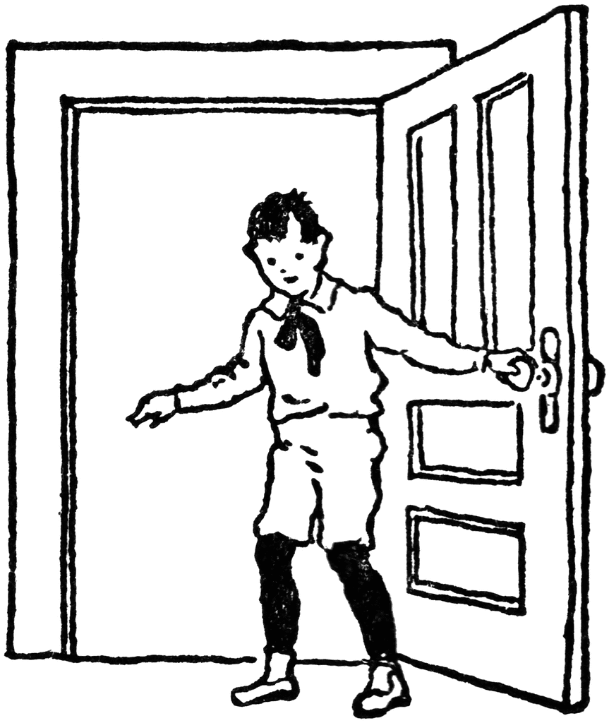
2 different events at 2 different times in the past.
One event ends before the second event happens.
Adam left the apartment.
Diana knocked on the door.
Past Perfect: Adam had left the apartment when Diana knocked on the door.

Slide 3
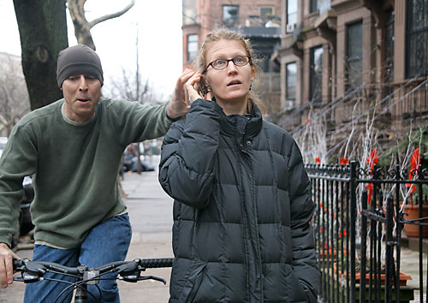
Ariel called her mother.
A cyclist grabbed her phone.
Past Perfect: Ariel had called her mother when a cyclist grabbed her phone.

Slide 4
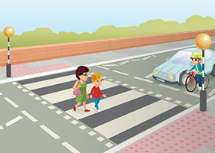
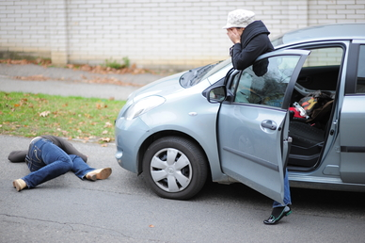
We crossed the road.
A car hit a pedestrian.
Past Perfect: We ___________ …………………..
Past Perfect: We had crossed the road when a car hit a pedestrian.
OR
Past Perfect: We had crossed the road before a car hit a pedestrian.

Slide 5
We USE IT for:
TIME EXPRESSIONS, such as:
when
I had eaten the cake, when he came home with presents.
after
After Ana had finished her work, she went to lunch.
before
Jane had finished her book before John came to see her.
already
They had already completed the task when he arrived

Slide 6
My cat spilled the coffee.
I drank coffee.
Which do you think happened first?
Past Perfect: I had drunk the coffee when my cat spilled it.

Slide 7
I had not been at home when the letters arrived.
With NEVER
I had never been to France before.
I had never seen anyone like her.

Slide 8
Exercise: Write the sentences using the words in brackets:
1. There was a picture lying on a floor.
It /fall/ off/the/ wall
2. The people sitting next to you on the plane were nervous.
They/ never/fly/before.
3. You went back home recently after many years. It wasn’t the same as before.
It /change / a lot
4. Somebody sang a song. You didn’t know it.
You/not/ hear /it/before
5. I met Daniel last week. It was good to see him again after such a long time
I /not/ see/ him/ for five years
6. Last year we went to Mexico. It was our first time there.
We /not/ be /there/ before
7. I offered my friends something to eat, but they weren’t hungry.
They/ just / have/ lunch.
8. I invited Marko to the party, but he couldn’t come.
He /arrange/ to do something else

Slide 9
Exercise: Write the sentences using the words in brackets:
1. There was a picture lying on a floor.
It /fall/ off/the/ wall It had fallen off the wall.
2. The people sitting next to you on the plane were nervous.
They/ never/fly/before. They had never flown before.
3. You went back home recently after many years. It wasn’t the same as before.
It /change / a lot It had changed a lot.
4. Somebody sang a song. You didn’t know it.
You /not/ hear /it/before. You hadn’t heard it before.
5. I met Daniel last week. It was good to see him again after such a long time
I/not/see him/for five years. I hadn’t seen him for five years.
6. Last year we went to Mexico. It was our first time there.
We /not/ be /there/ before. We hadn’t been there before.
7. I offered my friends something to eat, but they weren’t hungry.
They/ just / have/ lunch. They had just had lunch.
8. I invited Marko to the party, but he couldn’t come.
He/arrange/to do something else. He had arranged to do something else.

Slide 10
HOMEWORK:
WB. Pg 23. exercise 4
24 ,exercise 5

