Slide 1
MYSTERY PERSON
?
- Profession : deliver packages
- Period af activity : winter holidays
- Citizenship : unknown , there are rumours it is Laponia
- Residence : somewhere in the north
- Partners : elves
- Distinguishing marks : fat , red clothes , white beard

Slide 2
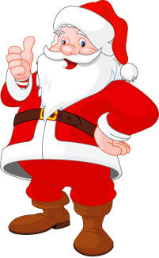
SANTA CLAUS

Slide 3
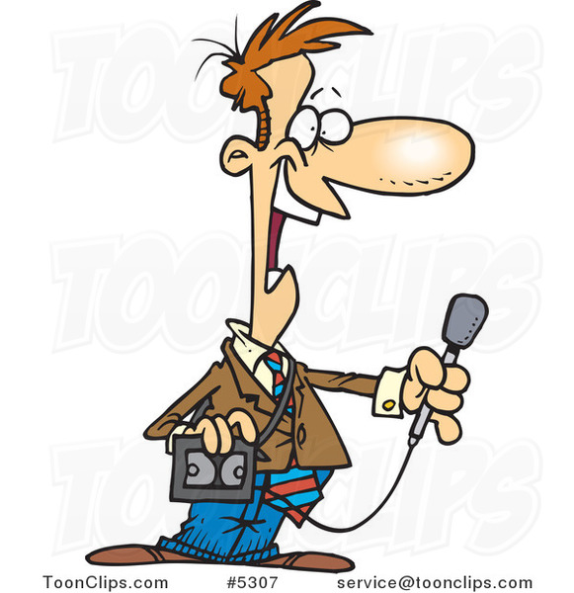
Our special reporter in Laponia had an interview with Santa Claus
Hello,I am pretty buisy at the moment,you know,with these winter holidays.
Hello Santa, how are things going?

Slide 4
Sorry, I can’t tell you that. Let’s just say that my friends call me Nick.
Can you tell us your real name ?

Slide 5
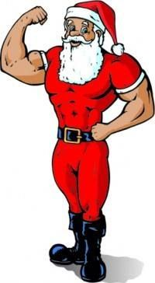
Not really, I used to be fit when I was younger but then I started to eat a lot of sweets and this is the result.
Did you always look like this ?

Slide 6
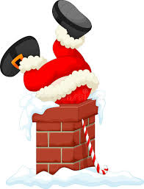
Chimneys were good in the past , but now these designers of new buildings don’t think about me,so I simply knock on the door or go through the window if possible .
How do you deliver your presents, through chimney or do you have other ways?

Slide 7
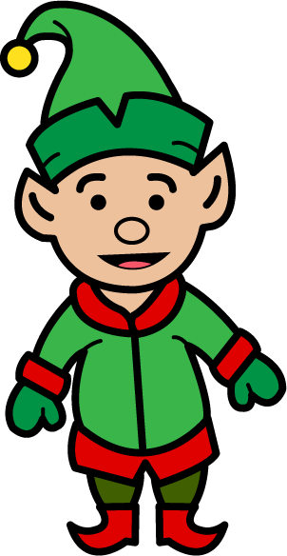
I have a lot of my elf buddies who help me a lot,especially during winter holidays.
Your job is pretty difficult, do you have any assistants?

Slide 8
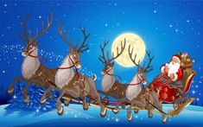
No way, they are still the fastest ride on the globe.There’s no airplane that can stand a chance against my raindeers.
Did you consider replacing your raindeers and sleigh, they are quite old?

Slide 9
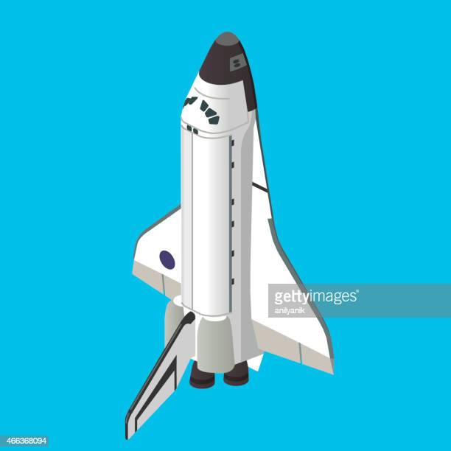
If you only knew how many letters did I receive with requests such as real space shuttle or an elephant, I am sure their parents would disagree.
Children sometimes don’t get what they asked in their letters,why?

Slide 10
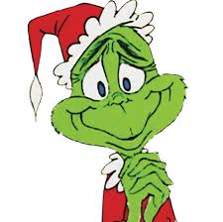
No,on the contrary , I am considering giving him a job as my assistant because he turned out to be a very nice chap.
What about Grinch , is he making any troubles again?

Slide 11
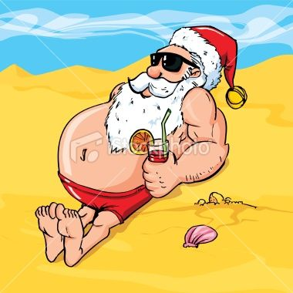
Well it’s not so bad, I try to relax and to prepare myself for the winter.
You are working during winter holidays, how do you spend your time during the rest of the year ?

Slide 12
You are welcome, and you will get your present only if you keep up being a good boy.
Thank you Santa for this interview,I hope you will bring me a present.

Slide 13
