Slide 1
7th grade MUCH/MANY - MORE - THE MOST
4.2 EATING HABITS

Slide 2
IRREGULAR COMPARISON OF ADJECTIVES
Positive: Comparative: Superlative:
much/many more the most
We use many with plural countable nouns (books, dogs, pencils)
We use much with uncountable nouns (sugar, water, flour)

Slide 3
Examples:
There are many people in England, more people in India, but the most people live in China.
We don't have much time left so let's go soon.
Many people use the Internet and more people join every year.
I don't have many books.
I don’t have much work to do.
He has the most free time.

Slide 4
Exercise 1 – write much or many:
1 Do you know _____________ words in English?
2 He didn’t eat ____________ meat.
3 There isn’t ____________ butter in the fridge.
4 How ___________ lessons do you have on Mondays?
5 There was too __________ noise in the street.
6 I cannot see __________ stars in the sky tonight.

Slide 5
Exercise 1 – write much or many – key:
1 Do you know ____ many ___ words in English?
2 He didn’t eat ___ much ____ meat.
3 There isn’t ____ much __ butter in the fridge.
4 How __ many ____ lessons do you have on Mondays?
5 There was too __ much ___ noise in the street.
6 I cannot see __ many ___ stars in the sky tonight.

Slide 6
SB, p. 45, ex. 2: write many or much, more or the most to complete the sentences:
1 There aren’t _________ cooks in this hotel.
2 Who has _________ DVDs, Mike or Steve?
3 There are _______ TV channels now than last year.
4 Of all the subjects, children have _________ fun in PE classes.
5 Our club has __________ members of all the sports clubs in the school.
6 Sorry, I don’t have _________ time now. I’ll call you later.

Slide 7
SB, p. 45, ex. 2: write many or much, more or the most to complete the sentences:
1 There aren’t __ many __ cooks in this hotel.
2 Who has __ more __ DVDs, Mike or Steve?
3 There are __ more _ TV channels now than last year.
4 Of all the subjects, children have _ the most_ fun in PE classes.
5 Our club has _ the most _ members of all the sports clubs in the school.
6 Sorry, I don’t have __ much __ time now. I’ll call you later.

Slide 8
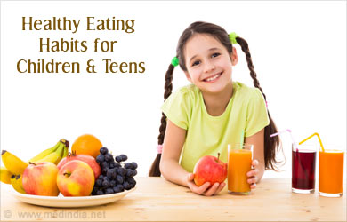
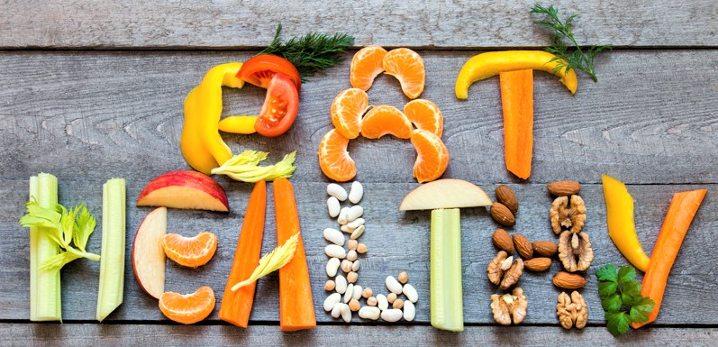
4.2 eating habits (SB, p. 44)

Slide 9
Eating habits of kevin, Janice and mark
Kevin: buys hamburgers or cheeseburgers; he doesn’t much time during recesses; his parents work all day long; they don’t have enough time to cook; he eats fast food
Janice: her father has time to cook healthy food; she eats home-made food
Mark: his mom works and doesn’t have enough time for cooking; salad, fat-free; he usually eats ready-made food

Slide 10
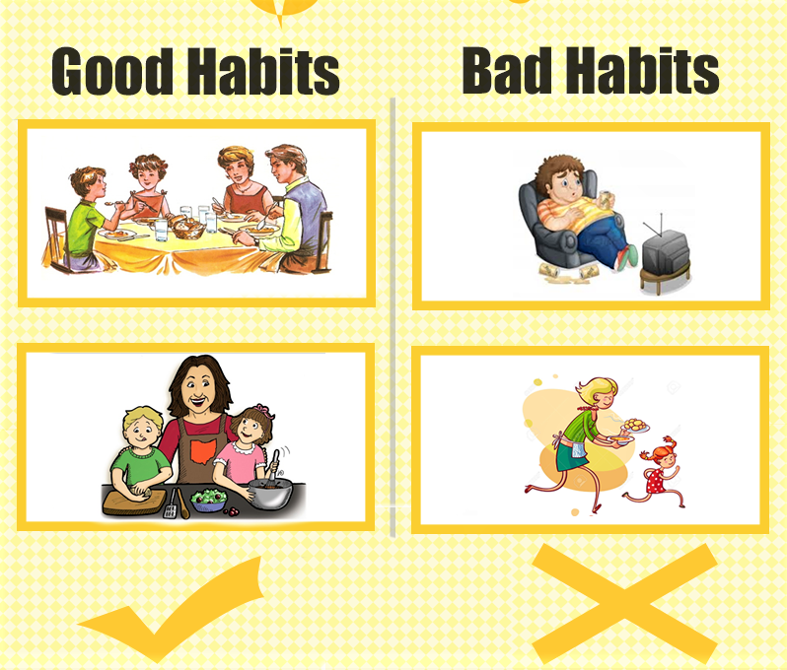
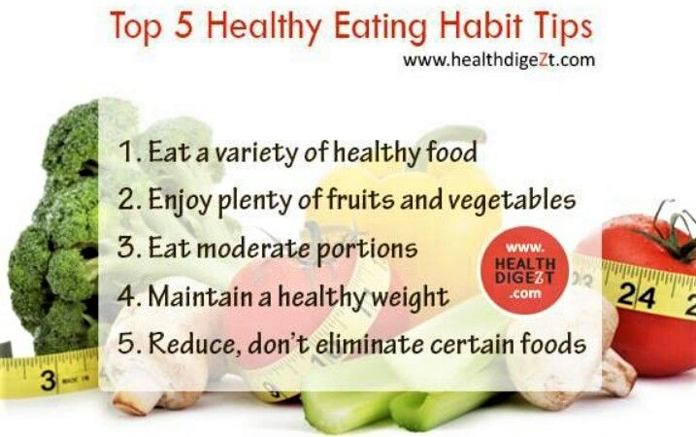
tips

Slide 11
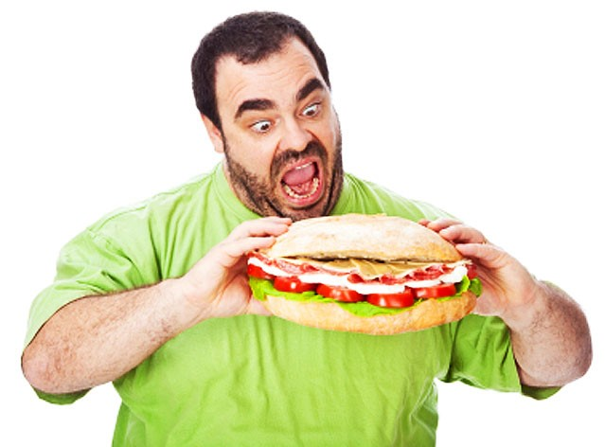
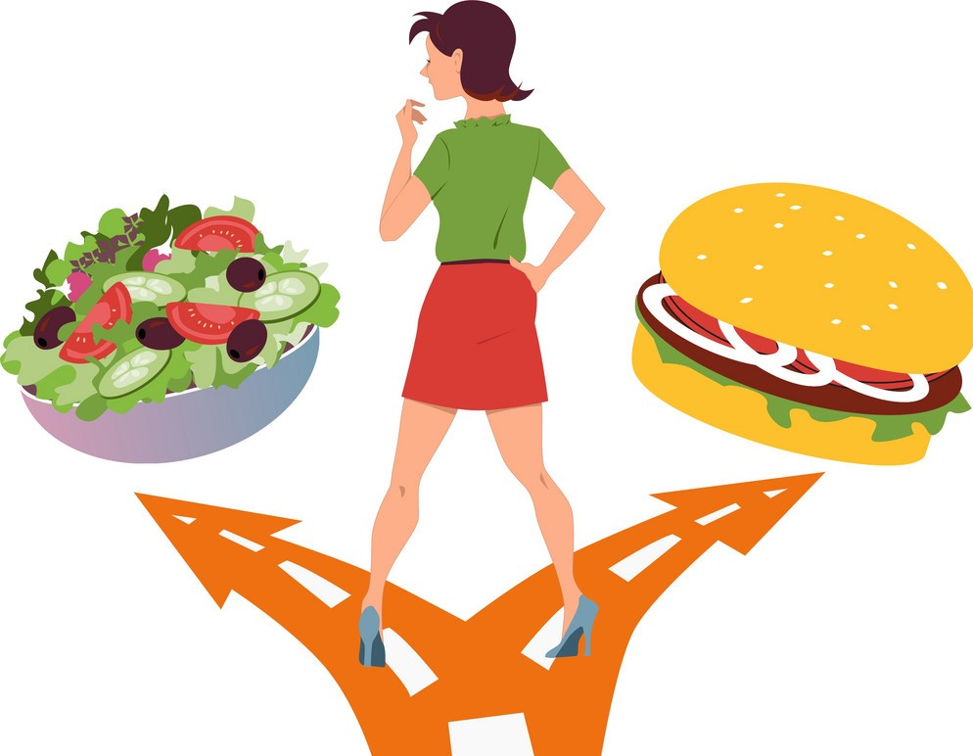
Which of these are your eating habits?

Slide 12
Homework:
1 Read the text 4.2 Eating habits on page 44 in Student’s Book
2 Workbook, page 31, ex. 3 – put the words in brackets into the correct form

Slide 13
Thanks for your attention

