Slide 1
Revision: My home

Slide 2
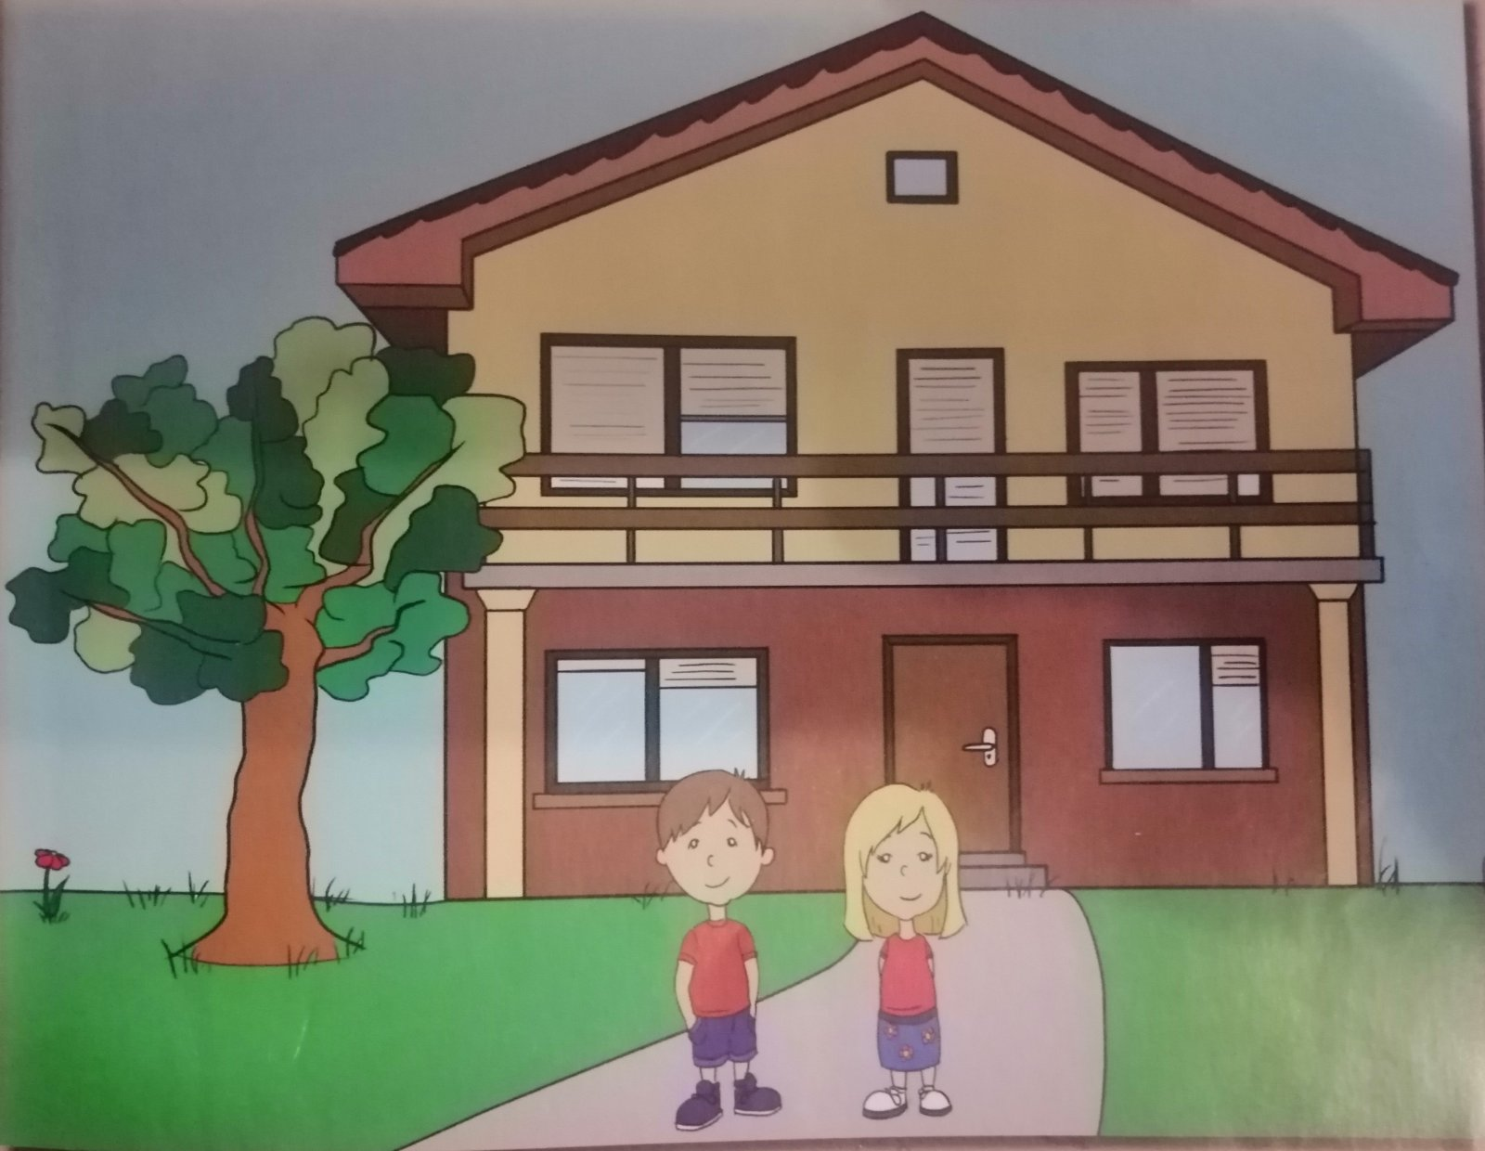

Slide 9
1
2
1
3
4

Slide 16
No homework

