Slide 1
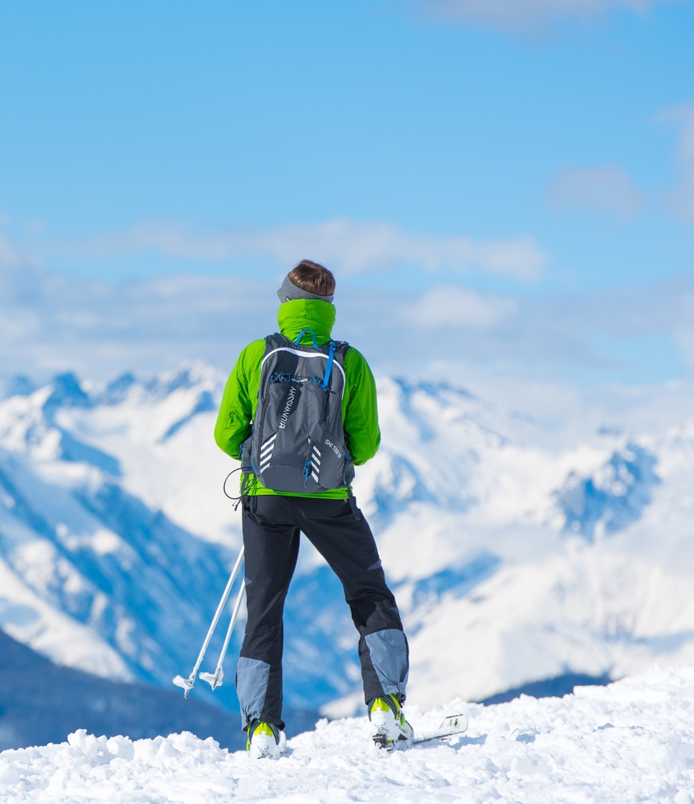
HOME AND AWAY
3.1 JAHORINA – THE OLYMPIC MOUNTAIN

Slide 2
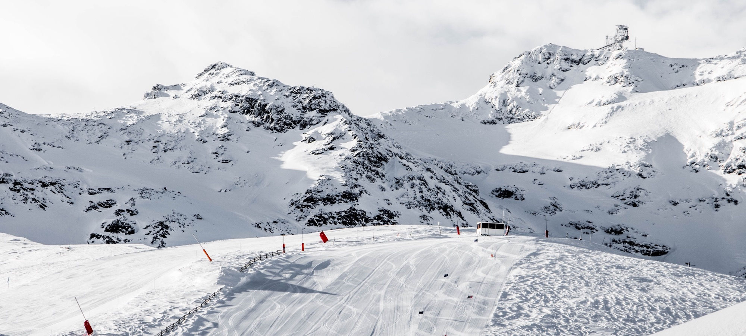
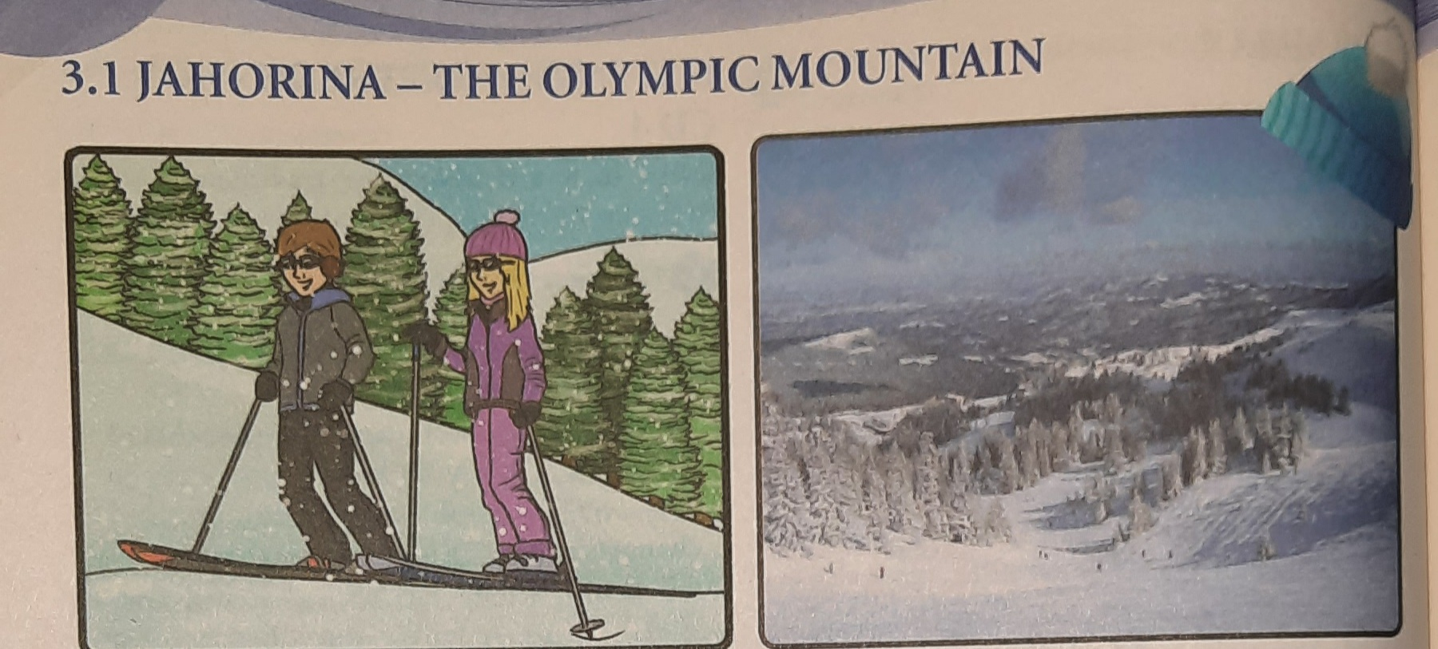
What do you know about Sarajevo?
What do you like about Sarajevo?
Do you like winter sports?
Who is in the picture?

Slide 3
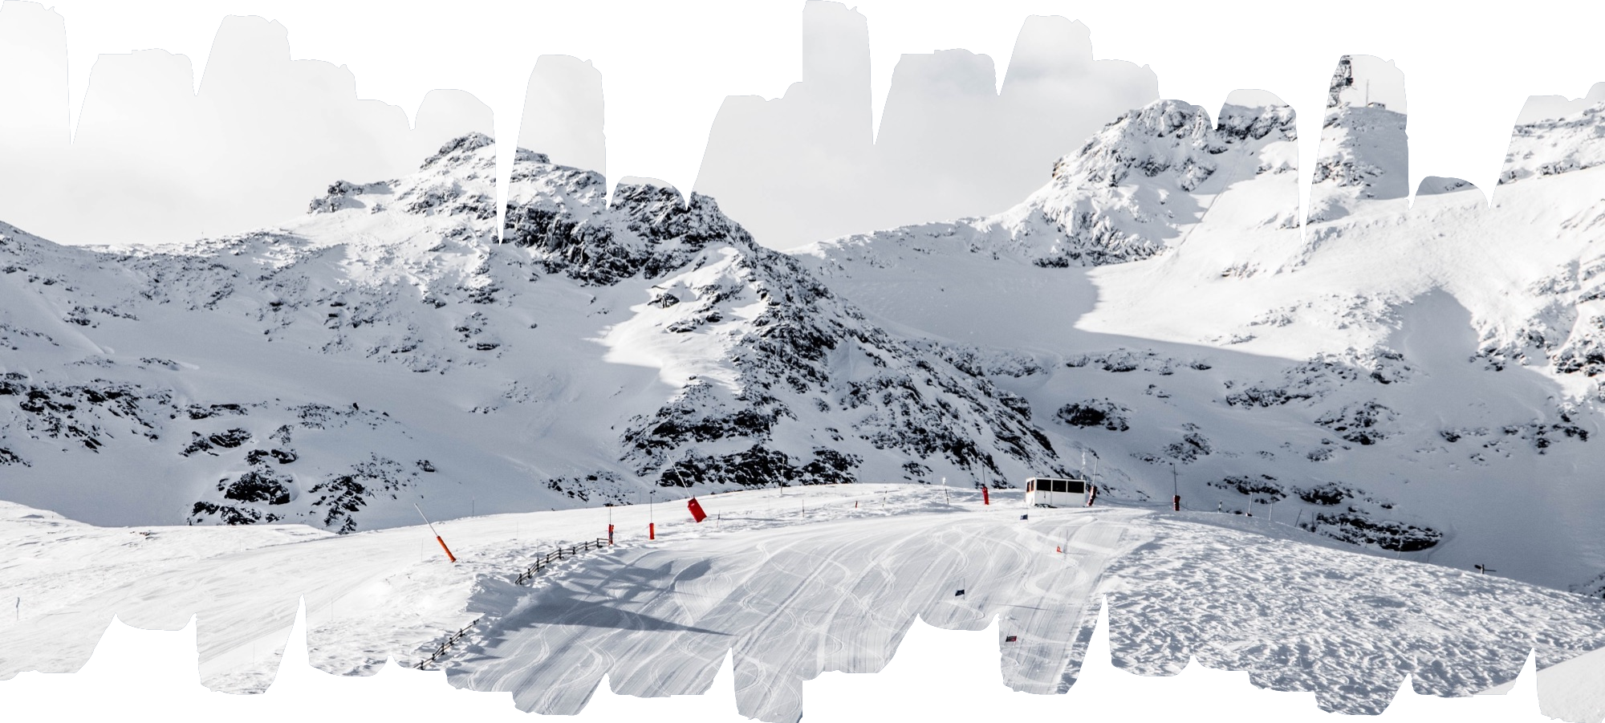

Slide 4
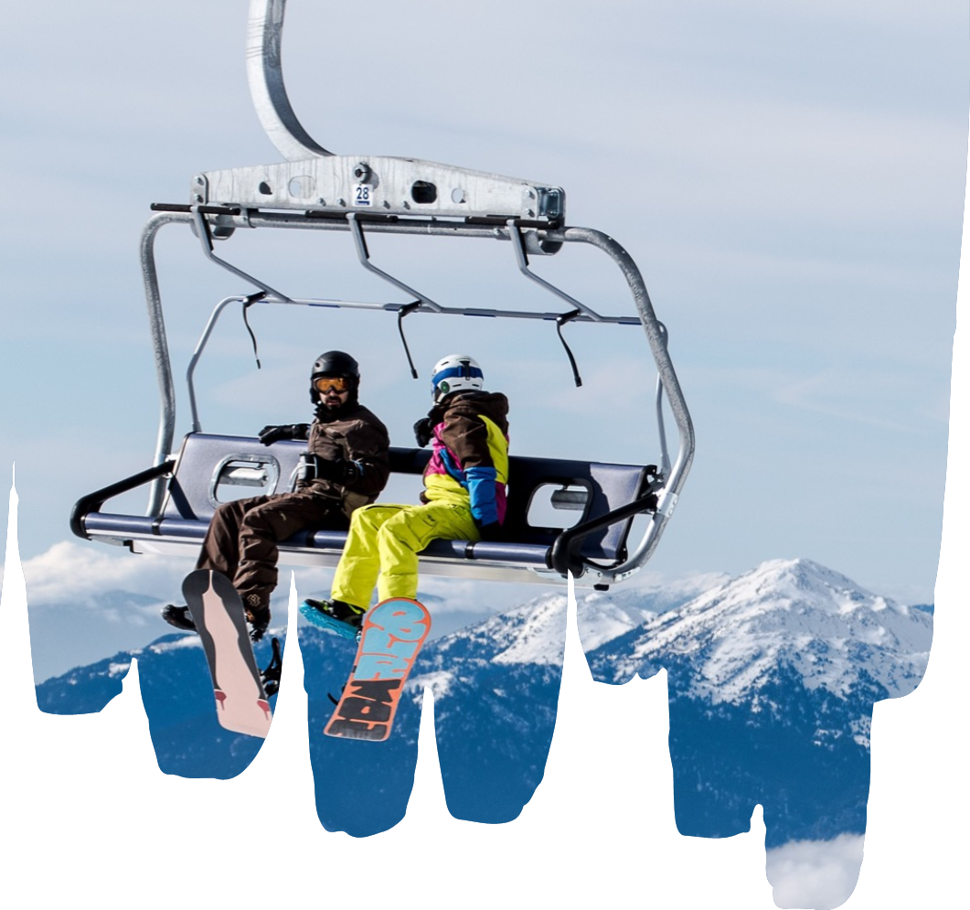
Vocabulary
Freezing – very cold
Hemisphere – part of the globe
Adult – a person who is older than 18
Select – choose
Mascot – a symbol of something
Imagine – see something in your mind
Goggles – glasses for skiing
Obligations – things you have to do

Slide 5
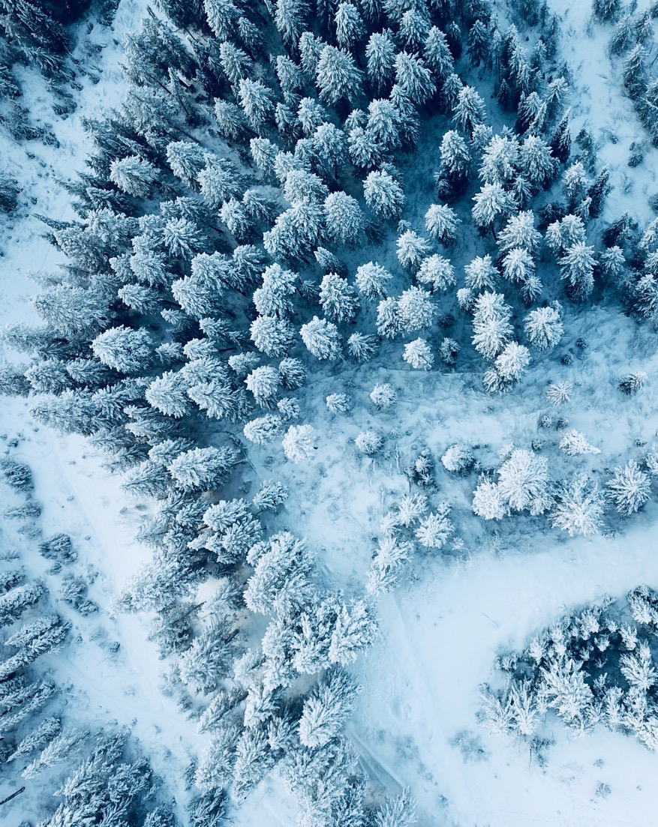
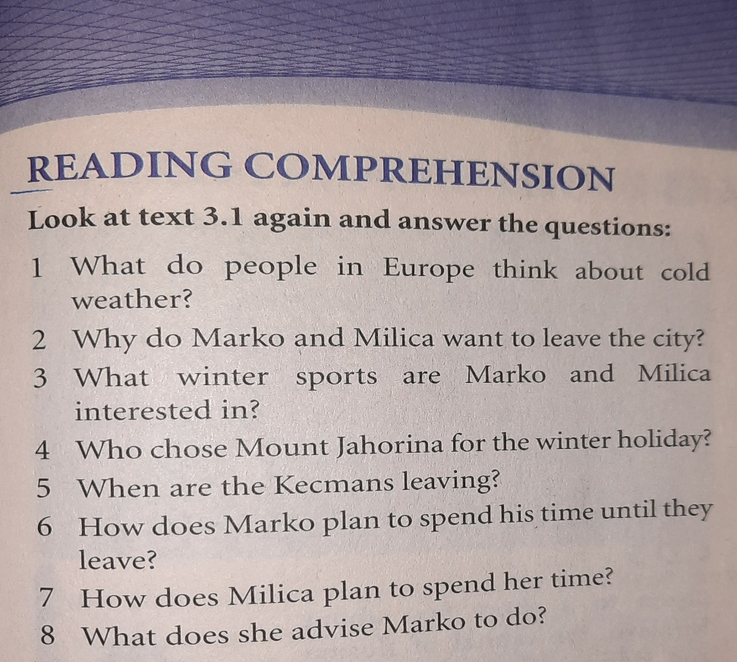
HOMEWORK
SB.pg.31 Reading comprehension
Answer the questions

