Slide 1
UNIT 5 AROUND THE WORLD repetition workbook,pg40

Slide 2
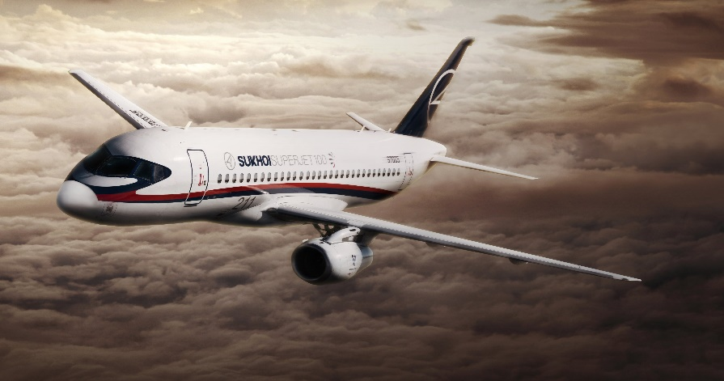
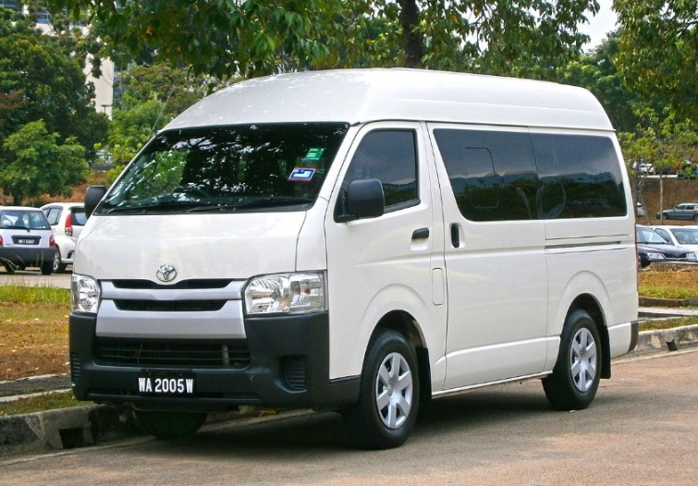
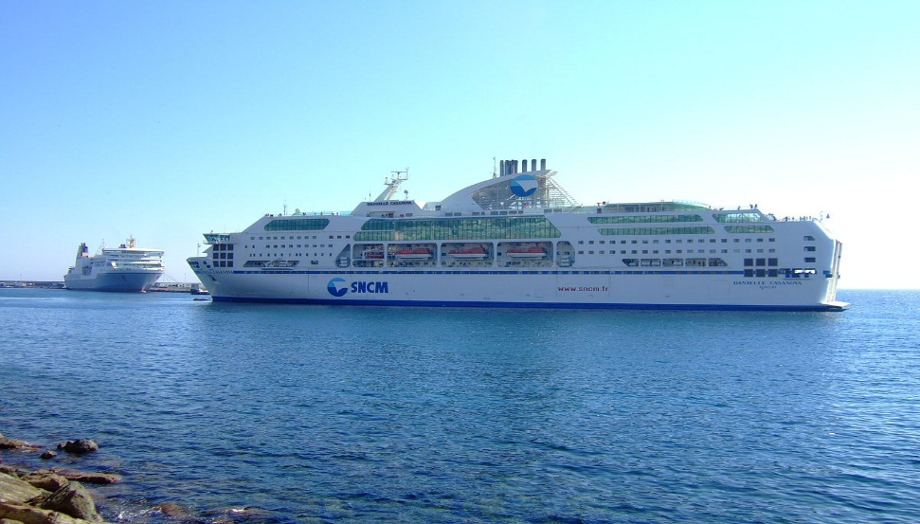
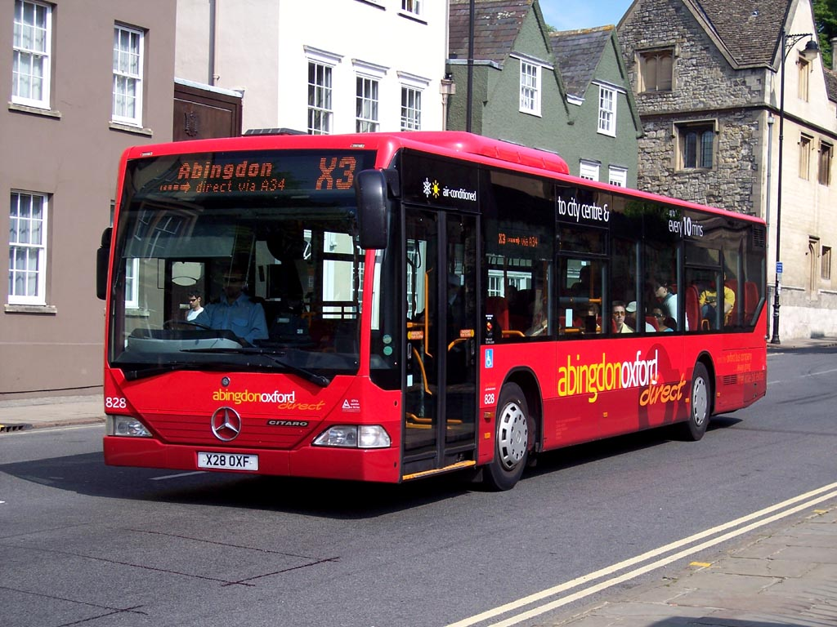
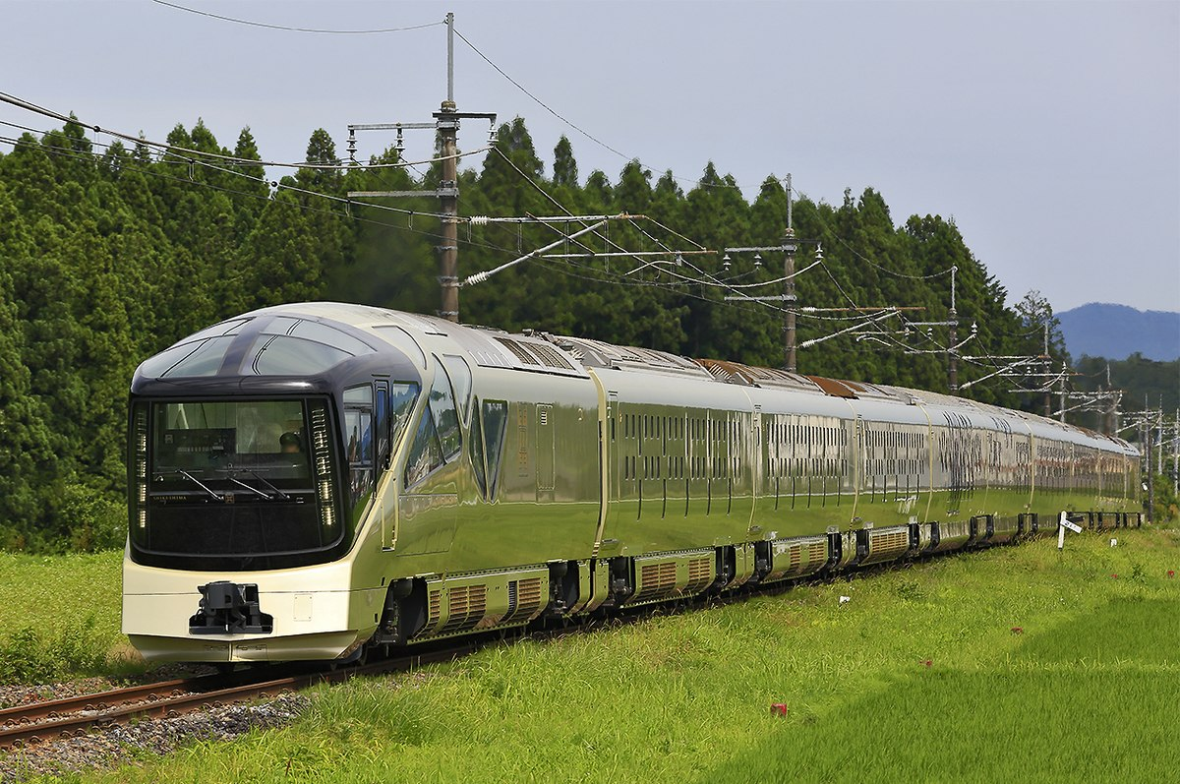

Slide 3
IF CLAUSES – zero type
- to talk about things that are always true, facts
If you are in a hurry, take a taxi.
IF + PRESENT SIMPLE + PRESENT SIMPLE
IMPERATIVE
If you heat ice, it melts.
If + condition + result
WHEN can replace IF

Slide 4
IF CLAUSES – 1st type
- to talk about real and possible situations in the future
If you don’t study, you will fail the exams.
If you don’t study, you are going to fail the exams.
IF +PRESENT SIMPLE + FUTURE SIMPLE
GOING TO

Slide 5
1 ANSWER (AT, ABOUT, FOR ,TO and ON) WORKBOOK,pg. 40
1 It’s time for a snack.
2 That evening, we talked about our favourite movies.
3 A: Where are they? B: They are having lunch at a restaurant.
4 Next month, I am travelling to the USA.
5 I am leaving on Monday morning.

Slide 6
PRESENT SIMPLE VS. PRESENT PROGRESSIVE
PRESENT SIMPLE - ADVERBS | PRESENT PROGRESSIVE - ADVERBS
OF INDEFINITE TIME | OF DEFINITE TIME
ALWAYS | NOW
USUALLY | TODAY
OFTEN | TONIGHT
SOMETIMES | THIS WEEK / MONTH / YEAR
EVERY DAY / EVENING /TUESDAY | THESE DAYS/ WEEKS
EVER | TOMORROW
NEVER | NEXT WEEK/ YEAR

Slide 7
2 ANSWER WORKBOOK,pg. 40
1 We are going to have a picnic next weekend.
2 We usually eat eggs for breakfast, but today we are eating sandwiches.
3 My father usually works on weekends.
4 Look at the sky. It is going to rain tomorrow.
5 We usually don’t go out on Sundays.
6 My friends are going to have a party next week.
7 Fred usually plays basketball with his brother.
8 We are going to have dinner with my grandparents tomorrow.
9 We play baseball every day.
10 Is it going to rain this afternoon?

Slide 8
3 ANSWER WORKBOOK,pg. 40
Are you going to see a play tonght? – No, we are going to a concert.
Are you flying to New York? – No, we want to see Washington this time.
Is Susan doing her homework? - She did not go to school. She is ill.
What are you doing this weekend? – We are having a picnic.
Is Jane leaving tonight? – No, she is taking a plane tomorrow.

Slide 9
4 ANSWER WORKBOOK,pg. 40
BREAK
BEACHES
SAILBOAT
UNFORGETTABLE
ESPECIALLY

Slide 10
HOMEWORK
Why I (dis)like going to the sea in summer?
Why I (dis)like going to the mountains in winter?

Slide 11
Why people (dis)like travel(l)ing?
like dislike
experience new culture journeys can last too long
see new places uncomfortable buses, accomodation
meet different people get sick
make new friends drink only bottled water
exchange their ideas with others be careful what to eat
improve their lives unexpected situations

