Slide 1
An English Class
Student’s book p. 32

Slide 2
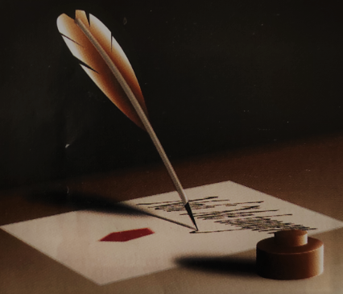
An English class p. 32
Do you like reading?
Who is your favorite writer?
Do you like reading poetry?
Have you ever written a poem?

Slide 3

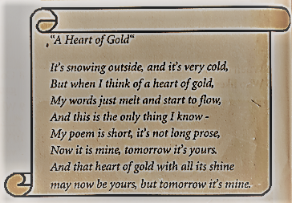
An English class p. 32

Slide 4
An English class p. 32
1. Look at text 3.2 again. Choose the correct answer:
Literature/ Homework is an art.
Dave read/ wrote a poem for homework.
It is about a heart/ class of gold.
Last month, Dave’s class wrote/ read Oliver Twist.
Oliver Twist is not a book/ an essay.
In Dave’s poem, it’s cold/ warm outside.
His words can melt and fly/ flow.
He says the heart of gold can run/ shine.

Slide 5
An English class p. 32
Answers:
Literature/ Homework is an art.
Dave read/ wrote a poem for homework.
It is about a heart/ class of gold.
Last month, Dave’s class wrote/ read Oliver Twist.
Oliver Twist is not a book/ an essay.
In Dave’s poem, it’s cold/ warm outside.
His words can melt and fly/ flow.
He says the heart of gold can run/ shine.

Slide 6
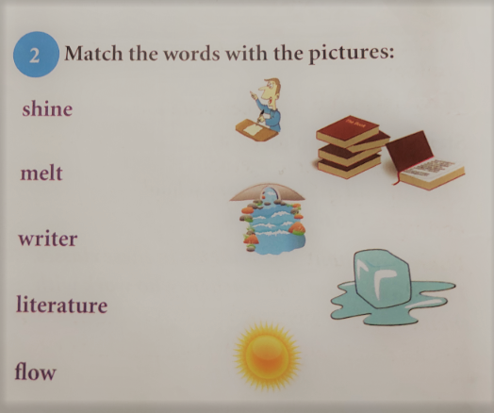
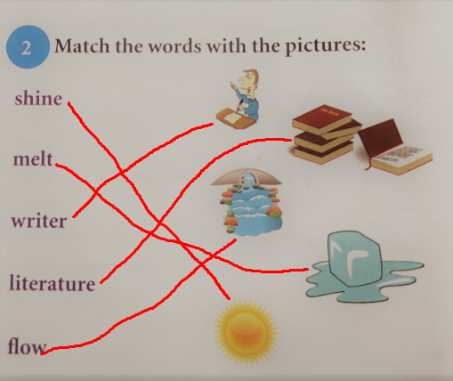
An English class p. 32

Slide 7
An English class p. 32
3. Look at text 3.2 again. Then fill in the missing words:
Dave and his friends are having an ___________ class.
Literature is an ___________ part of their school life.
Last week, the children _________ poetry in class.
They _________ poems or essays for homework.
The __________ which they got for homework was “A Heart of Gold”.
Ice __________ when the weather is hot.
Water __________ in rivers.
Dave wrote a poem for homework. He didn’t write long ___________.
Charles Dickens was a famous English ____________.
He wrote a great book about a boy whose name was _____________ Twist.

Slide 8
An English class p. 32
Answers:
Dave and his friends are having an English class.
Literature is an important part of their school life.
Last week, the children read poetry in class.
They wrote poems or essays for homework.
The topic which they got for homework was “A Heart of Gold”.
Ice melts when the weather is hot.
Water flows in rivers.
Dave wrote a poem for homework. He didn’t write long prose.
Charles Dickens was a famous English writer.
He wrote a great book about a boy whose name was Oliver Twist.

Slide 9
Homework:
Activity book; page 21
Exercise 1- Fill in the missing words.
Exercise 4 - Find eight words from text 3.2
“It’s the books you read when you’re young that stay with you always“
J.K. Rowling

