Slide 1
In the living room
STUDENT’S BOOK, page 32

Slide 2
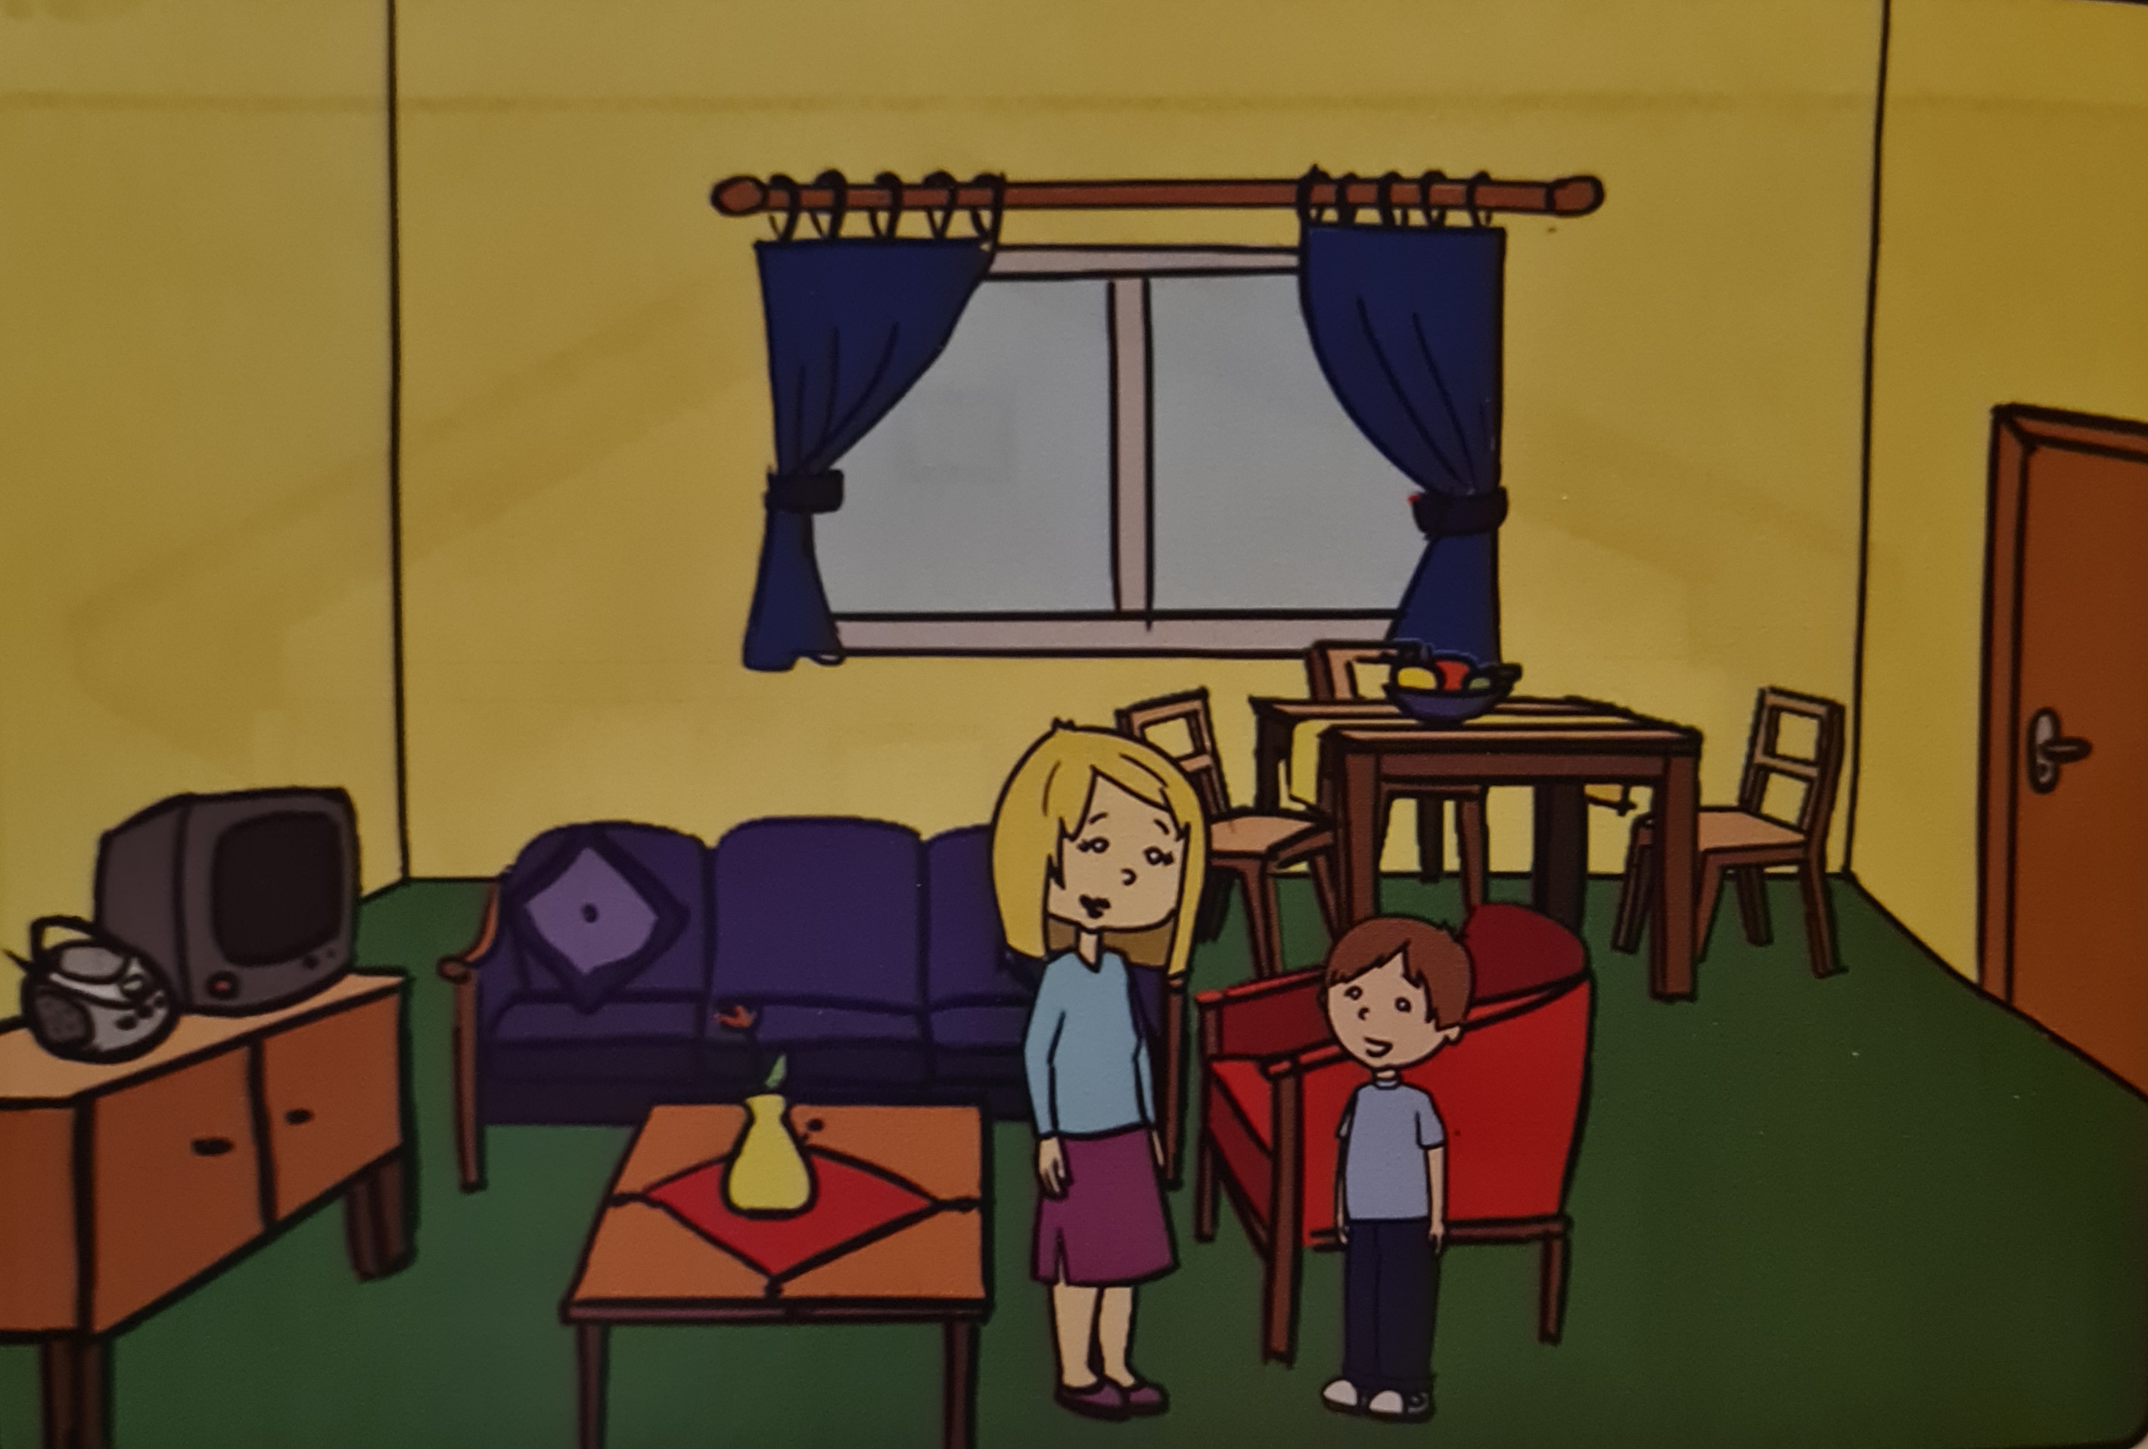
This is the living room in the Kecman home.They have a big table and chairs, a sofa,an armchair and a coffee table.They have a green carpet and blue curtains.Marko is in the living room . He is talking to his mother.

Slide 3
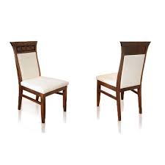
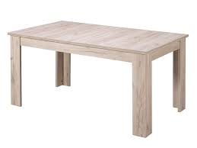
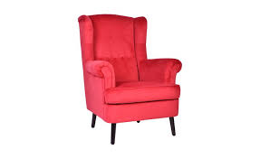
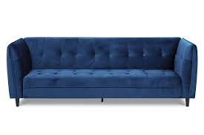
a big table chairs
an armchair a sofa

Slide 4
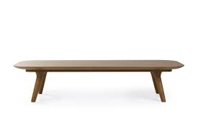
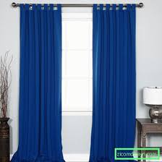
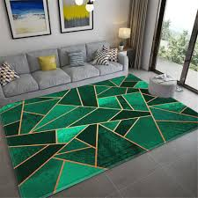
a coffee table
curtains
a carpet

Slide 5
Activity book, page 33 exercise 2: Answer the questions:
1)Do you have a living room in your house ?
Yes, I do.
2)Do you have a sofa in your living room ?
Yes, I do .
3)Does your house have a garden ?
Yes, it does./No,it does n’t.
4)Do you listen to music on Sundays ?
Yes, I do. / No, I don’t .
5)What color are the curtains in your home ?
The curtains in my home are ________(blue).
They are______(blue).

Slide 6
This is your homework:
Activity book , page 33
Exercise 1 Fill in the blanks
Exercise 3 Circle the odd one out and write.

