Slide 1
Eнглески језик за 3.разред

Slide 2
Уџбеник, страна 39

Slide 3
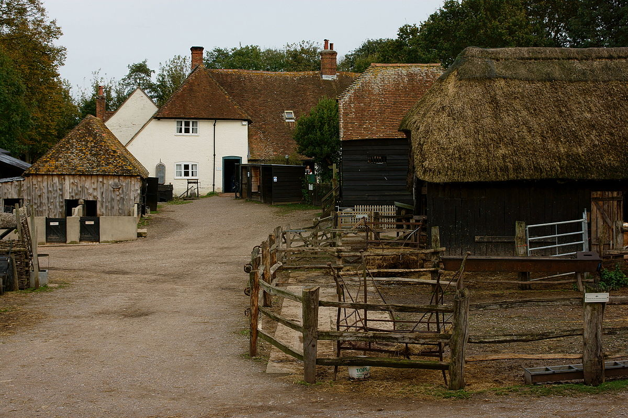
This Photo by Unknown Author is licensed under CC BY-SA

Slide 4
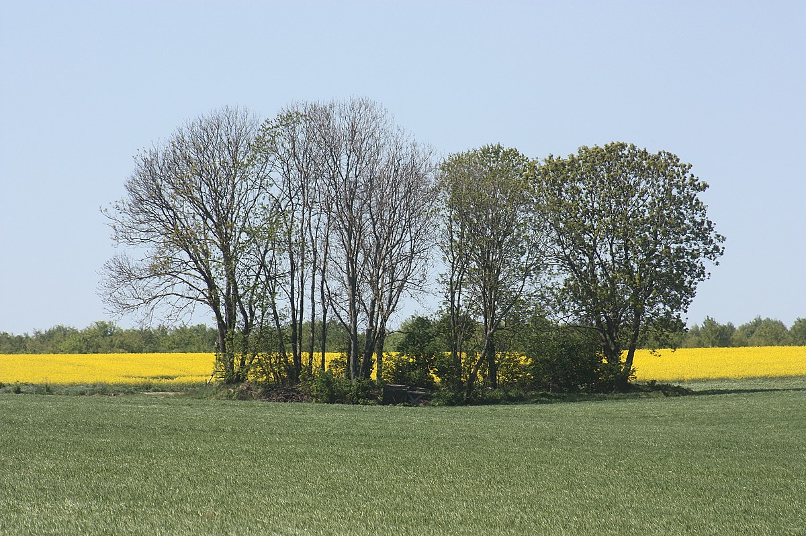
This Photo by Unknown Author is licensed under CC BY-SA

Slide 5
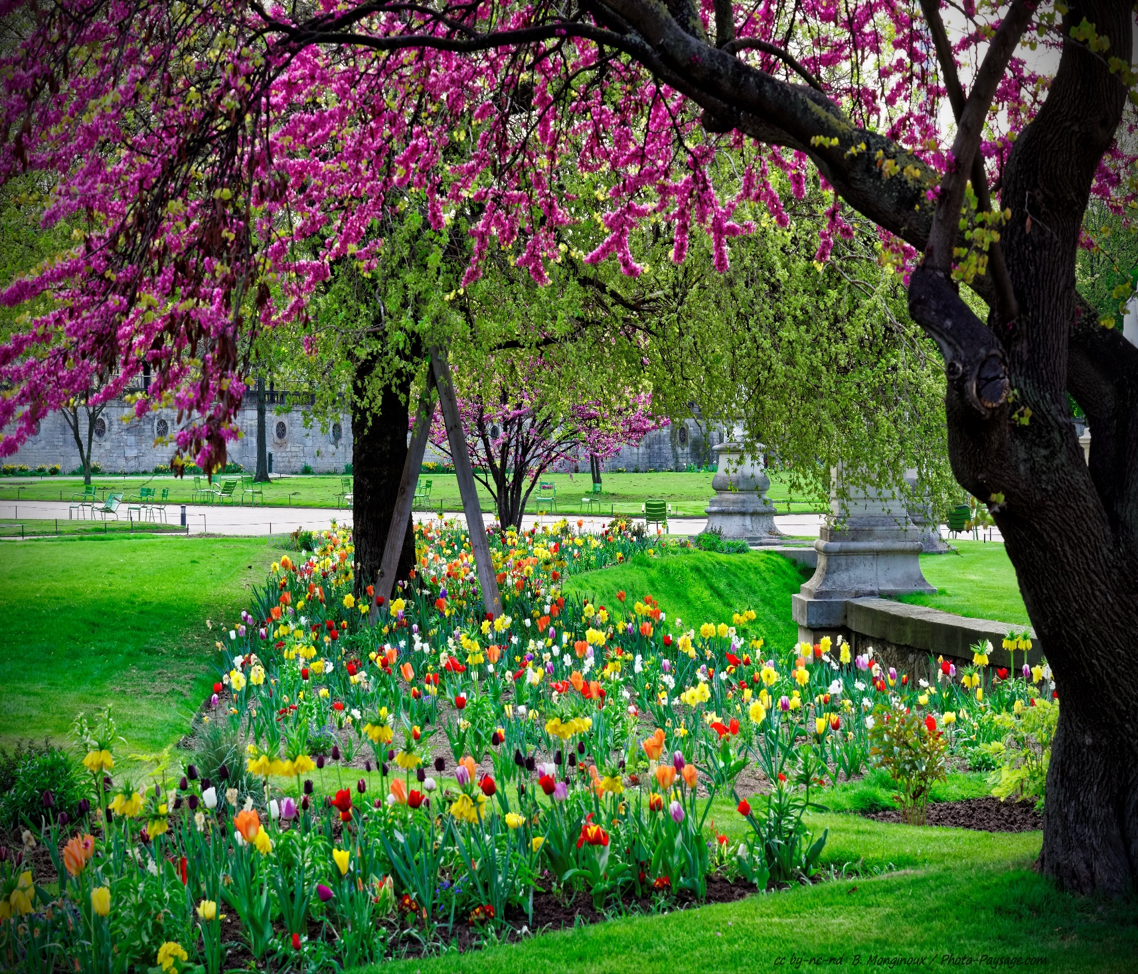
This Photo by Unknown Author is licensed under CC BY-NC-ND

Slide 6
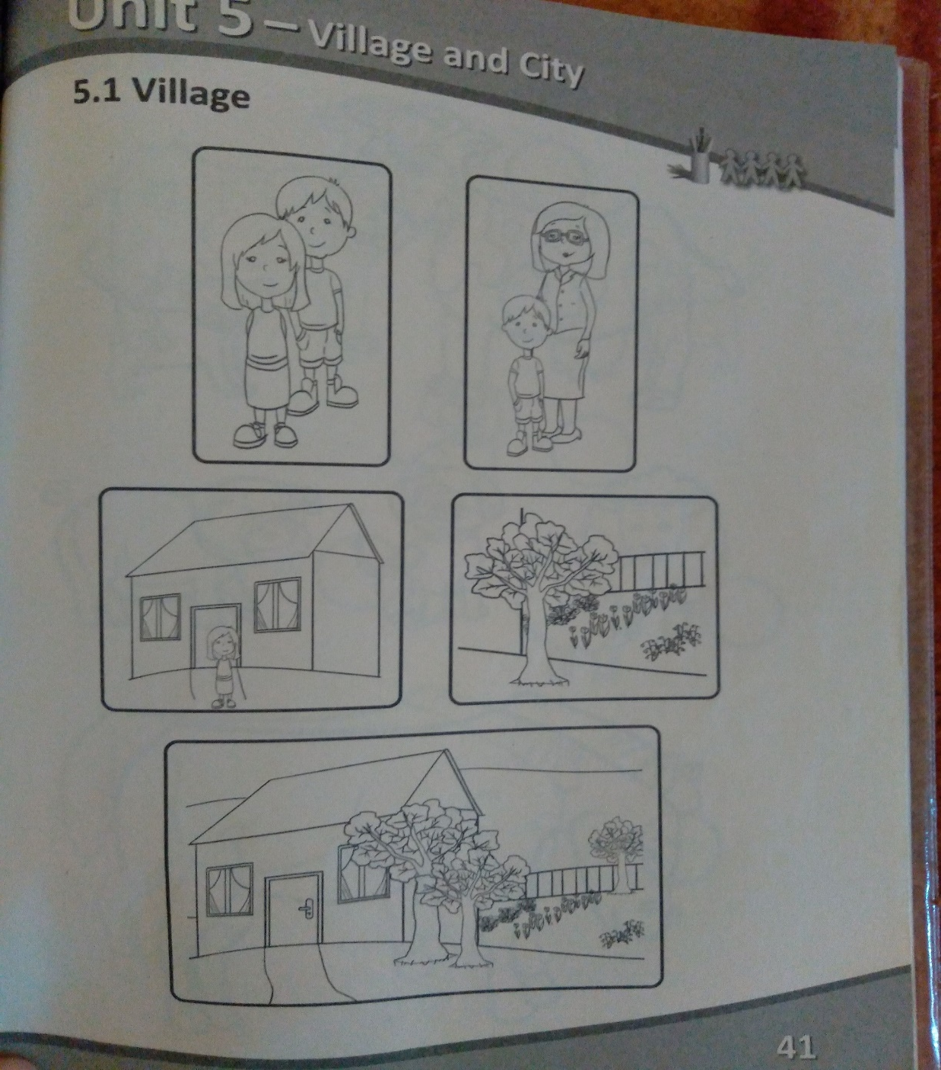
Задаћа:
Радна свеска, стр.41
Обојити сличице

Slide 7
Хвала на пажњи!

