Slide 1
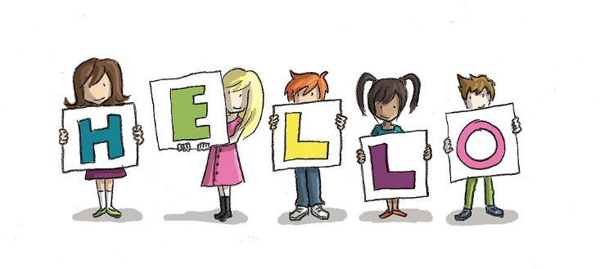

Slide 2
GOING OUT
STUDENT’S BOOK, PAGE 33

Slide 4
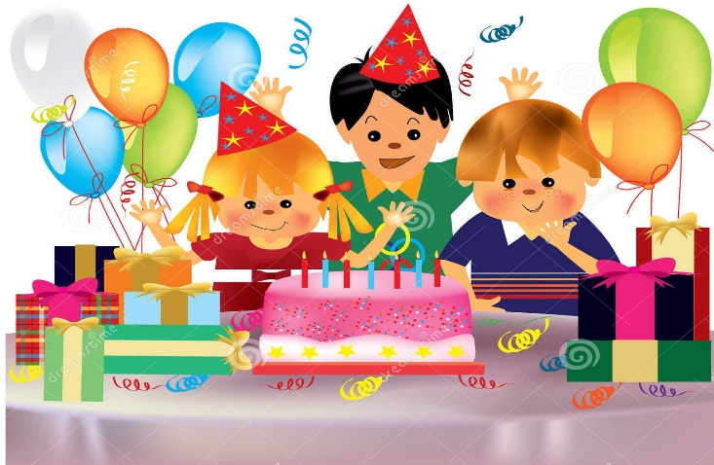
Let’s repeat the words you know:
a cake
a birthday party
a present

Slide 5
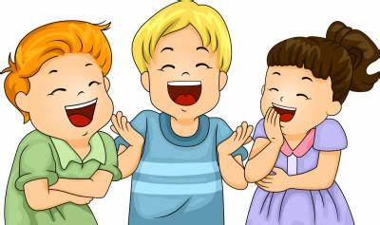
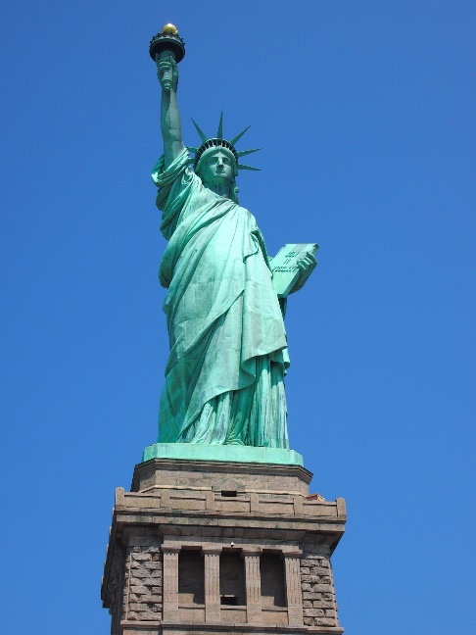
New words:
candles
tell jokes and laugh
the Statue of Liberty

Slide 6
WORDLIST:
candles- свјећице
tell jokes- причати вицеве
laugh- смијати се
the Statue of Liberty- Кип слободе

Slide 7
FILL IN THE BLANKS:
1. Lisa’s birthday is in _____.
April
2. She usually ______a party.
has
3. She invites her ______.
friends
4. Her _____ makes a cake.
mother
5. She puts ______ on the cake.
candles
6. Lisa gets a lot of ________.
presents

Slide 8
HOMEWORK:
ACTIVITY BOOK, PAGE 38
EXERCISE 2 (MATCH THE SENTENCE PARTS)

