Slide 1
A funny computer

Slide 2
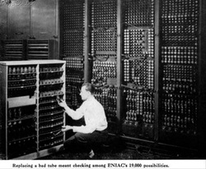
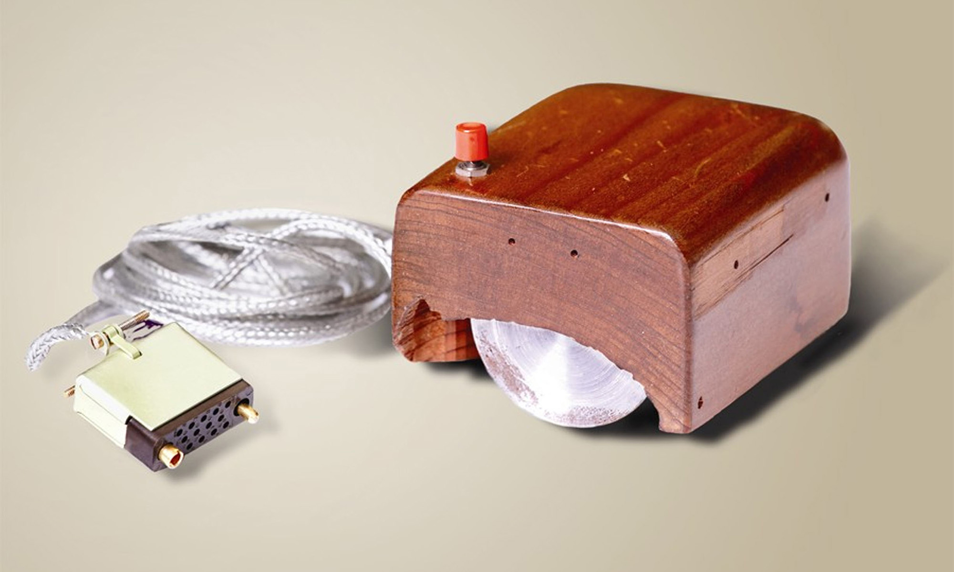
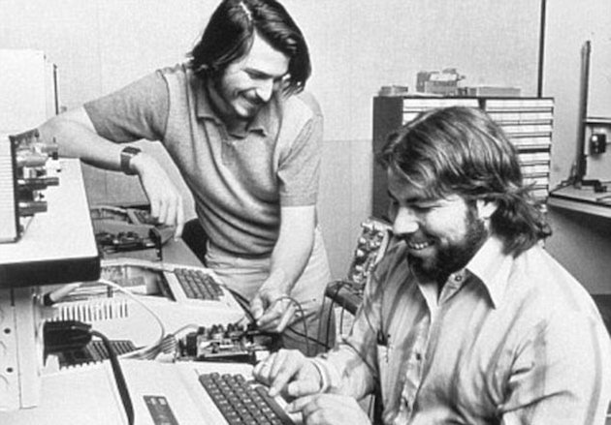
F
U
N
F
A
C
T
S
1. The first electronic computer weighed more than 27 tons
and it took up 1800 square feet.
2. The first computer mouse was invented around 1960 and
it was made of wood.
3. There are more than 5000 computer viruses released every month.
4. HP, Microsoft and Apple were all started - in a garage!
5. The first 1GB hard disk drive cost $40,000!

Slide 3
Do you use your computer every day?
How much time do you spent on your computer every day?
What do you use if for?

Slide 4
Class book, page 69

Slide 5
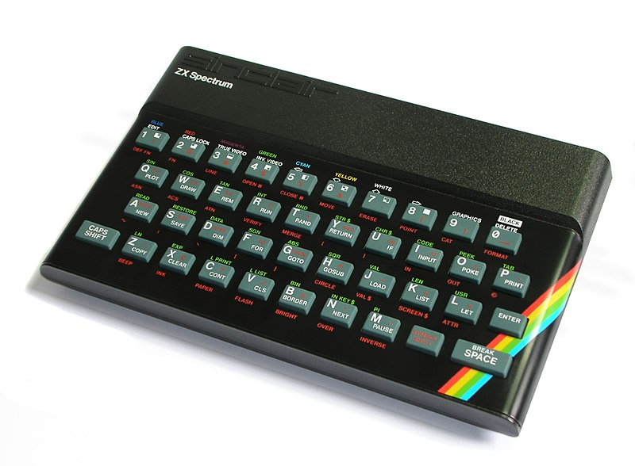
Reading comprehension, p. 70
1. What kind of computer did Steve show to Mike?
He showed him an old computer called ZX Spectrum.
2. How did Steve get this computer?
- He got it from his father.
3. How did children use computers in 1970?
- They used them for playing games.
4. Where else were the computers used?
- They were used in schools for education.
* It was a home computer that you had to attach to a TV set in order to play!
* It had 48 KILOBYTES of memory.
-

Slide 6
5. What did students learn at school in the 1980s?
-They learned how to use computers and how to make simple programs.
6. When did Steve’s father buy his first PC?
- He bought his first PC in the 1990s.
7. What happened with the first PC Steve’s father bought?
- He sold it to buy a new one.
8. Why does Steve’s father like his ZX Spectrum?
- Because it brings him back to his childhood.

Slide 7
Vocabulary match the words with their explanations
vintage
key
rubber
curious
household
decade
replace
load
someone who wants to know something
ten years
put a program into the memory of a computer
people who live together in a house
typical of the past; old
use instead of something else
button on the keyboard
a kind of soft material

Slide 8
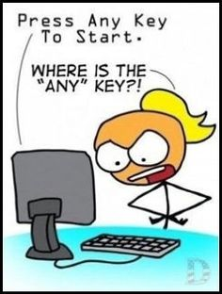
Use the words from previous exercise to complete the sentences:
1
My brother has always been ................. . He wants to know everything.
This ball is made of ................. .
If you want to play a video game, you must .................. it first.
Press any ................ to start a game.
My grandfather has a ................ car from 1964.
They all live in the same .................. .
Cell phones will ................. computers.
Computers were very slow three ................... ago.
vintage key rubber curious household decade replace load
curious
rubber
load
key
vintage
household
replace
decades

Slide 9
homework
WORKBOOK: page 56, exercise 1!

