Slide 1
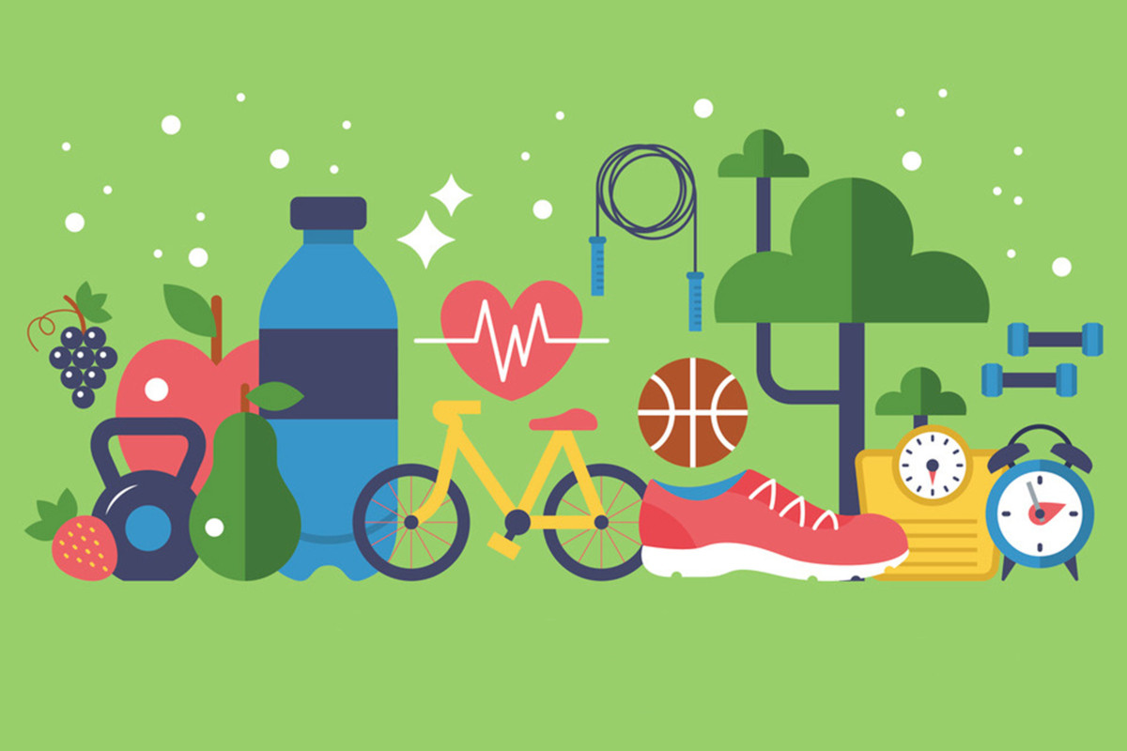
MY LIFESTYLE

Slide 2
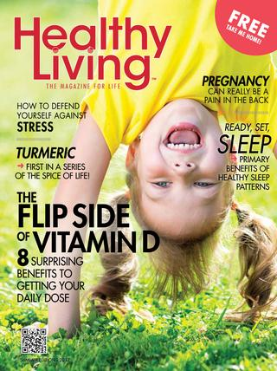
Do you sometimes read magazines ?
Do you like to read pages about health and sport?
Do you think your lifestyle is healthy?

Slide 3
New vocabulary:
offer – when we want to give something to someone, we offer them this
several – a few
questionnaire – list of questions and offered answers to circle those that are true for you
bottom – the lowest part of something, e.g. of a page in a book
description – when you are describing something, what you are saying in your description of it
quite – to a certain level
even - more

Slide 4
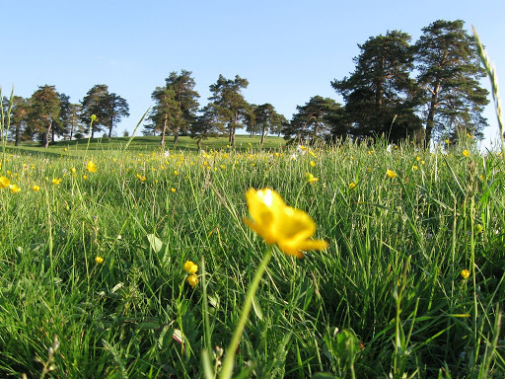
Open your books, please, at page 52 .

Slide 5
Find the words from the text among these jumbled letters (student book page 52, exercise 1)
onnaquestiire _ _ _ _ _ _ _ _ _ _ _ _ _
rasevel _ _ _ _ _ _ _
toombt _ _ _ _ _ _
veen _ _ _ _
uteqi _ _ _ _ _

Slide 6
Key: student book page 52, exercise 1
onnaquestiire questionnaire
rasevel several
toombt bottom
veen even
uteqi quite

Slide 7
Use the words from exercise 1 to complete the sentences (student’s book page 52, exercise 2):
This is good, but I think you can do _________ better than that.
I can say that my lifestyle is ___________ healthy.
You will find your score at the ___________ of this page
A: What is another word for ‘a few’?
B: It’s ____________.
This__________ is so interesting. I like all the questions.

Slide 8
Key: student’s book page 52, exercise 2
This is good, but I think you can do even better than that.
I can say that my lifestyle is quite healthy.
You will find your score at the bottom of this page
A: What is another word for ‘a few’?
B: It’s several.
This questionnaire is so interesting. I like all the questions.

Slide 9
Homework: Workbook page 35
Exercise 1 : Complete the text with the words from the box. Use each word once.
Exercise 4 : There is one spelling mistake in each line. Find it and correct it.

