Slide 1
4.5. Sunday evening
Page 35

Slide 2
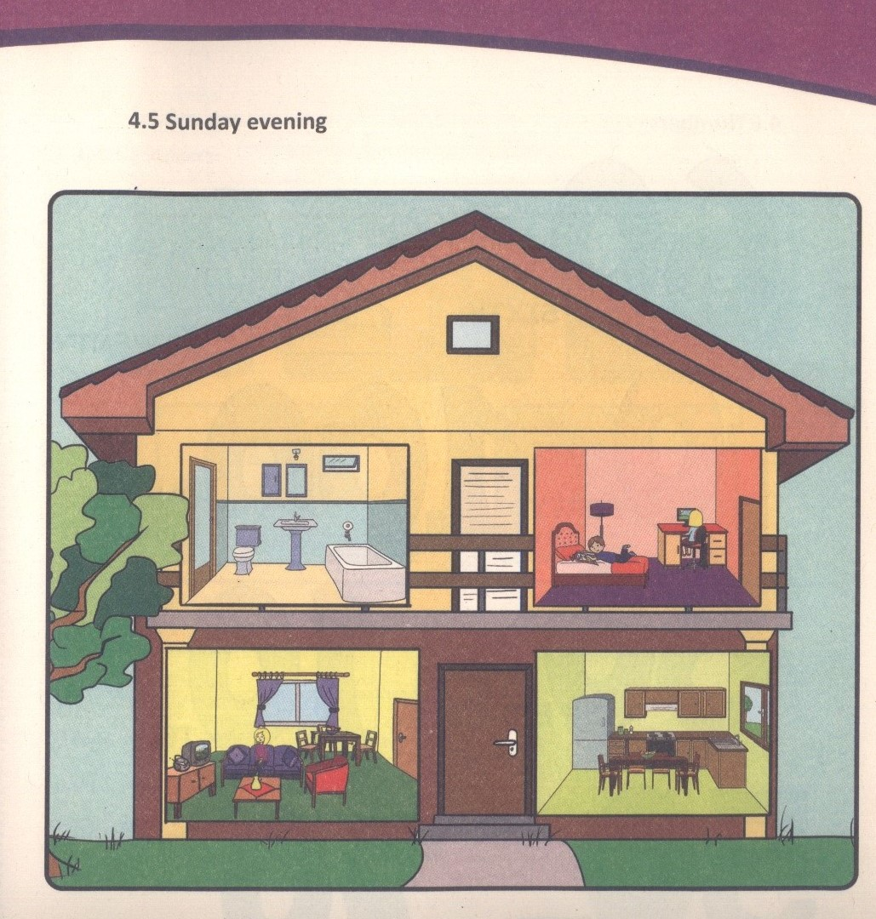

Slide 3
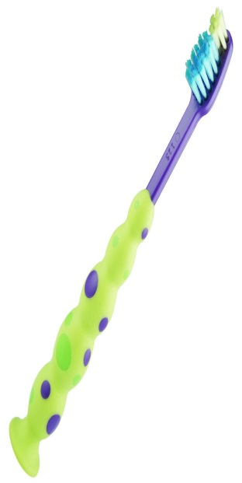
Reading
It is Sunday evening. Marko and Milica are upstairs, in Milica’s bedroom.Mrs. Kecman is downstairs, in the living room.
Marko: Tomorrow is Monday. On Mondays we go to school.
I am making a poster for school.
Milica: Today is Sunday. On Sundays, I watch TV but tonight I am playing a computer game.
Mrs. Kecman: Children, it is late! Take your toothpaste and your toothbrush! Brush your teeth. Get ready for bed.

Slide 4
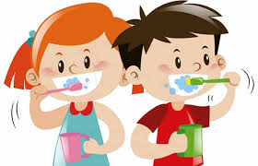
Vocabulary
Make a poster – napraviti poster
Tonight – večeras
It is late – kasno je
Toothpaste – pasta za zube
Toothbrush- četkica za zube
Brush your teeth - operi zube

Slide 5
Practice:
Is Milica writing now ?
No, she is not.
Is Marko doing a project ?
Yes, he is.
Are they at school on Sunday ?
No,they are not.
Is it Sunday evening ?
Yes, it is.
Are they all watching TV?
No, they are not.

Slide 6
Homework
Activity book, page 38
Exercise 4. write the missing letters, match and spell

