Slide 1
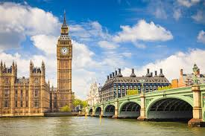
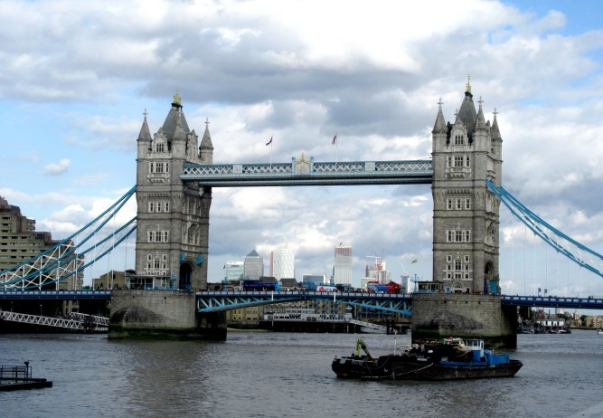
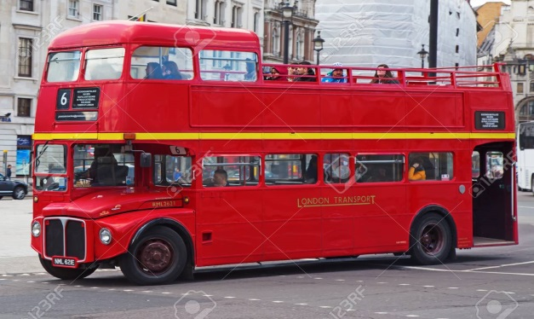
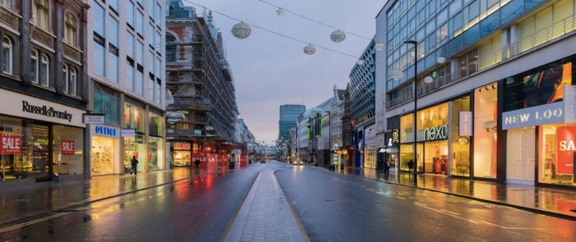
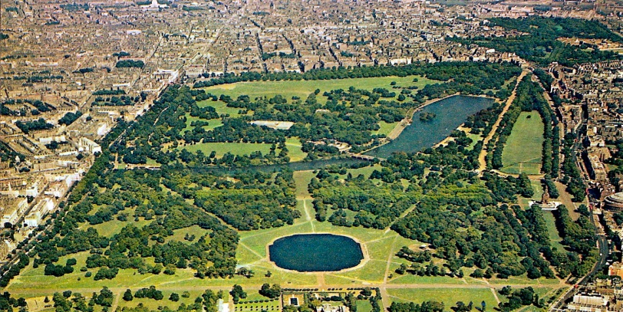
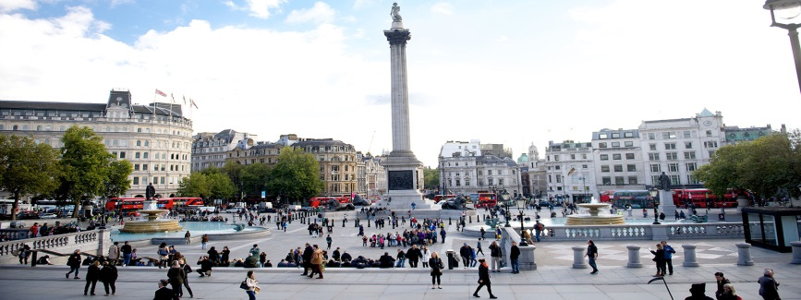
LONDON
Student‘s books

Slide 2
6.1 London, page 45
Uncle Boris is a pilot.He flies to many countries all over the world. He is flying to London today. Uncle Boris likes London because it is a beautiful city. London is the capital of the United Kingdom and of England. The English people are proud of their capital. It is an old and big city on the river Thames. Many people visit London every year. They want to see Big Ben, a famous clock, Hyde Park, Tower Bridge and Trafalgar Square. London is famous for big red buses called double-deckers. You can see them in every street. Oxford street is very beautiful. There are many stores in this street. People go to Oxford street to buy clothes, souvenirs and many other things. Uncle Boris is in Oxford street now. He is buying presents for his children.
pilot
capital – главни град
proud - поносан
Thames

Slide 3
London

Slide 4
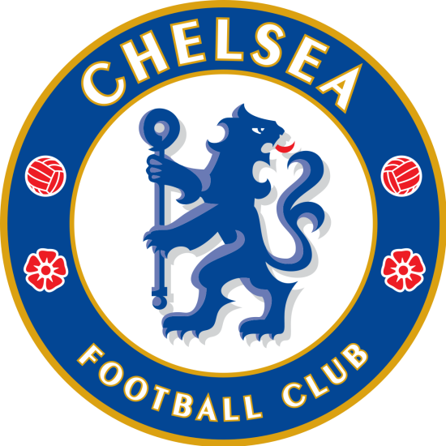
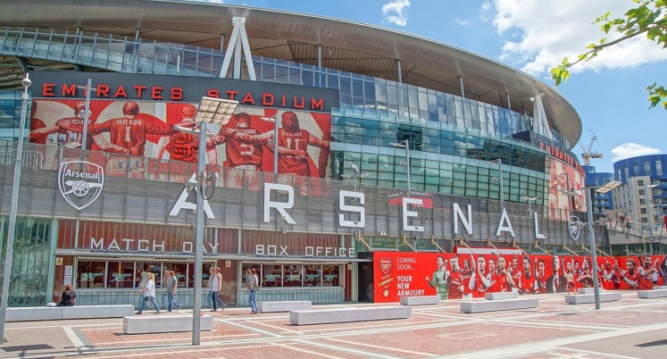

Slide 5
LONDON
Answer the questions
What is uncle Boris?
Where is uncle Boris flying today?
Why does uncle Boris like London?
Why is London famous?
Why do people go to Oxford street?
Answers
Uncle Boris ( He) is a pilot.
He is flying to London today.
Because it is a beautiful city
London is famous for the big red buses called double deckers.
They go to Oxford street to buy clothes, souvenirs and many other things.

Slide 6
ACTIVITY BOOK p50
Fill in the blanks
Uncle Boris is a pilot. Pilots fly ___ many cities all _____ the world. Today, uncle Boris is flying ____ London. London is the capital ___ the United Kingdom and ____ England. It is an old and big city ____ the river Thames. The English people are proud ___ their capital. Many people travel ___ London to see Big Ben, a famous clock, Hyde Park, Tower Bridge and Trafalgar Square. London is also famous ____ the big red buses called double-deckers. You can see then ____ every street.

Slide 7
WORKBOOK p50
Fill in the blanks
Uncle Boris is a pilot. Pilots fly to many cities all over the world. Today, uncle Boris is flying to London. London is the capital of the United Kingdom and of England. It is an old and big city on the river Thames. The English people are proud of their capital. Many people travel to London to see Big Ben, a famous clock, Hyde Park, Tower Bridge and Trafalgar Square. London is also famous for the big red buses called double-deckers. You can see then in every street.

Slide 8
HOMEWORK
ACTIVITY BOOK p50
Exercises:
2. Write true ( T) or false ( F)
3. Match the sentence parts

