Slide 1
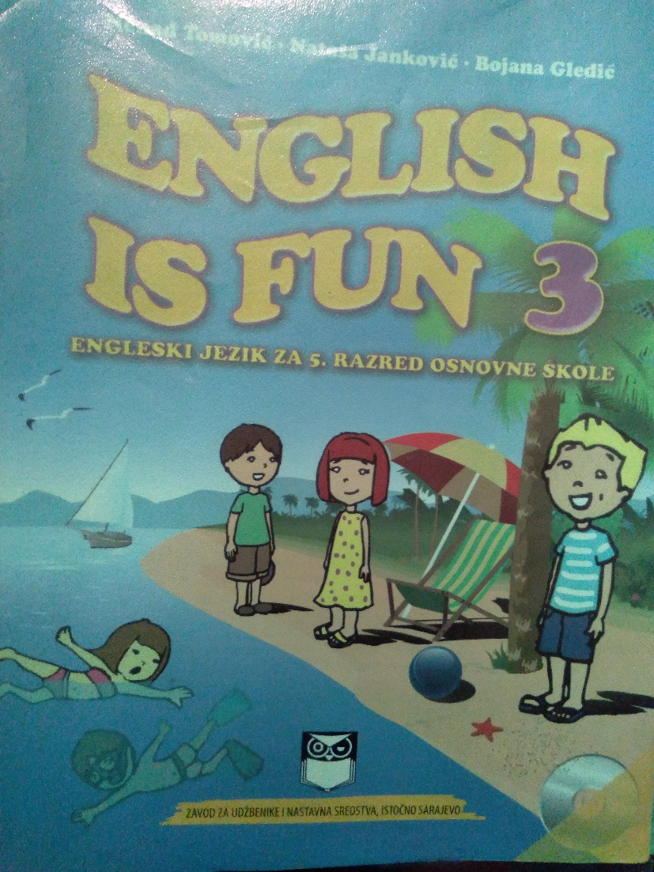
ENGLISH CLASS, GRADE 5

Slide 2
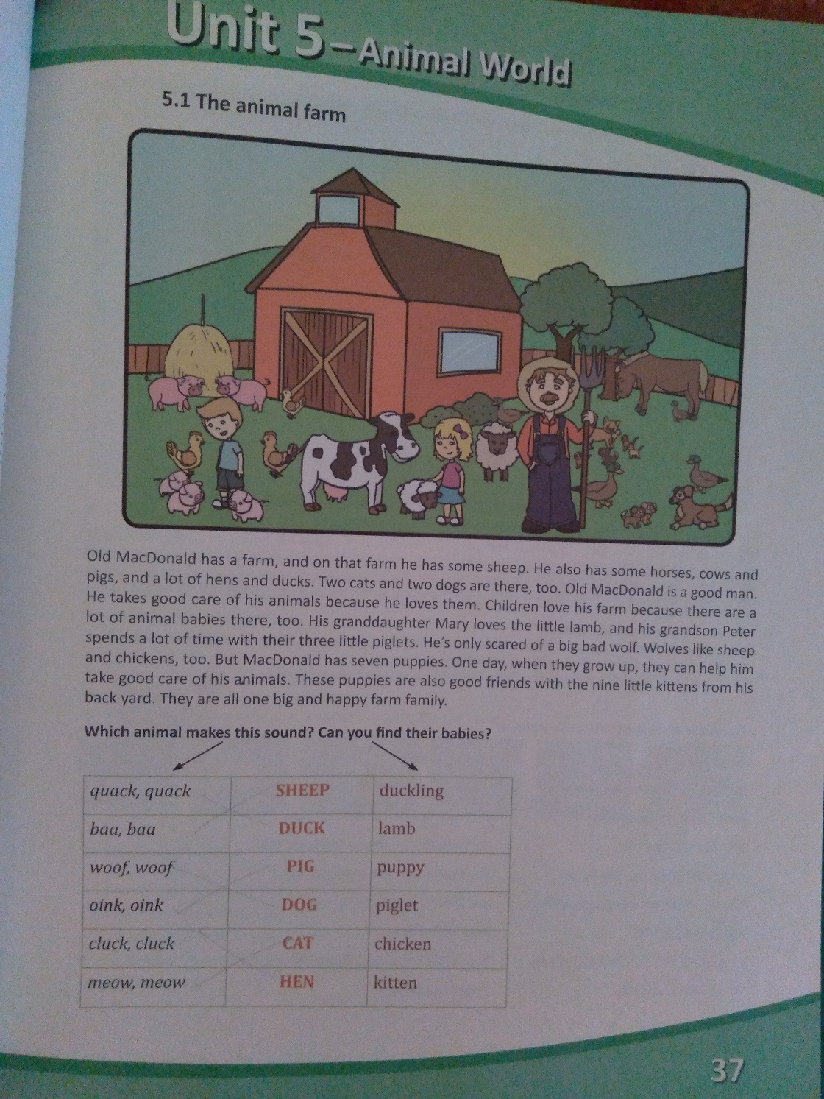
Student’s book page 37

Slide 3
wordlist
Animals
Sheep- ovca
Duck- patka
Pig- svinja
Dog- pas
Cat- mačka
Hen- kokoška
Animal Babies
Lamb- jagnje
Duckling- pače
Piglet- prase
Puppy- štene
Kitten- mače
Chicken- pile

Slide 4
Workbook, page 41, exercise 3
Old MacDonald has some horses, kauz and pigs
and a lot of hens and daks. Two cats and two dogs
are there, too. Old MacDonald grandaughter
Mary loves the little lam, and his grandson Peter
spends a lot of time with their tree little pigs.
cows
ducks
grandda ughter
lamb
three

Slide 5
Homework
Workbook, page 41, exercise 2:
Fill in the blanks!

Slide 6
Thank you for your attention!

