Slide 1
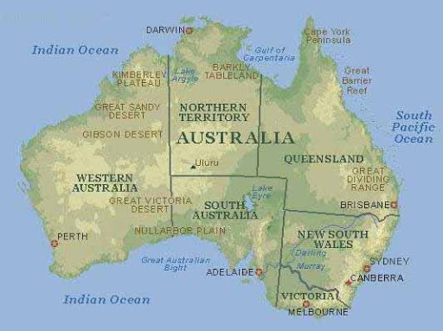
5.6 Australia-the land down under

Slide 2
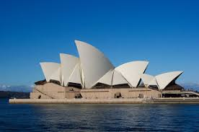
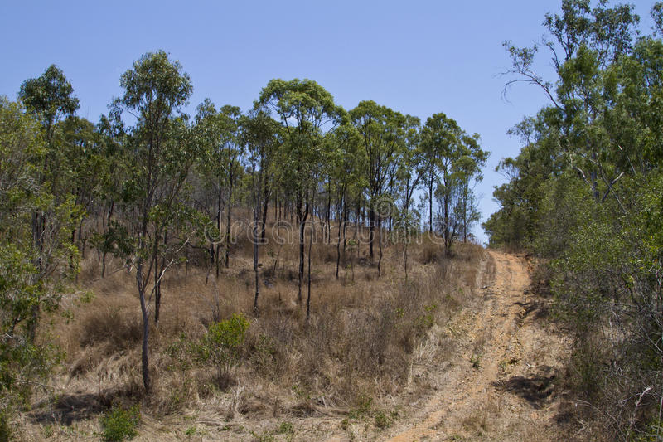
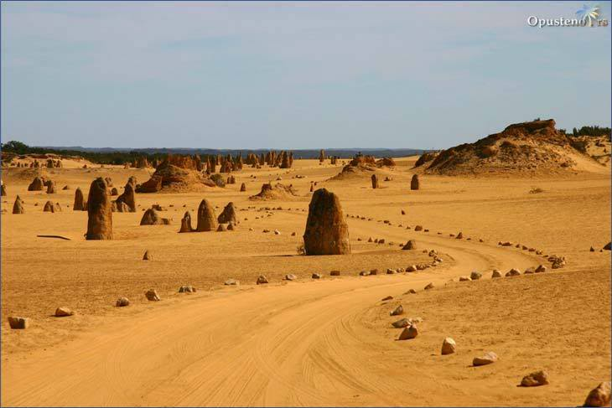
5.6 Australia-the land down under
Australian wilderness

Slide 3
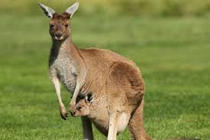
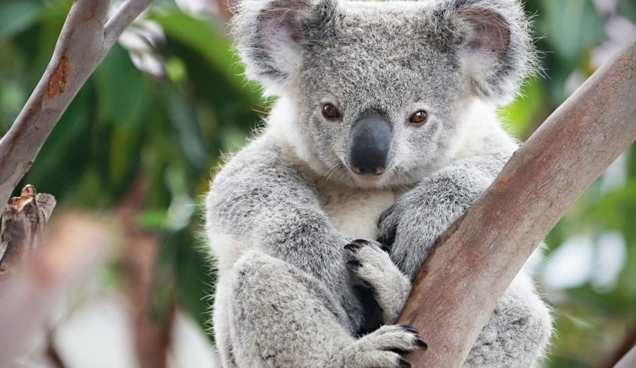
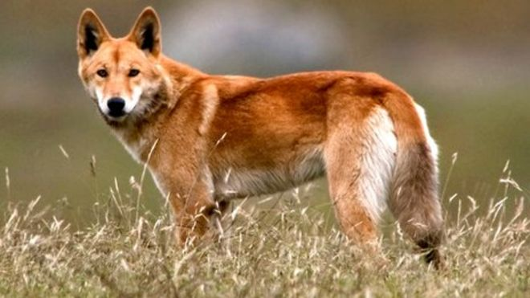
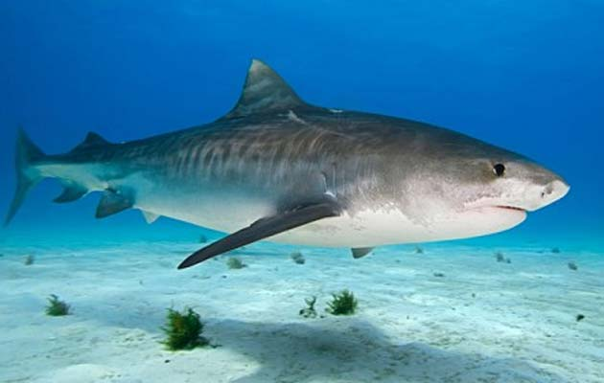
5.6 Australia-the land down under
Australian animals

Slide 4
5.6 Australia-the land down under
Find the names of the following animals in text 5.6 (page 65, exercise 2):
1. This animal lives in oceans. It is a fish and it is dangerous.

Slide 5
5.6 Australia-the land down under
Find the names of the following animals in text 5.6 (page 65, exercise 2):
1. This animal lives in oceans. It is a fish and it is dangerous. SHARK

Slide 6
5.6 Australia-the land down under
Find the names of the following animals in text 5.6 (page 65, exercise 2):
This animal lives in oceans. It is a fish and it is dangerous. SHARK
This animal is a wild dog.

Slide 7
5.6 Australia-the land down under
Find the names of the following animals in text 5.6 (page 65, exercise 2):
This animal lives in oceans. It is a fish and it is dangerous. SHARK
This animal is a wild dog. DINGO

Slide 8
5.6 Australia-the land down under
Find the names of the following animals in text 5.6 (page 65, exercise 2):
This animal lives in oceans. It is a fish and it is dangerous. SHARK
This animal is a wild dog. DINGO
This animal can jump very high.

Slide 9
5.6 Australia-the land down under
Find the names of the following animals in text 5.6 (page 65, exercise 2):
This animal lives in oceans. It is a fish and it is dangerous. SHARK
This animal is a wild dog. DINGO
This animal can jump very high. KANGAROO

Slide 10
5.6 Australia-the land down under
Find the names of the following animals in text 5.6 (page 65, exercise 2):
This animal lives in oceans. It is a fish and it is dangerous. SHARK
This animal is a wild dog. DINGO
This animal can jump very high. KANGAROO
This animal lives in the trees

Slide 11
5.6 Australia-the land down under
Find the names of the following animals in text 5.6 (page 65, exercise 2):
This animal lives in oceans. It is a fish and it is dangerous. SHARK
This animal is a wild dog. DINGO
This animal can jump very high. KANGAROO
This animal lives in the trees. KOALA

Slide 12
5.6 Australia-the land down under
PREPOSITION OF PLACE
(IN, ON, FROM)

Slide 13
5.6 Australia-the land down under
PREPOSITION OF PLACE
(IN, ON, FROM)
Australia is the biggest island in the world.
Koalas live in trees.
Australia is far from Europe.
Australian climate is different from European climate.
Kangaroos walk slowly on four legs.

Slide 14
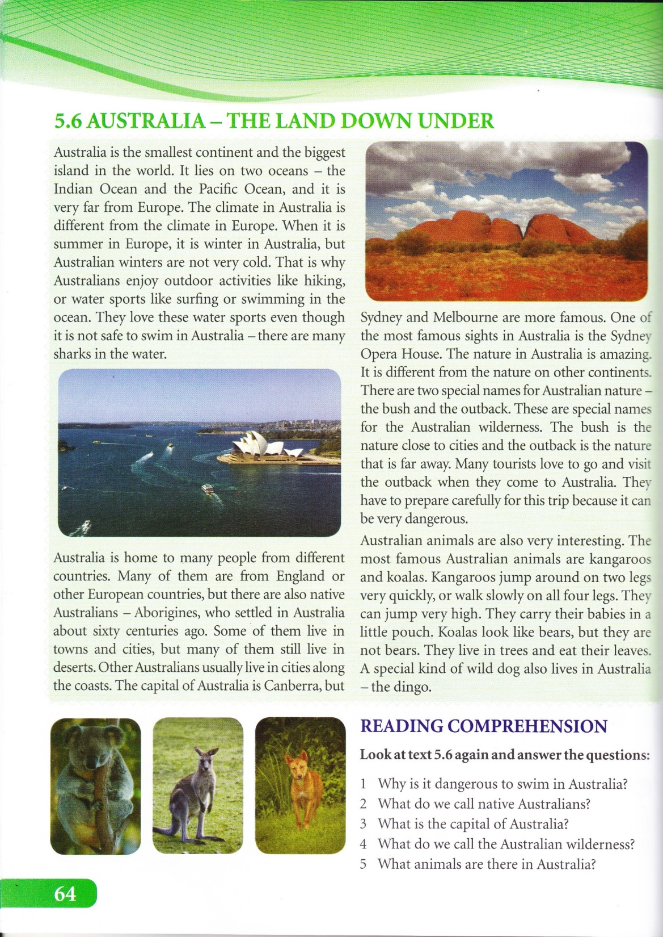

Slide 15
Homework
SB, page 65, ex. 3: Fill in the blanks with the following words:
native, sight, outback, coast, pouch.
SB, page 65, ex. 1: Look at the examples, then write in, from, or
on to complete the sentences.

