Slide 2
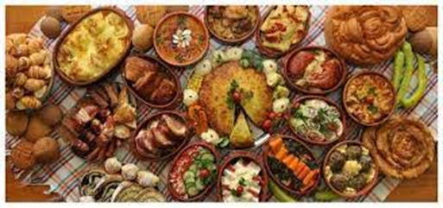
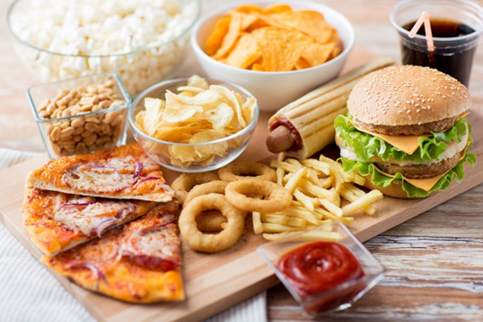
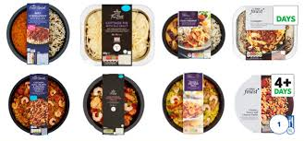
Types of food
Home made food
Food that is prepared and cooked at home.
Fast food
Food that is already cooked and prepared and all we do is buy it and eat it.
Ready-made food
A ready-made food is a packaged frozen or fresh meal that requires none or very little preparation besides heating up.

Slide 3
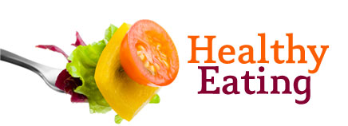
Students book p. 42 Let’s read the text to find out the following:
How can we keep healthy eating habits?
What things can we do to stay on a healthy diet?

Slide 4
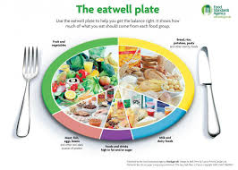
Vocabulary
Diet: the kinds of food that a person usually eats. (исхрана)
To diet/ to go on a diet: To eat less in order to lose weight.
Balanced/Healthy diet: a good mixture of healthy foods.

Slide 5
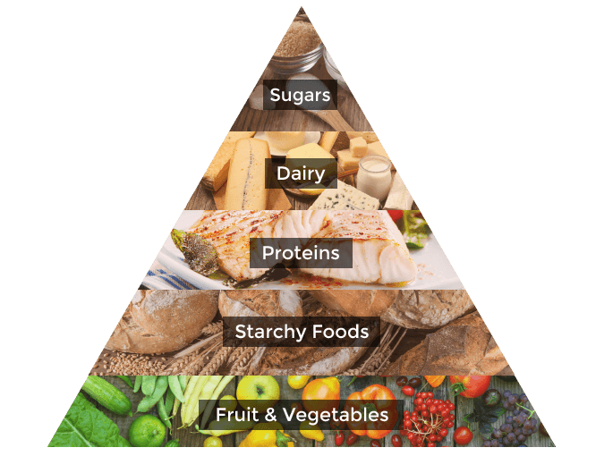
Do you know about healthy pyramid?

Slide 6
Homework
Student’s book, page 42
READING COMPREHENSION
Look at the text 4.1 again and circle the correct answer

