Slide 1
ENGLISH
IS FUN 3

Slide 2
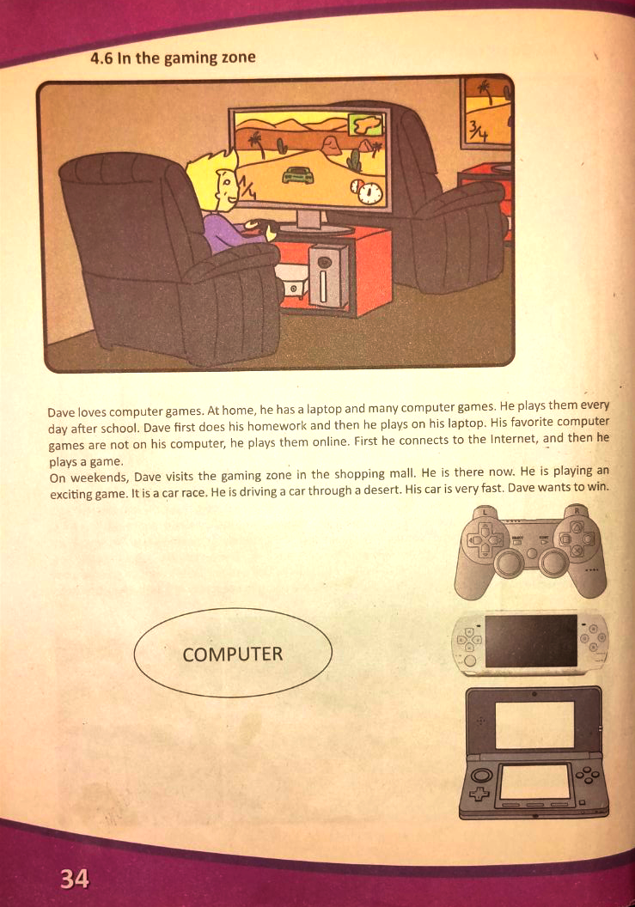
4.6 In the gaming zone

Slide 3
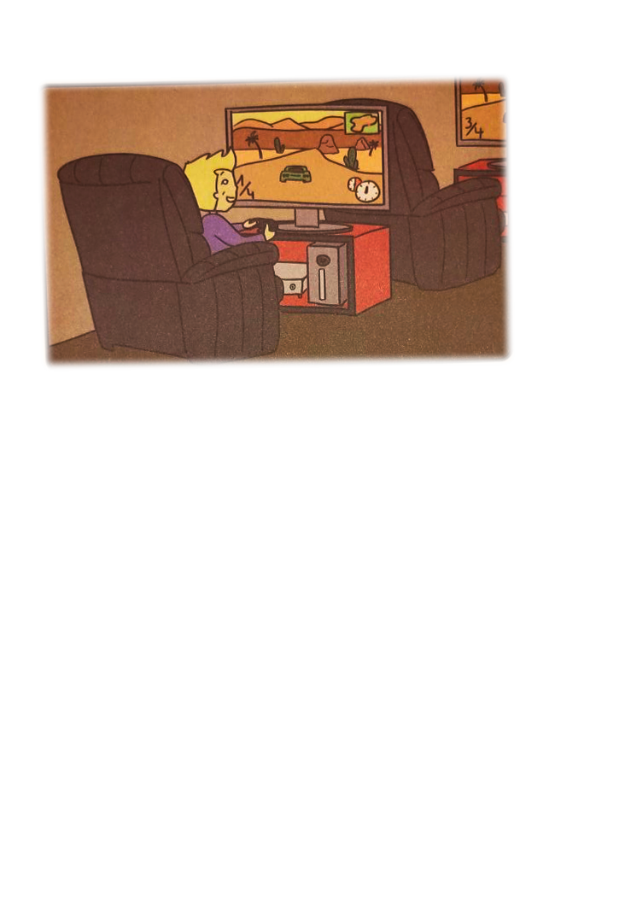
Dave loves computer games. At home, he has a laptop and many computer games. He plays them every day after school. Dave first does his homework and then he plays on his laptop. His favorite computer games are not on his computer, he plays them online. First he connects to the Internet, and then he plays a game.
On weekends, Dave visits the gaming zone in the shopping mall. He is there now. He is playing an exciting game. It is a car race. He is driving a car through a desert. His car is very fast. Dave wants to win.

Slide 4
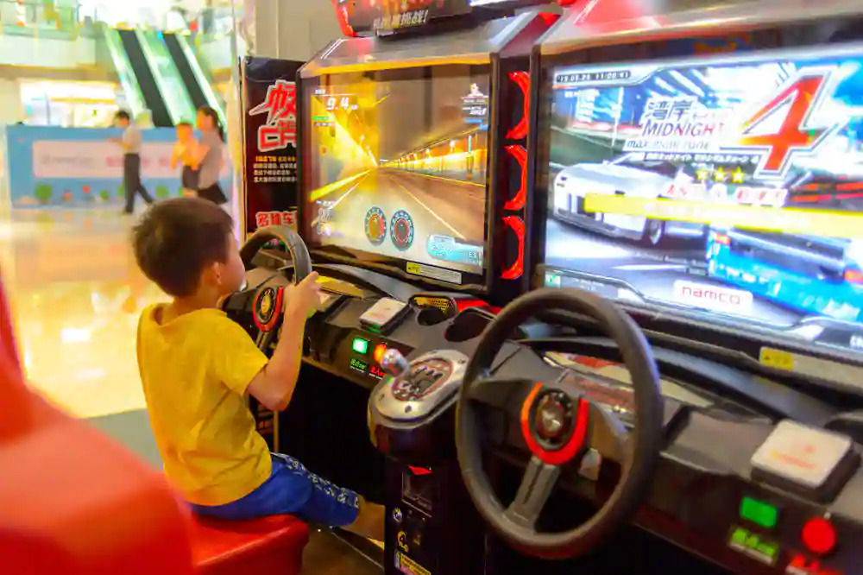
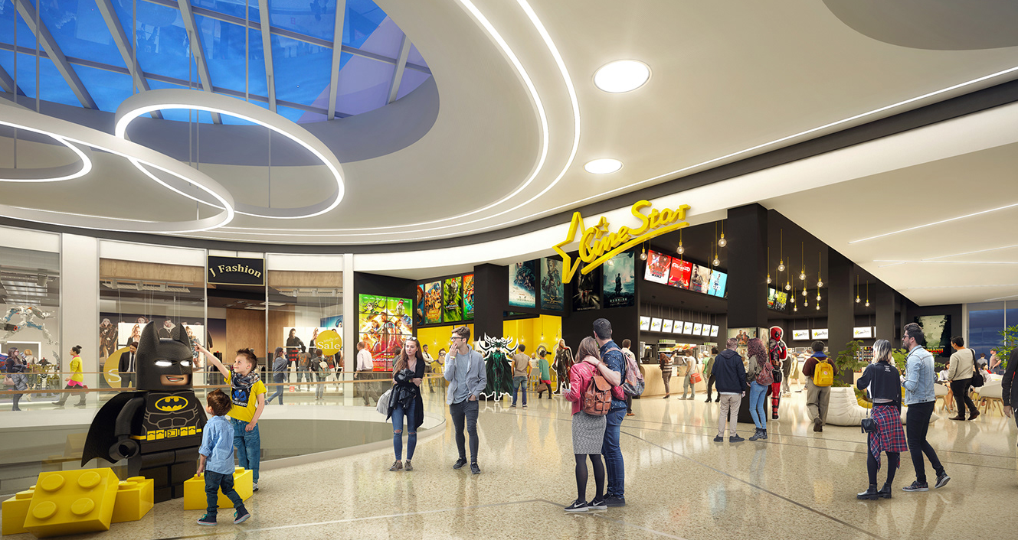
shopping mall
gaming zone

Slide 5
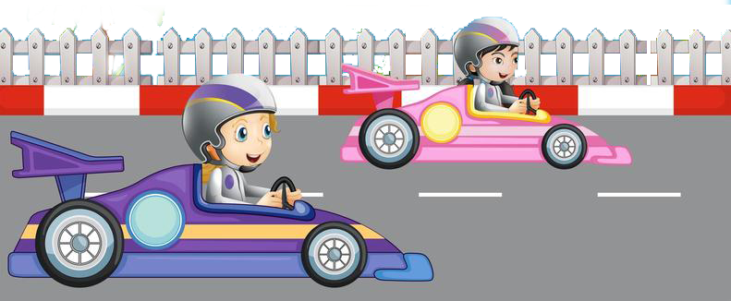
race
laptop
desert

Slide 6
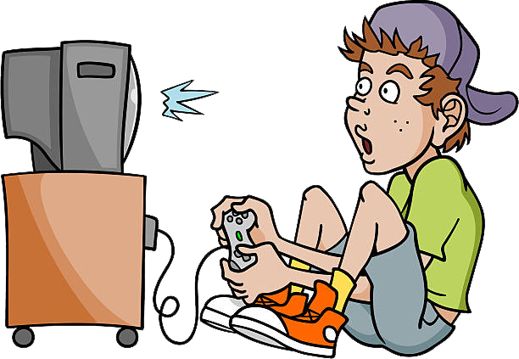
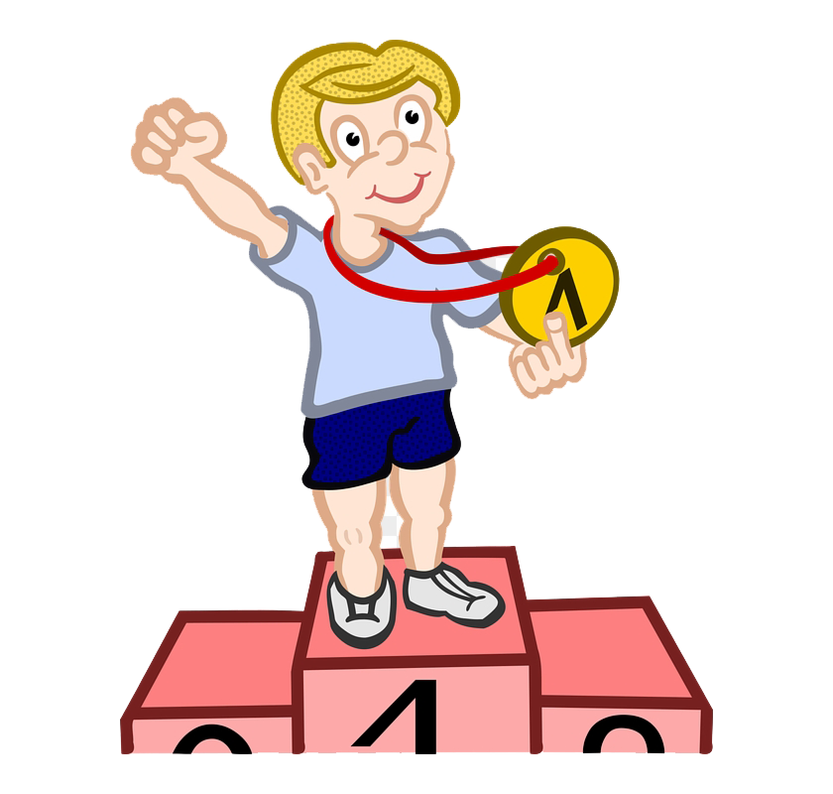
first
exciting game
win

Slide 8
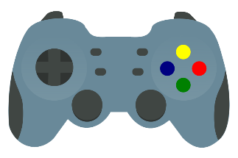
Dave has a laptop and many computer games at home.
He is playing an exciting game, it is a car race.
He is driving a car through a desert.
Dave wants to win.

Slide 9
4

Slide 10
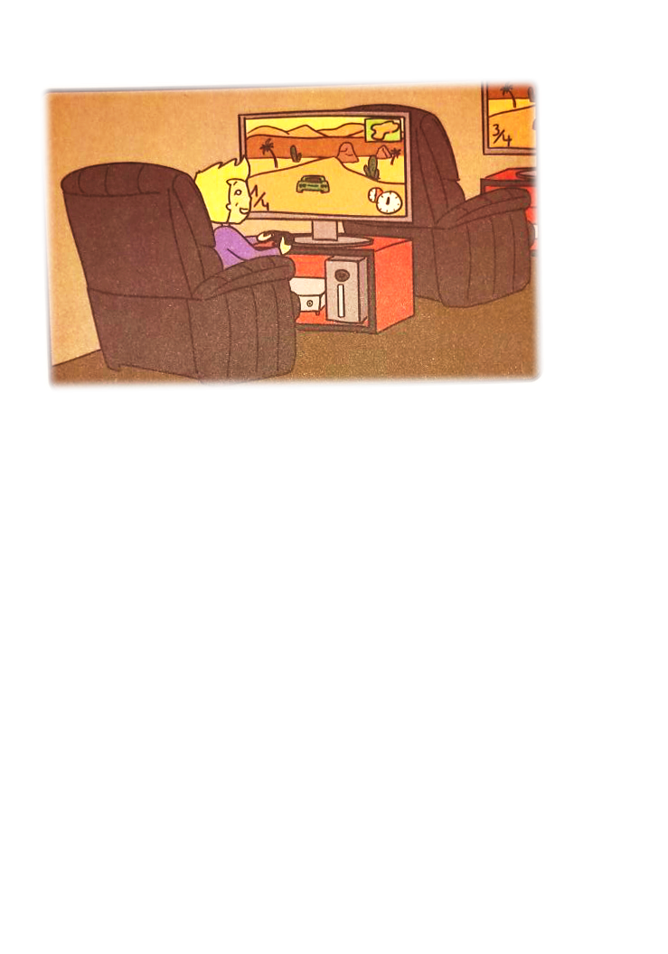
Dave is in his room.
Dave is playing with his friends.
Dave is playing a computer game.
In the game, he is driving a car.
Dave is sitting on a wooden chair.

Slide 11
