Slide 1
ENGLISH CLASS, GRADE 4

Slide 2
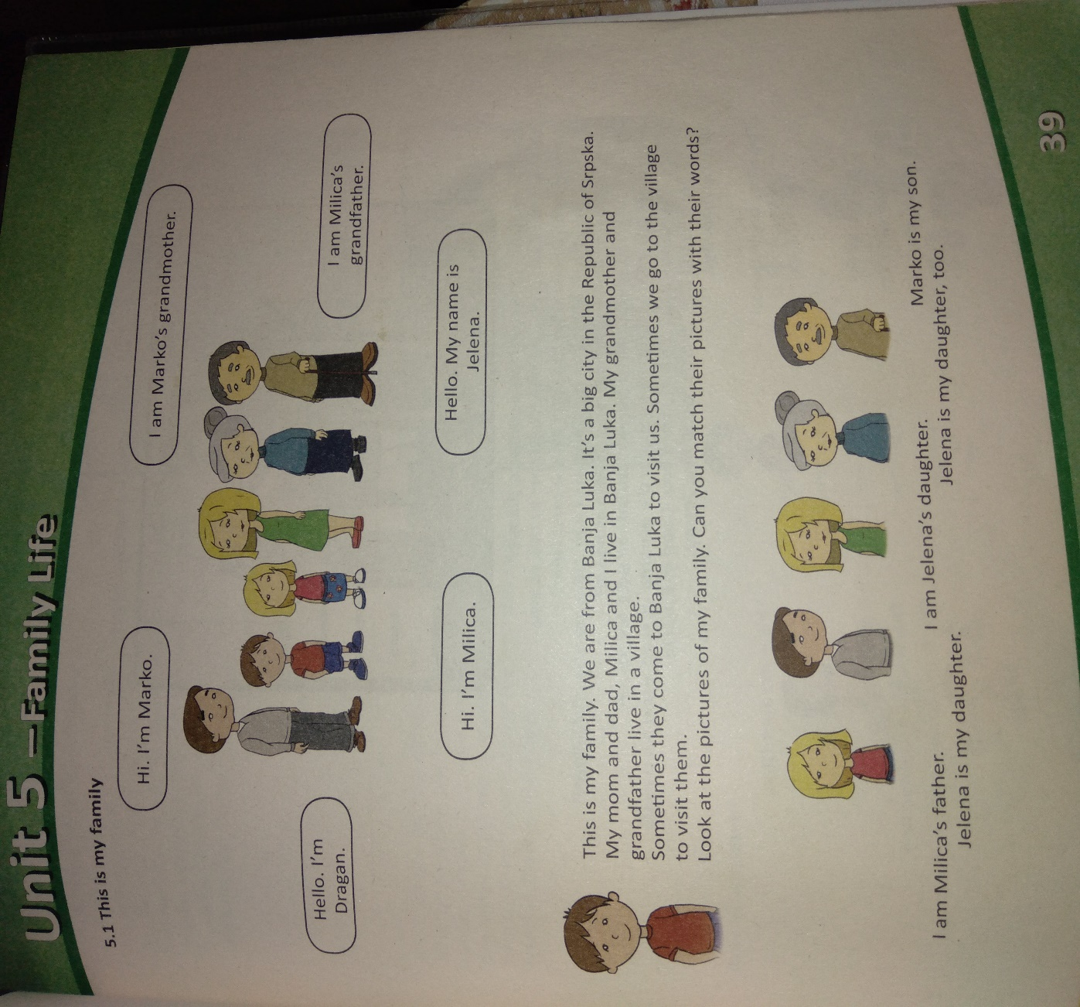
Student’s book page 39

Slide 3
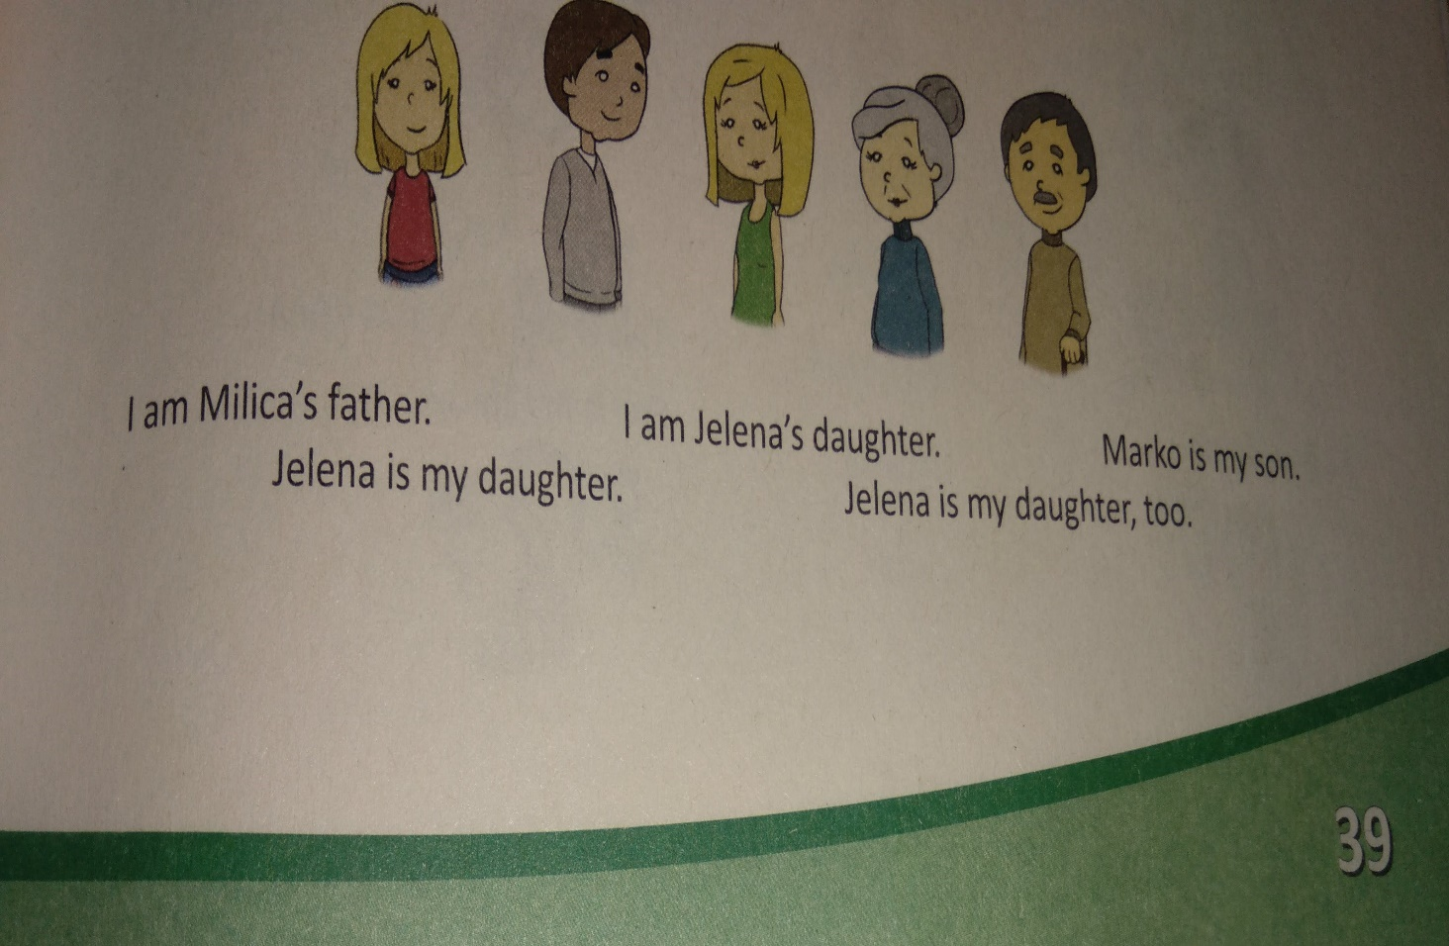

Slide 4
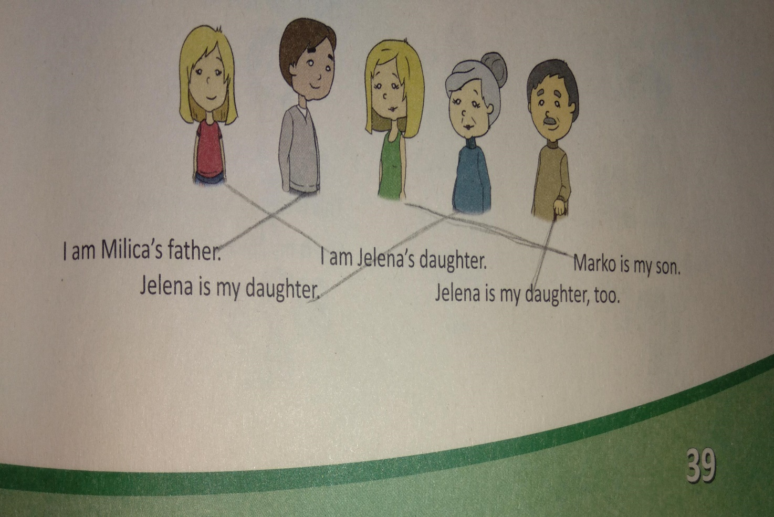

Slide 5
wordlist
Mother- majka
Father- otac
Grandmother- baka
Grandfather- deda
Son- sin
Daughter- ćerka

Slide 6
Workbook, page 41, exercise 1
Marko is Milica’s
Milica is Marko’s
Dragan is Milica’s
Jelena is Marko’s
Marko is Dragan’s
Milica is Jelena’s
brother.
sister.
father.
mother.
son.
daughter.

Slide 7
Homework
Workbook, page 41, exercise 2:
Circle the odd one and write.

Slide 8
Thank you for your attention!

