Slide 1
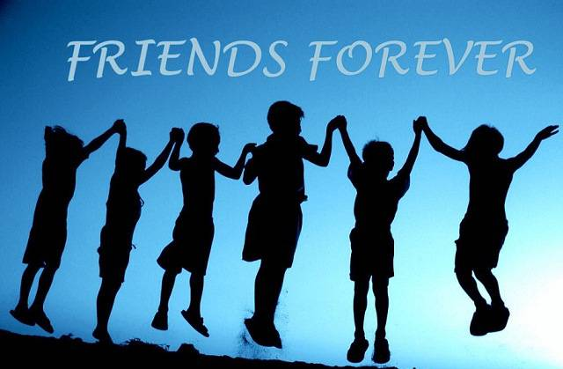
FRIENDS MATTER

Slide 2
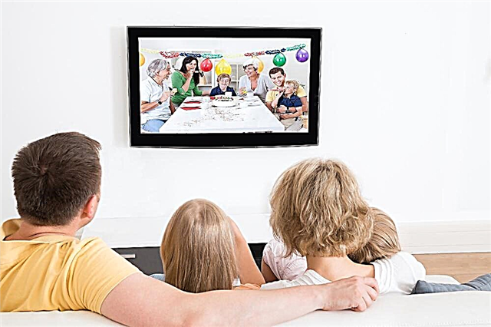
What kind of series do you like?
When do they show your favorite TV series?

Slide 4
New vocabulary:
matter- something that matters is important
the other day- a few days ago or yesterday
downtown – in the center of the city
comic books – story in pictures e.g. Mickey Mouse
science-fiction (sci-fi)- modern story or movie about the way of living in the future

Slide 6
Choose the correct word or phrase (Student’s book page 52, exercise 1)
You can find the most shops and restaurants in big cities downtown/out of the city.
That’s correctly/exactly what he said.
Rare/Real collections of comic books and movies are often more expensive than new ones.
Books and movies about life on other planets belong to romantic stories/science fiction.
I like some school subjects, special/especially English.

Slide 7
Key : Student’s book page 52, exercise 1
You can find the most shops and restaurants in big cities downtown.
That’s exactly what he said.
Rare collections of comic books and movies are often more expensive than new ones.
Books and movies about life on other planets belong to romantic stories.
I like some school subjects, especially English.

Slide 8
Join the parts on the left and right to get everyday expressions from text 4.6:
have | did last year
the other | chance
like we | of fact
didn’t have a | matter
as a matter | an idea
friends | day

Slide 9
Key: student’s book page 52, exercise 2
have an idea
the other day
like we did last year
didn’t have a chance
as a matter of fact
friends matter

Slide 10
Homework:
Workbook, page 33:
Exercise 1: The sentences below are jumbled. Read them in proper order.
Exercise 4: Use everyday expressions from the text to complete the dialogs.
Exercise 5: Read the text in exercise 1 again and write T(true) or F (false)

