Slide 1
Engleski jezik
3. razred

Slide 2
HELLO!

Slide 3
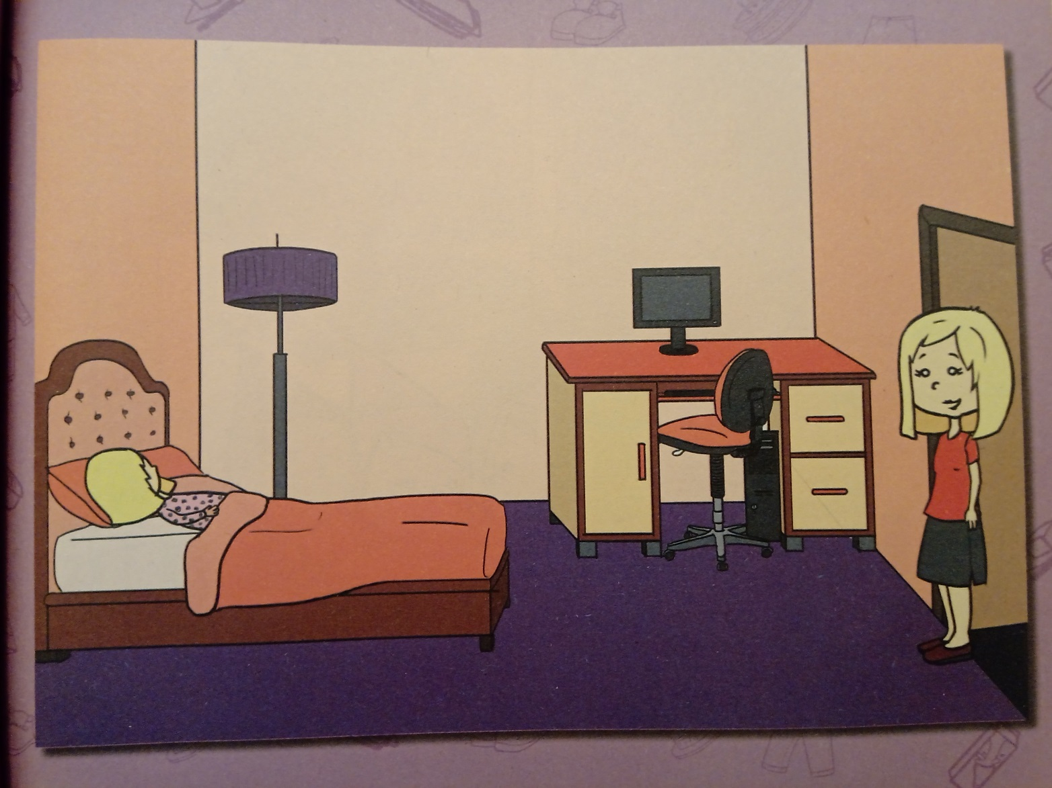
Get up! It’s time to go!
strana 33

Slide 4
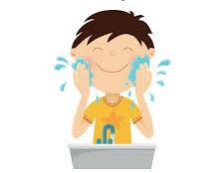
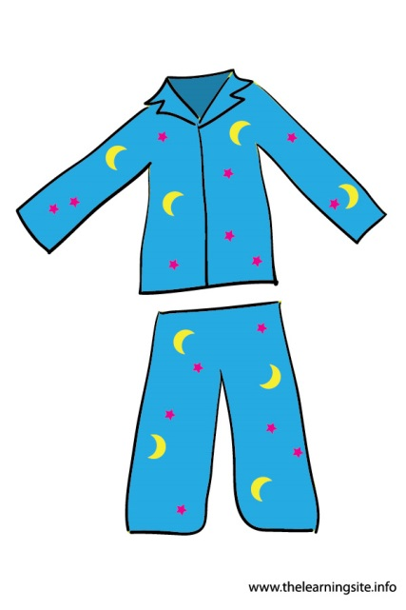

Slide 5
GOODBYE!

