Slide 1
ENGLISH
IS FUN 2

Slide 2
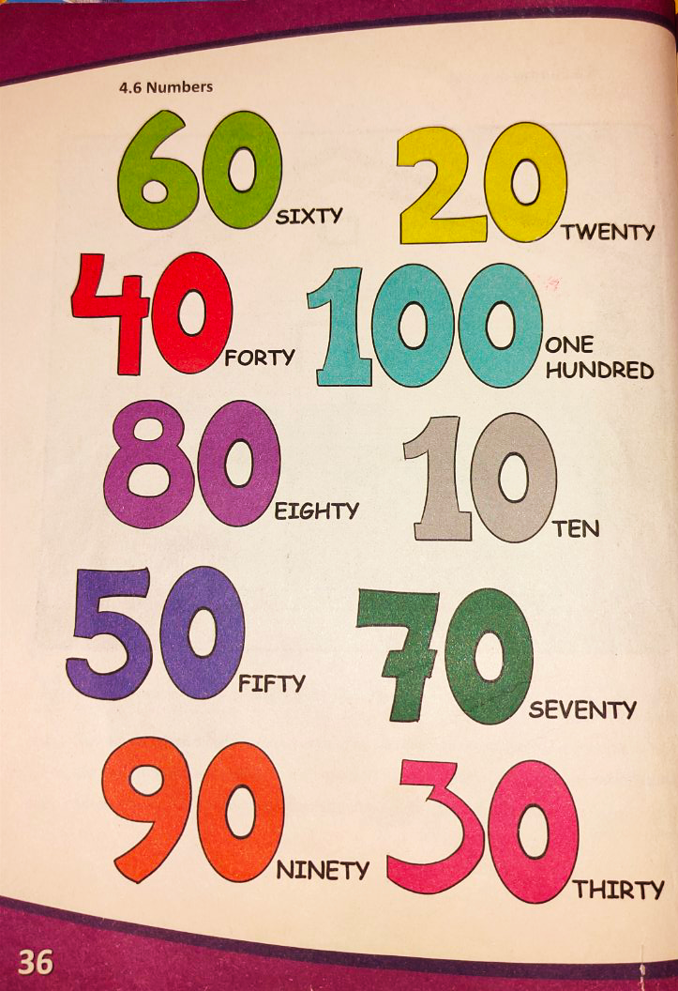
4.6 Numbers

Slide 3
100
70
20
ONE HUNDRED
10
SEVENTY
30
TWENTY
80
60
TEN
EIGHTY
THIRTY
50
40
90
SIXTY
FIFTY
FORTY
NINETY

Slide 5
Say the number!

Slide 8
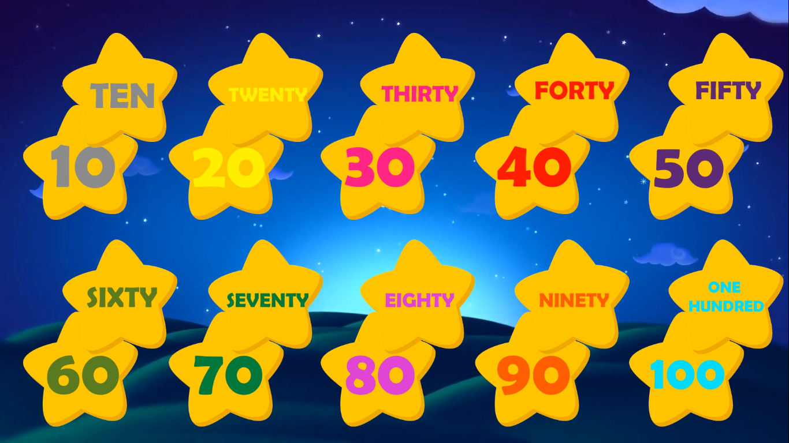

Slide 10
70
TEN
60
TWENTY
100
THIRTY
10
FORTY
90
FIFTY
80
SIXTY
30
40
SEVENTY
EIGHTY
50
20
NINETY
ONE HUNDRED

Slide 11
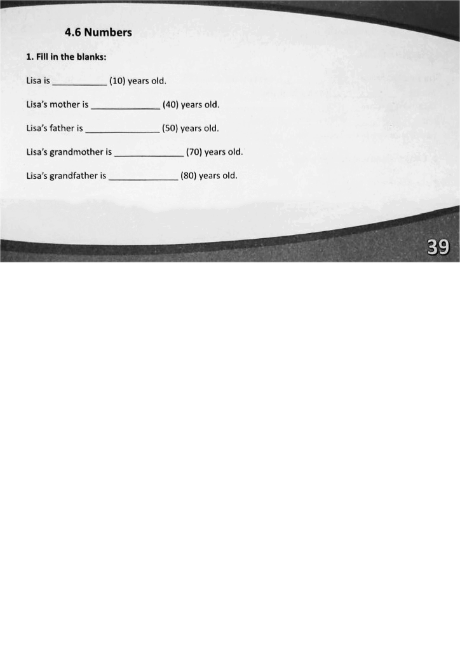
HOMEWORK

