Slide 1
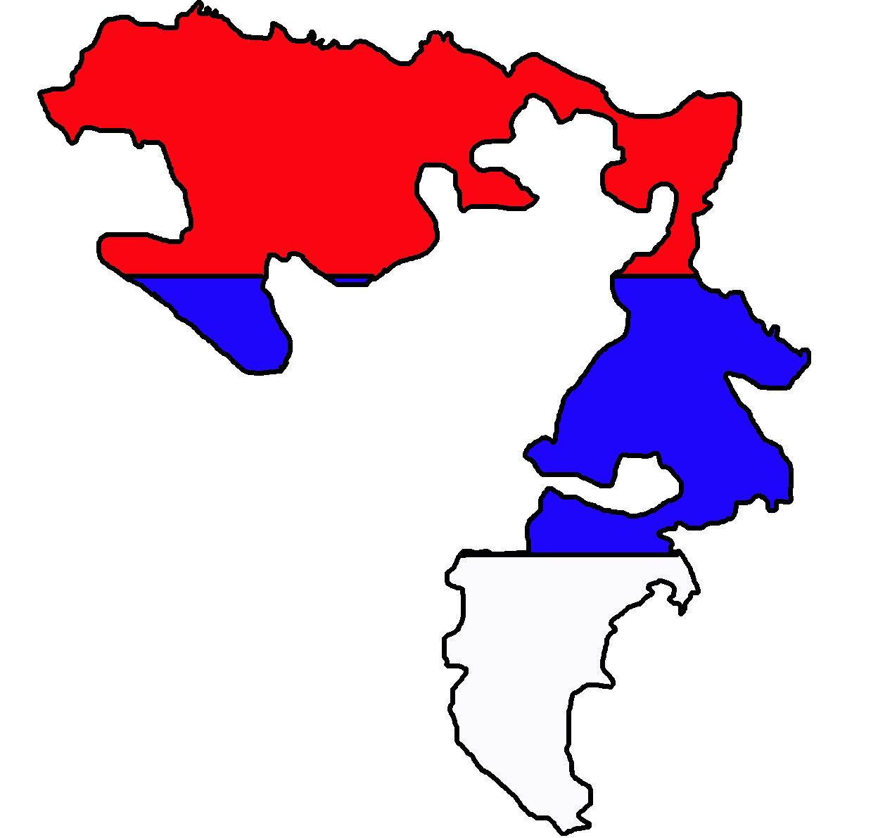
THE REPUBLIC OF SRPSKA –
A PLACE OF GREAT BEAUTY

Slide 2
English is fun 5, Student’s book p 56

Slide 3
Vocabulary
peak /piːk/ - the highest, the best point of something (e.g. mountain peak);
territory /ˈter.ɪ.tər.i/ - an area of a land that belongs to a country or a person;
novel /ˈnɒv.əl/ - a long printed story about imaginary people and events;
meadow /ˈmed.əʊ/ - a field with grass and wild flowers in it
bridge /brɪdʒ/ a structure that is built over river to allow people and vehicles to cross from one side to another;

Slide 4
Use the words peak, territory, novel, meadow and bridge to complete the sentences:
1 How big is the _______ of that country?
2 This mountain has a very high ____ .
3 Look at all the cows on that _______!
4 My friend’s father wrote a ______.
5 Let’s cross that old ______ on the Drina!
territory
peak
meadow
novel
bridge

Slide 5
Look at the text 5.2 again and write T (true) or F (false):
Reading and comprehension
1 The Republic of Srpska is an entity in Bosnia and Herzegovina.
2 There are many national parks in the Republic of Srpska.
3 Ivo Andric is a winner of the Nobel Prize in Literature.
4 The Bridge on the Drina is about the people of Banja Luka.
5 Many tourists visit the bridge in Visegrad.
T
F
T
F
T

Slide 6
What you should know to say about the Republic of Srpska:
The Republic of Srpska is one of the two large entities. The largest city is Banja Luka. On the territory of our Republic there are two national parks: Sutjeska and Kozara. The highest peak in the Sutjeska National Park is Maglic. The Kozara national park is between four rivers: the Una, the Sava, the Sana and the Vrbas. It has beautiful forests and meadows. One of the most beautiful sights is the world-famous bridge in the town of Visegrad. Ivo Andric wrote a magnificent novel about it and its name is The Bridge on the Drina. He won the Nobel Prize in Literature for this novel.

Slide 7
Ordinal numbers
1st – the first
2nd – the second
3rd – the third
4th – the fourth, etc.

Slide 8
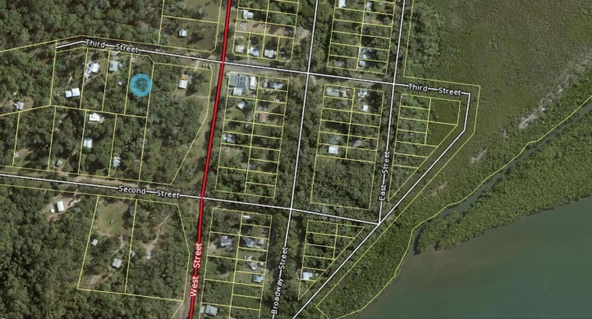
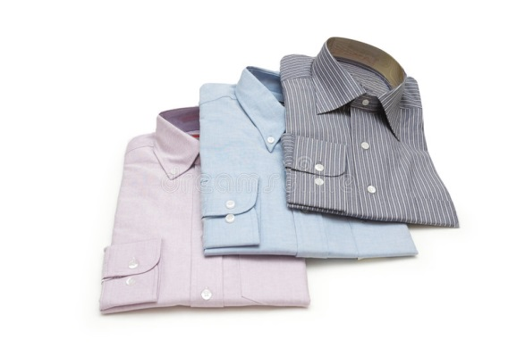
Take the third street on the left.
I bought three shirts yesterday.

